Slide 1
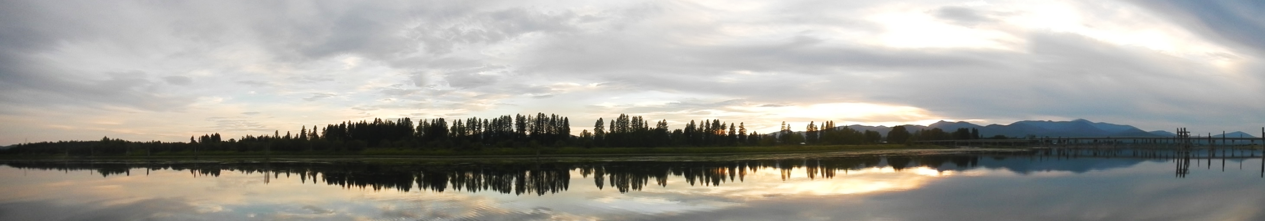
Longitudinal, Lateral, Vertical, and Temporal Thermal
Heterogeneity in a Large Impounded River:
Implications for Cold-Water Refuges
Francine H. Mejia¹, Christian E. Torgersen¹, Eric K. Berntsen², Joseph R. Maroney², Jason M. Connor², Aimee H. Fullerton³, Joseph L. Ebersole⁴ and Mark S. Lorang⁵
¹U.S. Geological Survey, ²Kalispel Tribe Natural Resources Department, ³National Marine Fisheries Service, ⁴U.S. Environmental Protection Agency, ⁵FreshwaterMap
Photo credit: Francine Mejia

Slide 2
Objectives:
Compare longitudinal patterns of temperature from TIR imagery to instream measurements in the water column.
Assess spatial & temporal thermal heterogeneity & potential cold-water refuges for salmonids.
Evaluate statistical associations between hydrologic & geomorphic variables & occurrence of cool-water areas and median water temperature.

Slide 3
All data and interpretations from:
Mejia, F.H.; Torgersen, C.E.; Berntsen, E.K.; Maroney, J.R.; Connor, J.M.; Fullerton, A.H.; Ebersole, J.L.; Lorang, M.S. Longitudinal, Lateral, Vertical, and Temporal Thermal Heterogeneity in a Large Impounded River: Implications for Cold-Water Refuges. Remote Sens. 2020, 12, 1386 https://doi.org/10.3390/rs12091386
Mejia, F.H., Torgersen, C.E., and Berntsen, E.K., 2019, Water temperature data from the Pend Oreille River, Washington and Idaho, 2016-2018: U.S. Geological Survey Data Release, https://doi.org/10.5066/P9U5HJH9.

Slide 4
Canada
Pend Oreille River
Washington
Pacific Ocean
Idaho
Columbia River
N
0 50 100 km
Oregon

Slide 5
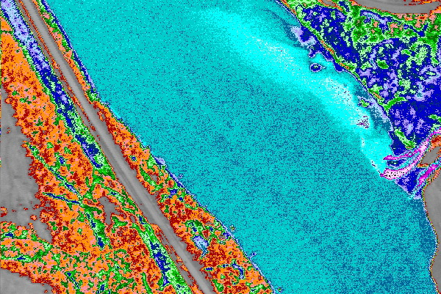
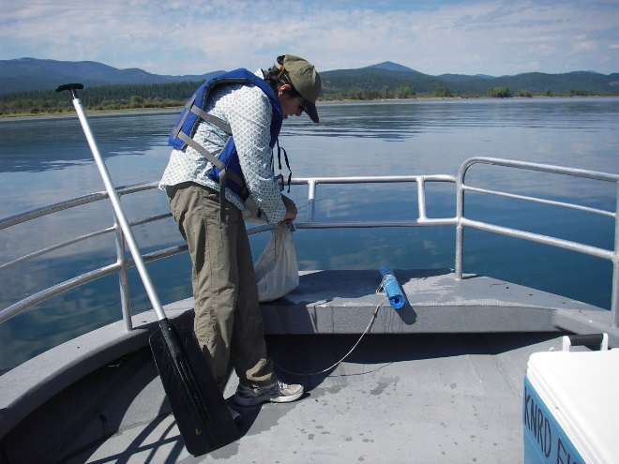
Methods:
Airborne TIR
Continuous deployment
HOBO pendant® temperature data loggers
Source: Quantum Spatial
30 cm
Photo credit: Christian Torgersen
Water temperature (ºC)
Disclaimer: Any use of trade, firm, or product names is for descriptive purposes only and does not imply endorsement by the U.S. Government.

Slide 6
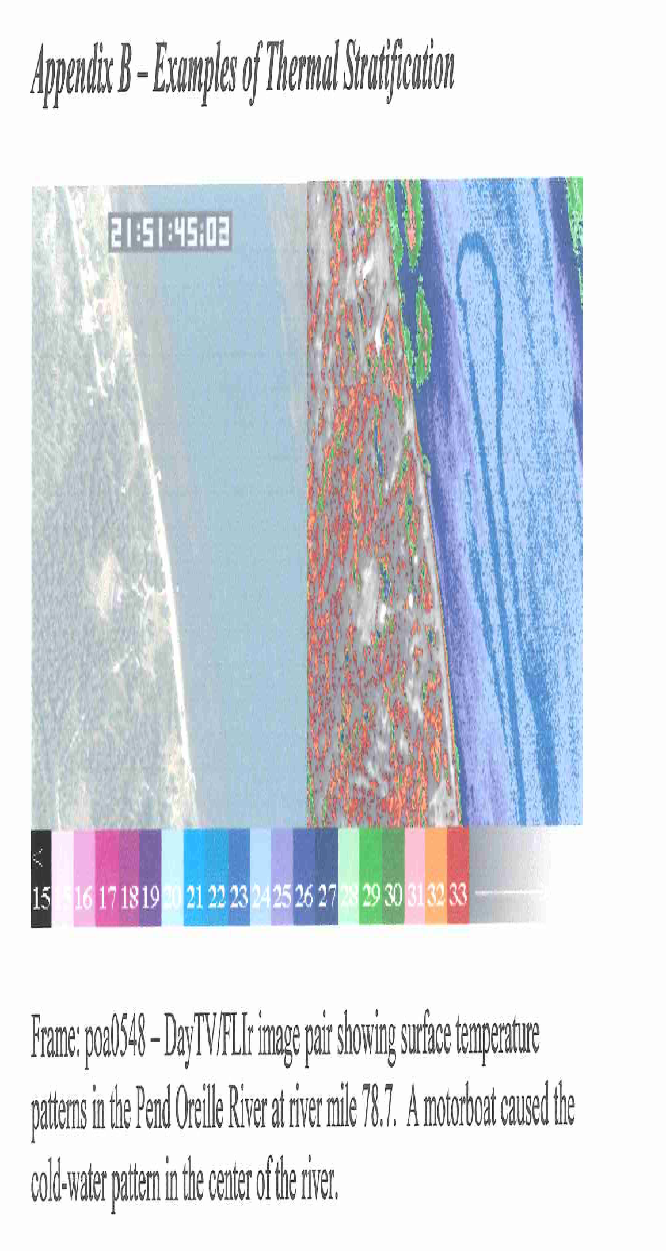
Stratification
22.7
25
24.3
Water temperature (ºC)

Slide 7
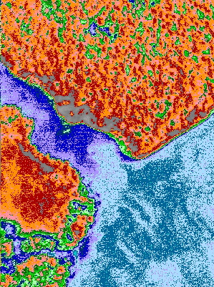
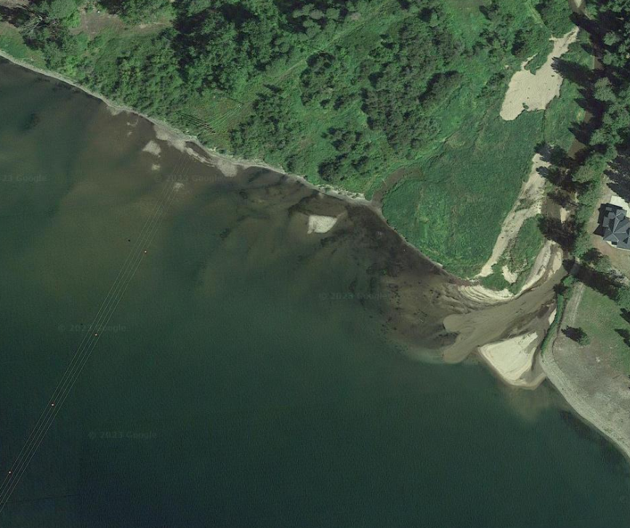
Tributary confluences
Plume
Plume
Water temperature (ºC)

Slide 8
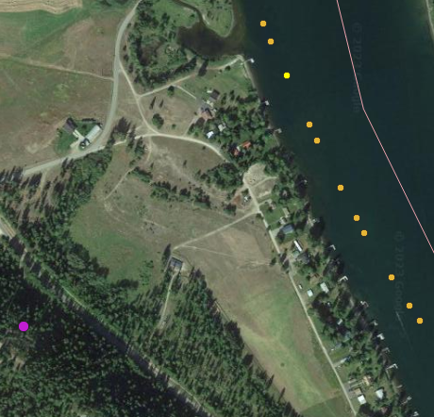
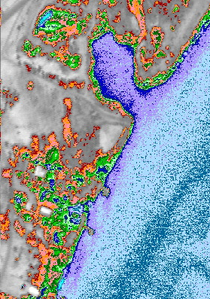
Seepages/springs
Water temperature (ºC)

Slide 9
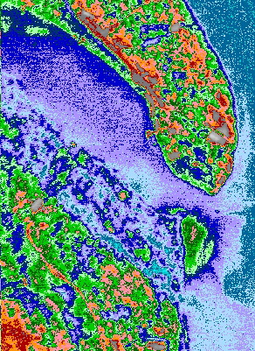
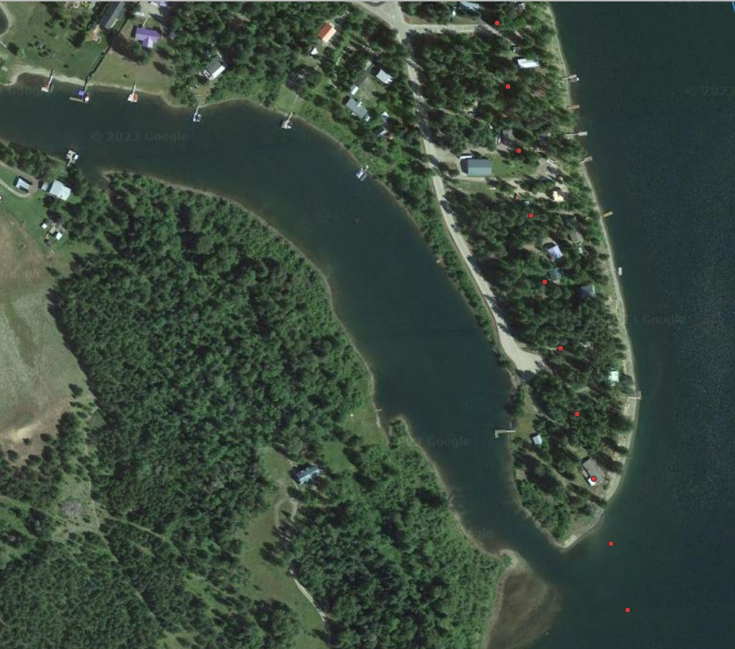
Water temperature (ºC)

Slide 10
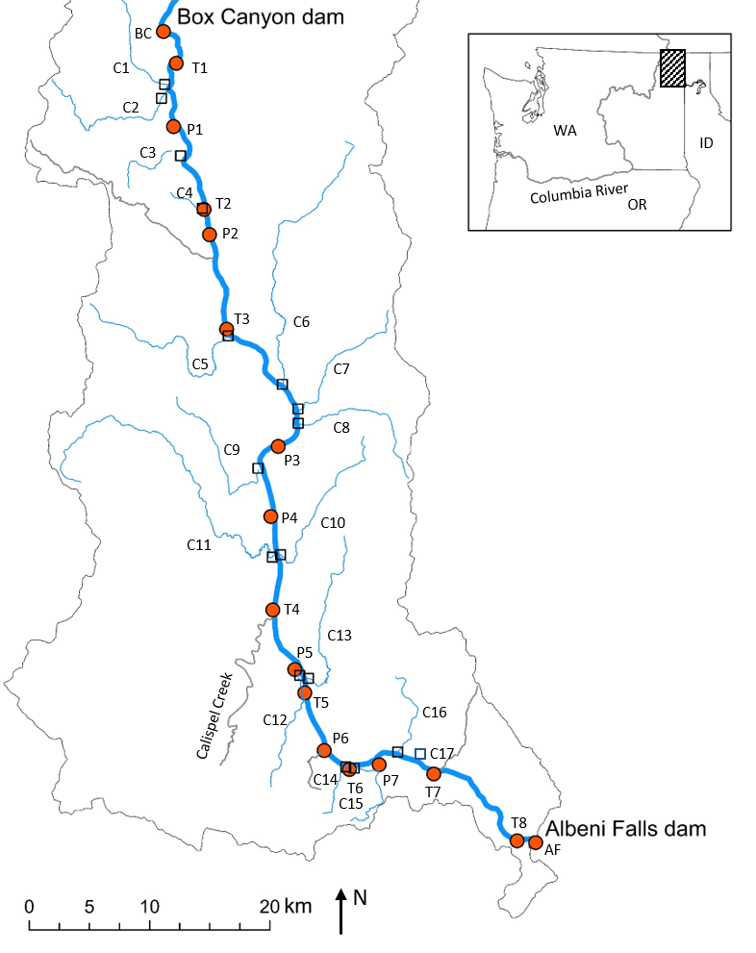
Pend Oreille River
Mainstem (n = 17)
Confluence (n = 22)
Notes:
Pend Oreille River study area in eastern Washington and northern Idaho, USA. Orange circles are main stem sites labeled as either P (peaks) or T (troughs), and hollow squares are tributary confluences (C) included in the study. Gray tributaries were sampled but not included in analysis because of missing data. Black arrow describes direction of flow from south to north.

Slide 11
Longitudinal thermal profile of the Pend Oreille River
Water temperature (°C)
Instream surface
Instream bottom
50 60 70 80 90 100 110 120 130 140
Distance upstream (km)

Slide 12
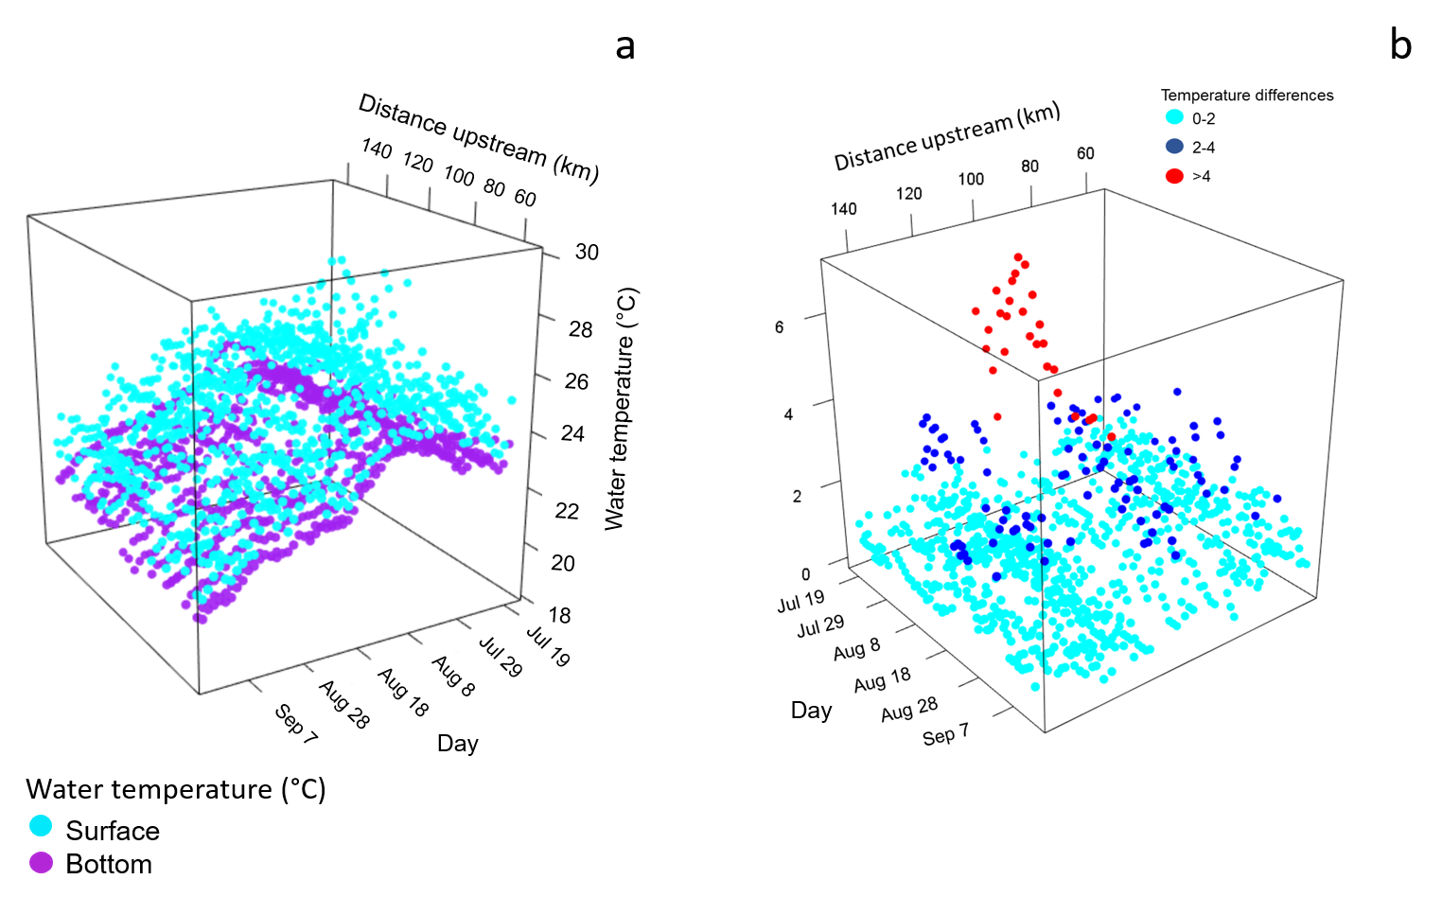
Patterns of longitudinal thermal heterogeneity instream maximum and minimum temperature
(7/17/2017 – 9/14/2017)
Maximum differences
(surface - bottom)

Slide 13
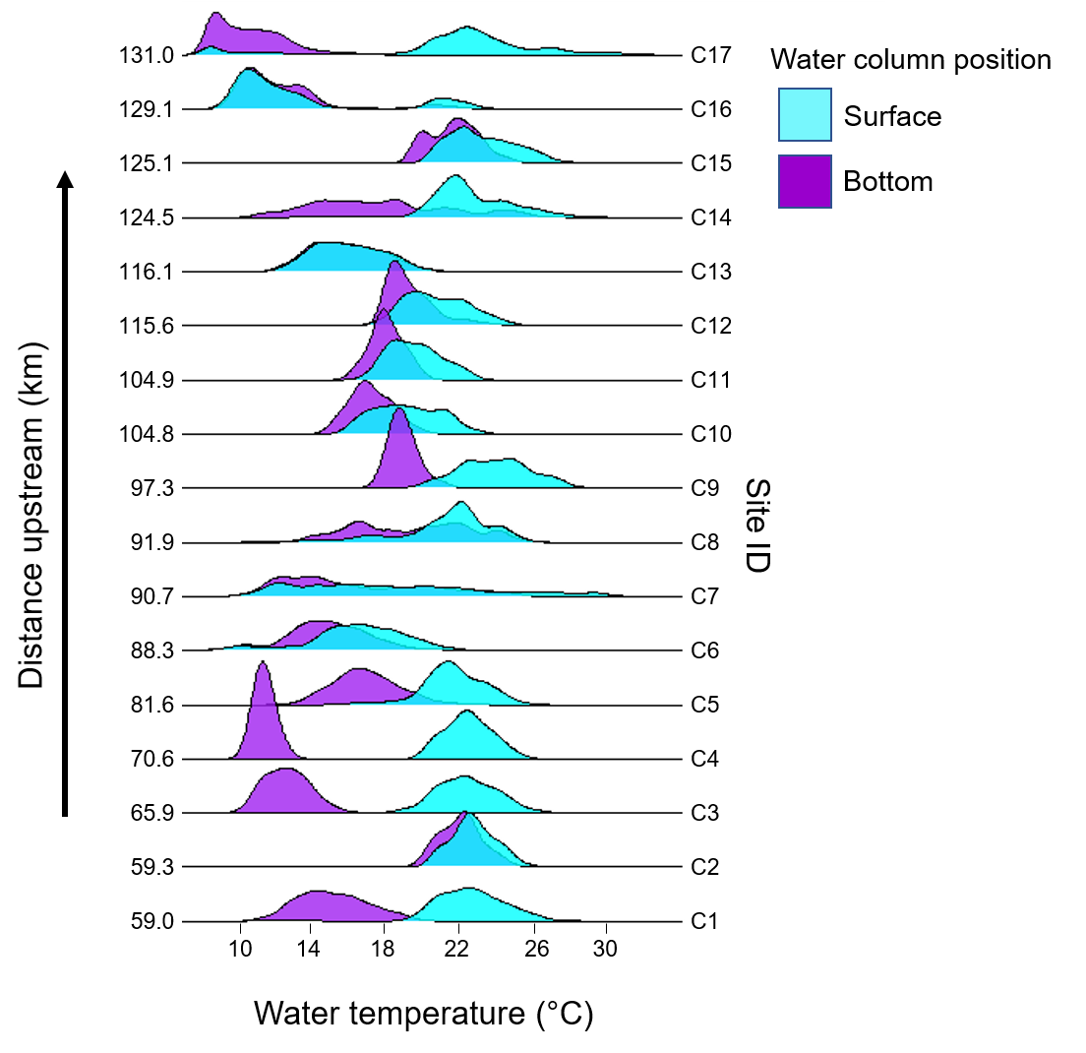
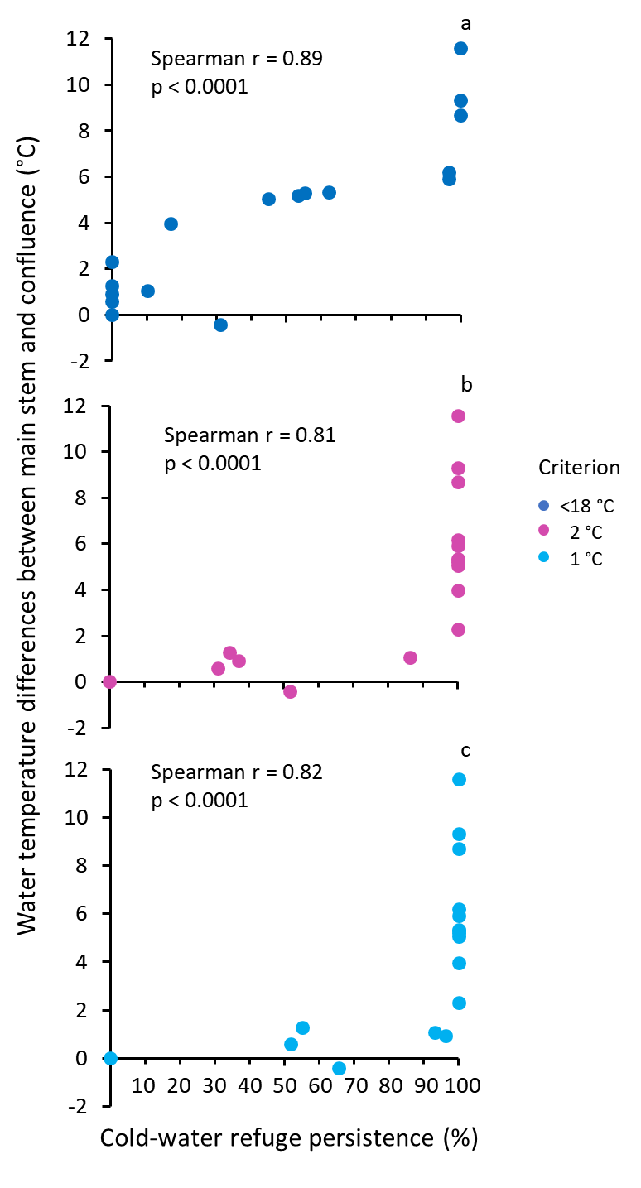
Confluences

Slide 14
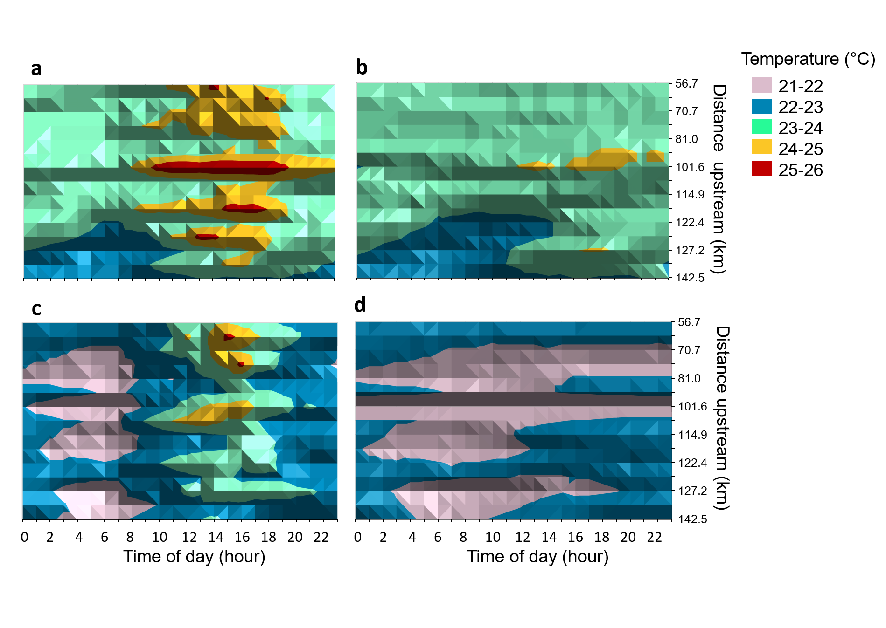
Hourly water temperature
Surface
Bottom
7/23/2017
8/27/2017

Slide 15
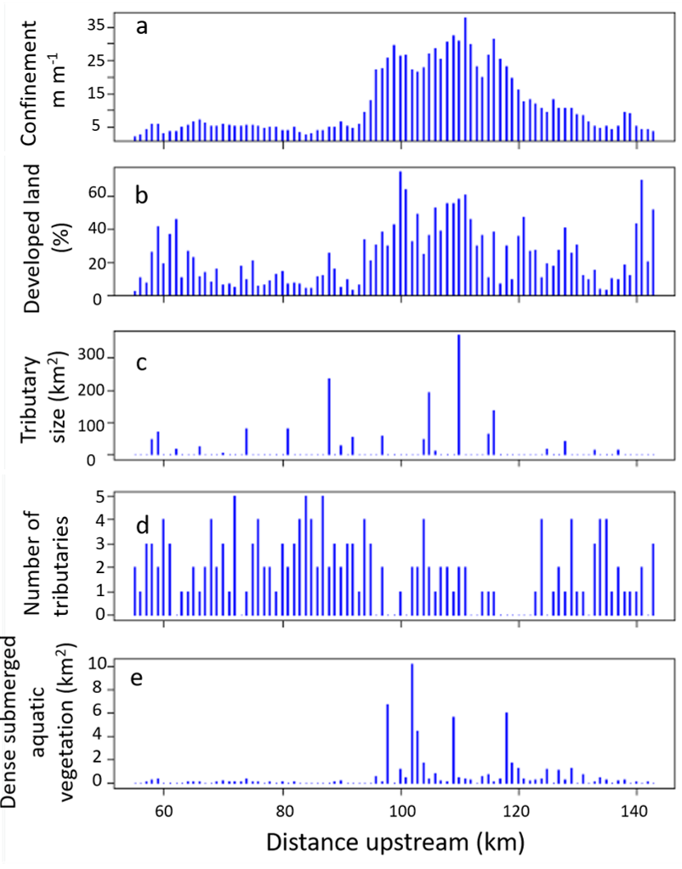
Longitudinal profiles of landscape metrics

Slide 16
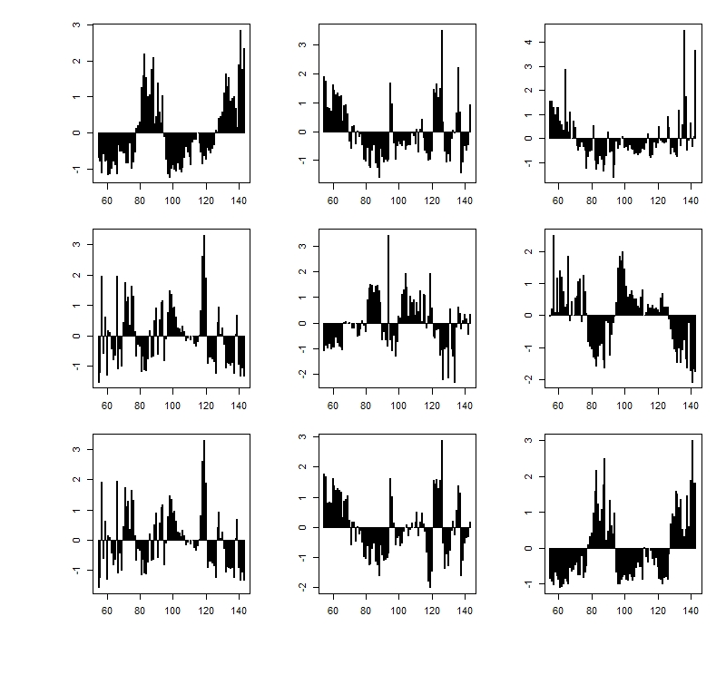
a b c
Longitudinal profiles of channel morphology metrics (z-scores)
Z-water velocity
Z-mean water depth
Z-maximum water depth
d e f
Z-wetted perimeter
Z-discharge
Z-cross-sectional area
g h i
Z-surface width
Z-hydraulic radius
Z-Froude number
Distance upstream (km)
Distance upstream (km)
Distance upstream (km)

Slide 17
Best generalized additive models for reach and subcatchment scales for median water temperature & probability of occurrence.
Model |  | edf | Ref.df | F | p-value | R-sq.(adj) | Deviance (%)
Reach scale
Median water temperature
s (Confinement) |  | 2.29 | 9 | 1.09 | <0.01 | 0.59 | 64
s(z-Area) |  | 6.72 | 9 | 9.95 | <0.001
s (z-Maximum depth) |  | 0.96 | 9 | 0.42 | 0.05
Probability of occurrence of cool water
s (Confinement) |  | 1.95 | 9 | 6.86 | 0.02 | 0.49 | 47
s (z_Area) |  | 0.95 | 9 | 17.64 | <0.001
Sub-catchment scale
Median water temperature
s (Distance from dam) |  | 7.78 | 9 | 21.07 | <0.001 | 0.68 | 71
Probability of occurrence of cool water
s (Distance from dam) |  | 6.65 | 7 | 21.73 | <0.01 | 0.63 | 64
s (Percent land developed) |  | 0.77 | 9 | 2.49 | 0.07

Slide 18
Take home message:
The complexity of thermal patterns in impounded rivers require a combination of approaches to understand implications for salmonids.
Lateral discontinuities provided most potential cold-water refuges for salmonids & were more persistent if temperature differences between main stem and confluences were largest.
Vertical thermal stratification present at slow-moving confluences isolated cool water near the bottom.
Need to consider thermal heterogeneity when restoring & maintaining aquatic landscapes to support native salmonids.

Slide 19



Acknowledgments
Jason Olson, KNRD
Raymond Ostlie, KNRD
Ken Merrill, KNRD
Disclaimer: The opinions expressed here are those of the authors and do not reflect opinions or policy of the Environmental Protection Agency.

Slide 20
Proposed budget for Snake River cold-water refuge assessment
Meeting with USFWS, BPA, and Army Corps of Engineers partners (24-April-2023)
Year 1 (Jan 1 - Dec 31, 2024)
Review existing data, deploy/retreive ground-truthing dataloggers, and collect airborne thermal IR imagery.
Total cost (high estimate) including thermal IR remote sensing: $175,336
USGS subtotal (high estimate): $35,336
Year 2 (Jan 1 - Dec 31, 2025)
Deploy in-situ temperature loggers to validate remotely sensed patterns and assess vertical stratification.
Analyze thermal IR imagery and field data and generate data releases.
Total cost (high estimate) including boat rental/operator: $236,475
USGS subtotal (high estimate): $186,475
Year 3 (Jan 1 - June 30, 2026)
Produce report and prepare draft manuscript for scientific journal
USGS subtotal (high estimate): $49,615
Cost summary for Years 1-3
Total: $461,426
USGS subtotal: $271,426

