Slide 1
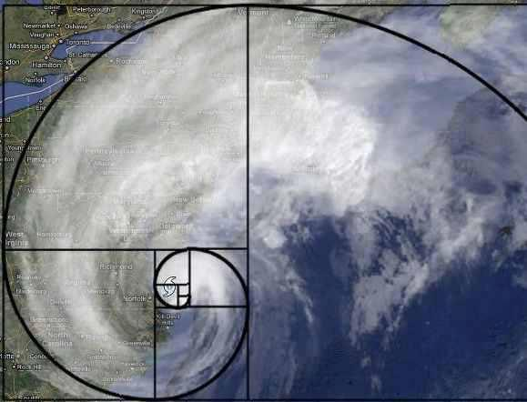
Ecological Scaling: Power Laws
E. Natasha Stavros
Ph.D. Candidate
University of Washington
Notes:
ADD a few slides on fractal dimension

Slide 2
Who am I? How did I get here?
B.A. in Mathematics at CU, Boulder
Minor: Computer Science
Taught Calculus Workshops in Applied Mathematics
Data Analysis Intern at Laboratory of Atmosphere and Space Physics
M.S. in Environmental Sustainability at University of Edinburgh, Scotland
Thesis: Assessment for implementing 3-PGN as a measuring tool for coniferous forest sustainability at the national scale: Wales Case Study
Ph.C. in Forest Resources at UW, Seattle
Dissertation: Investigating the when and where of megafires across the Western United States- implications for climate, wildfire, and air quality

Slide 3
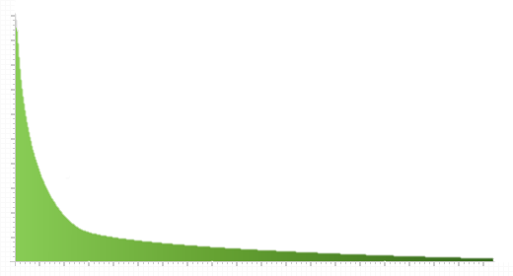
Concept of Scaling-Law
Quantitative bivariate linear or log-linear relationships
Usually 1 variable space or time, BUT not necessary
Scale invariant: scale x by constant → proportionate rescaling of function
Standard Power-law (simplest scaling law) formula
f(x) = Cx^{-a}
Developed using statistical models, theoretical models
or both
Deconstruct averaged statistics by:
Scale dependence of individual metrics
Frequency or cumulative frequency distributions
Frequency
Fire Size

Slide 4
Scale invariant: scale x by constant → proportionate rescaling of function
C=1 |  | C=2
x | y | x | y
1 | 1.00 | 1 | 2.00
2 | 0.50 | 2 | 1.00
3 | 0.33 | 3 | 0.67
4 | 0.25 | 4 | 0.50
 |  | 6 | 0.33
 |  | 8 | 0.25
2
1
0
1
0.5
0
y = Cx⁻¹
0 1 2 3 4
0 2 4 6 8

Slide 5
Koch Snowflake
What makes Koch Snowflake special?
Infinite length
Finite area
Why are we looking at it?
One of the earliest fractal curves described in 1904 by Swedish mathematician Helge von Koch
What is a fractal?
A geometric shape that can be split into parts similar in shape to the original shape
Property known as Self-similarity

Slide 6
Koch Snowflake
Each person grab N sticks
N = 244/number of students
Make an equilateral triangle with 27 sticks per leg
Take out the middle 9 sticks of each leg
Put two 9 stick legs of equilateral in the open space
Repeat down to legs of 1 stick in length

Slide 7
Self-similarity
http://upload.wikimedia.org/wikipedia/commons/6/65/Kochsim.gif

Slide 8
Koch Snowflake: Power-law Functions
# of segments= N = 3*4ª
a = iteration starting at 0
X= length of a segment (e.g., ~ 2”)
Length = L = X/3ª
perimeter of the initial triangle = L* 3
perimeter of resulting triangle = N*length = (3*4ª) * (x/3ª) = 3*X*(4/3)ª
Area of Triangle = s²(√3/4), s = side now take limit of sum of areas as length → infinite:
2*L²*(√3/5)

Slide 9
What is the fractal dimension?
Log 4/ log 3 ~ 1.26186

Slide 10
Scaling Laws and Complexity in Fire Regimes
Donald McKenzie and Maureen Kennedy. 2011. Chapter 2. in The Landscape Ecology of Fire. D. McKenzie, C. Miller, and D. Falk editors.

Slide 11
McKenzie Chapter 2 Concepts
Contagious disturbance: disturbance “that spreads across the landscape over time, and whose intensity depends explicitly on [ecological processes’] interactions with the landscape”
Two components of contagion
Momentum
Connectivity
Momentum and connectivity may seem scale-dependent even if the mechanisms of contagion do not

Slide 12
Concepts
Average vs. Emergent Behavior
Average behavior- subject to error propagation as averaging fine-scale properties across larger scales
Emergent behavior- when small entities interact to form more complex behaviors as a collective
Depends on scale of investigation, so must identify scales at which qualitative changes occur

Slide 13
TAKE HOME CONCEPT
The value of finding a power-law lies greatly in defining the ecological mechanisms driving the behavior

Slide 14
Questions
What are typical issues that arise in ecological research regarding scales? Can you think of one in your own research? Think about how you scale up or down data to see patterns.
What mechanisms cause power-law relations? Mathematically? Physically? Biologically? Ecologically?
How do scaling laws unveil emergent behavior? What techniques did they use in this chapter to do so? Can you think of any other ways to do this?

Slide 15
Case Study
Goal: identify the mechanisms behind scaling laws in fire regimes
Criterion 1: bottom-up controls are in effect such that mechanisms at fine scales drive fire propagation & interaction between process (fire spread) and pattern (topography & fuels)
Criterion 2: if events are separated by more distance in space and time than a limit of contagion, observed scaling laws cannot be reasonably linked to the driving mechanisms

Slide 16
Case Study
Method:
Neutral model to stochastically simulates power-law relationships in the SD variogram
Calibrate the mean fire size (μ_{size}), spread probability (p_{burn}), burn probability (p_{scar}) to make b₀*p_{scar} close to 1 values
Shows which conditions power-laws should be expected mathematically
Compare to observed patterns to indicate ecological conditions under which power laws are produced

Slide 17
Case Study
Methods (continued…)
Fit equations 2.3,2.5 and 2.6 to the SD variograms of real landscapes on simple (Twentymile) & complex (Swauk Creek) topography
Findings:
Swauk Creek followed power law
Twentymile did not
Implications:
Support Criterion 1: Topographic complexity provides bottom up controls on the spatial patterns of low severity fires

Slide 18
Conclusions
Scaling laws are an aggregate representation of landscape controls on fire
Scaling laws in low-severity fire regimes are driven by bottom-up controls
Top-down controls, like climate, can change the parameters (e.g. exponents) of scaling relationships over time
A percolation threshold has been crossed
Implications for ecosystem dynamics and management

Slide 19
Question 1: What are typical issues that arise in ecological research regarding scales? Can you think of one in your own research? Think about how you scale up or down data to see patterns.
Extrapolation to new studies and presence of new or unknown relationships
Error propagation
Categorization errors from clumping or clustering

Slide 20
Question 2: What causes power-law relations? Mathematically? Physically? Biologically? Ecologically?
Mathematically
Fractals
Physically
Phase Transitions (a.k.a. critical phenomena or percolation threshold)- specific conditions under which a system that has only a single macroscopic scale governing it and the resulting distribution of the macroscopic physical quantities follow a power law relation diverges
Biologically
Biological Extinction- the extinction of agents or species when a threshold of stress is exceeded after being subject to stresses in various sizes

Slide 21
Question 2: What causes power-law relations? Mathematically? Physically? Biologically? Ecologically?
Ecologically
Random Walks- randomly fluctuating process that ends when it hits zero
Highly Optimized Tolerance (HOT)- multiple events interact as they propagate through a system
Self organized Criticality (SOC)- system recovery is equivalent to the magnitude of the disturbance/event
The Yule Process (a.k.a. Gibrat Principle, Mathew Effect, cumulative advantage or preferential attachment)- “rich get richer” (the probability of something happening depends on how often it has happened before)

Slide 22
Question 3: How do scaling laws unveil emergent behavior? What techniques did they use in this chapter to do so? Can you think of any other ways to do this?
As a relationship- they don’t
Further investigation is necessary to understand the mechanisms behind the relationship
Simulation modeling
Multi-Criteria Pareto optimization- use the set of parameters that create an optimal solution by simultaneously meeting multiple criteria can provide insights into the driving mechanisms of pattern

Slide 23
TAKE HOME CONCEPT
The value of finding a power-law lies greatly in defining the ecological mechanisms driving the behavior

Slide 24
Extra Reading
Newman, M. E. J. 2005. Power laws, Pareto distributions and Zipf s law. Contemporary physics 46:323-351.
Yoda, K., Kira, T., Ogawa, H., AND Hozumi, K. (1963) Self-thinning in overcrowded pure stands under cultivated and natural conditions. Journal of Biology Osaka City University, 14, 107-129.
http://www.amnh.org/learn-teach/young-naturalist-awards/winners/2011/the-secret-of-the-fibonacci-sequence-in-trees

Slide 25
PBS Special: Fractals
https://www.youtube.com/watch?v=LemPnZn54Kw

