Slide 1
Issues of Scale in Restoration
Britta L. Timpane-Padgham

Slide 2
Restoration Motives
Legal
  ESA: restore species populations
  Clean Water Act
  Designation of National Parks and Wilderness areas
Economic Benefits
  Ecosystem Services: water quality & availability, biodiversity, species abundance, CO² sequestration

Slide 3
Restoration Funding
Individual (isolated) projects, rearing and spawning habitat or “beneficial” habitat in general
Bonneville Environmental Foundation 10-year model watershed program
  Long-term
  Community engagement
  Adaptive restoration (monitoring, evaluation)
Notes:
Focus on individual projects rather than regions
Some changes are happening → Bonneville Environmental Foundation

Slide 4
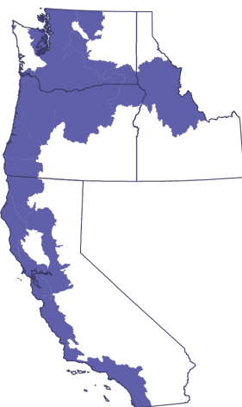
Land Area Affected by ESA Listed Salmon & Steelhead
5 Endangered
23 Threatened
176,000 sq. miles
61% of Washington’s land area, 55% of Oregon’s, 26% of Idaho’s & 32% of California’s
NOAA National Marine Fishery Services 2010

Slide 5
ESA and Restoration
(Torgersen et al. 2012)
Notes:
Divide and make into two different graphs – or create with R, draw spheres indicating restoration

Slide 6
ESA and Restoration
(Torgersen et al. 2012)

Slide 7
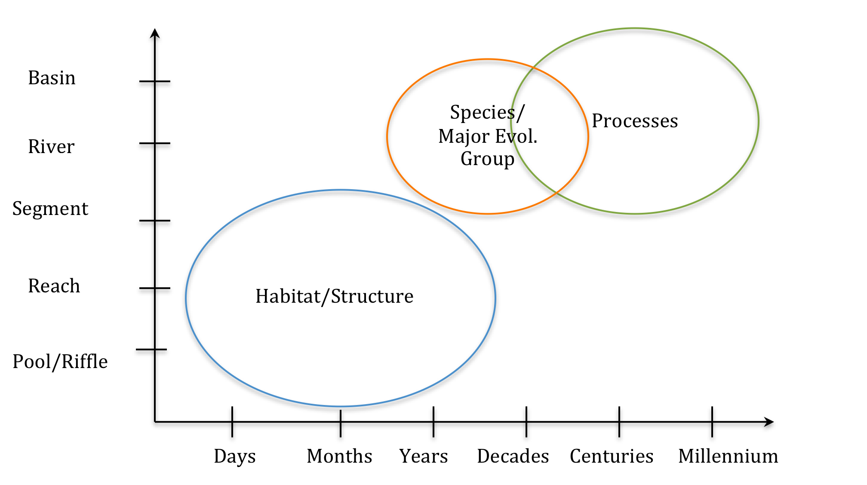
Ambitious Restoration
Space/time
Hab, ssp, physical processes

Slide 8
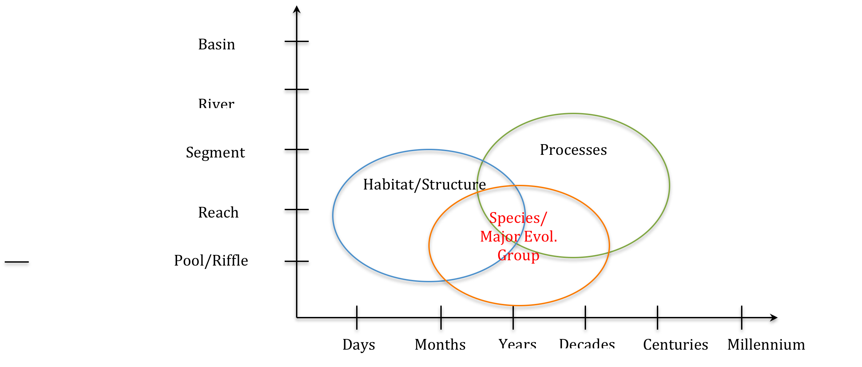
Restoration Projects
Space/time
Hab, ssp, physical processes

Slide 9
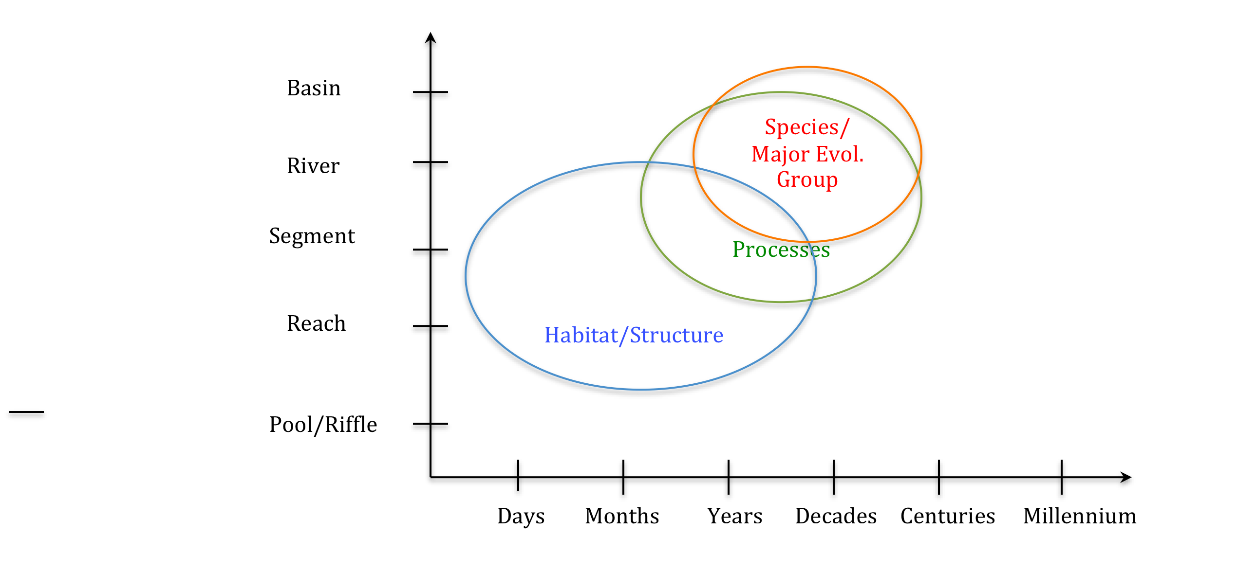
Restoration Potential
Space/time
Hab, ssp, physical processes

Slide 10
Monitoring
Notes:
Some monitoring plans use other indicator species, aerial photos, GIS inferences, but measurement within plots and over 1 decade or less is dominant

Slide 11
Other Scale Mismatches
Restoration & Climate Change
Evaluation
Scientific Knowledge and Management

Slide 12
Causal Relationships
Spatial
Temporal
Plots/Quadrants vs. Study Area
Perceptions of important scales for processes or species
Political Boundaries & Management
Scale of processes governing targeted restoration efforts
Goals & Explanations
Effect of restoration efforts – project performance curves
Scales of processes
Knowledge base surrounding restoration science
Historical and Cultural context of values

Slide 13
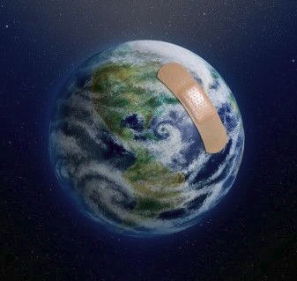
Source: 2012 Forum

Slide 14
References
Beechie, Timothy J., David A. Sear, Julian D. Olden, George R. Pess, John M. Buffington, Hamish Moir, Philip Roni, and Michael M. Pollock. 2010. Process-based Principles for Restoring River Ecosystems. BioScince 60(3): 209-222.
BEF: Bonneville Environmental Foundation. 2012. Model Watershed Restoration. http://www.b-e-f.org/watersheds/.
Frissell Christopher A., William J. Liss, Charles E. Warren, Michael D. Hurley. 1986. A hierarchical framework for stream habitat classification: viewing streams in a watershed context. Environmental Management 10(2): 199-214.
Shumm S.A., and R.W. Lichty. Time, space, and causality in geomorphology. American Journal of Science 263: 110-119.
TNC: The Nature Conservancy. A Practitioners Guide to the Design & Monitoring of Shellfish Restoration Projects. www.habitat.noaa.gov/pdf/tncnoaa_shellfish_hotlinks_final.pdf
Torgersen, Christian E, Ebersole Joseph L., Druscilla M. Keenen. 2012. Primer for Identifying cold-water refuges to protect and restore thermal diversity in Riverine Landscapes. U.S. EPA, Office of Water and Watershed. Seattle WA.

