Slide 1
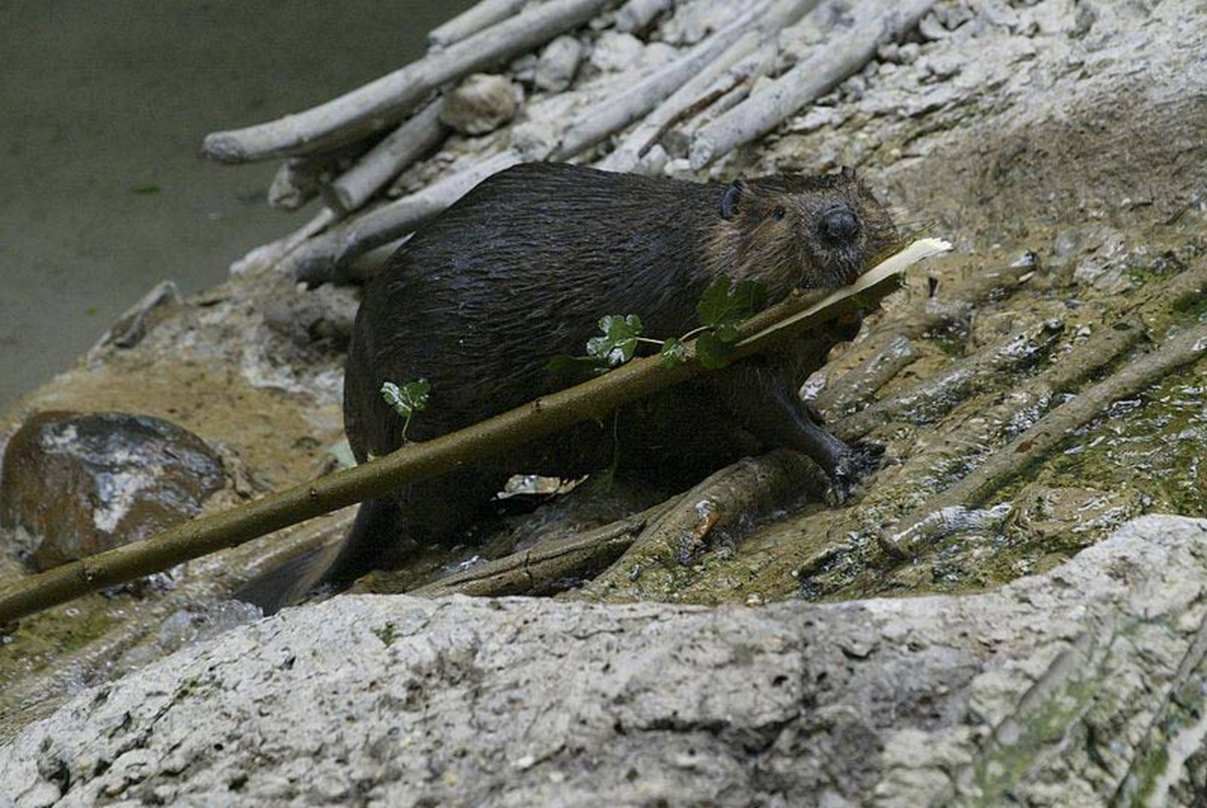
How busy are beavers?
problems of scale in quantifying beaver modifcation of a landscape
Notes:
My main thesis research project is looking at the relationship between beaver dams and fish community structure in the Southwest, in Arizona.
As we all know well after this class, that is a question fraught with problems of scale, but tonight I’m not even going to go there. Maybe I’m too afraid.
Anyway, what I do want to talk about is the relatively more simple question of problems of scale in trying to talk about the extent of beaver activity in a landscape.

Slide 2
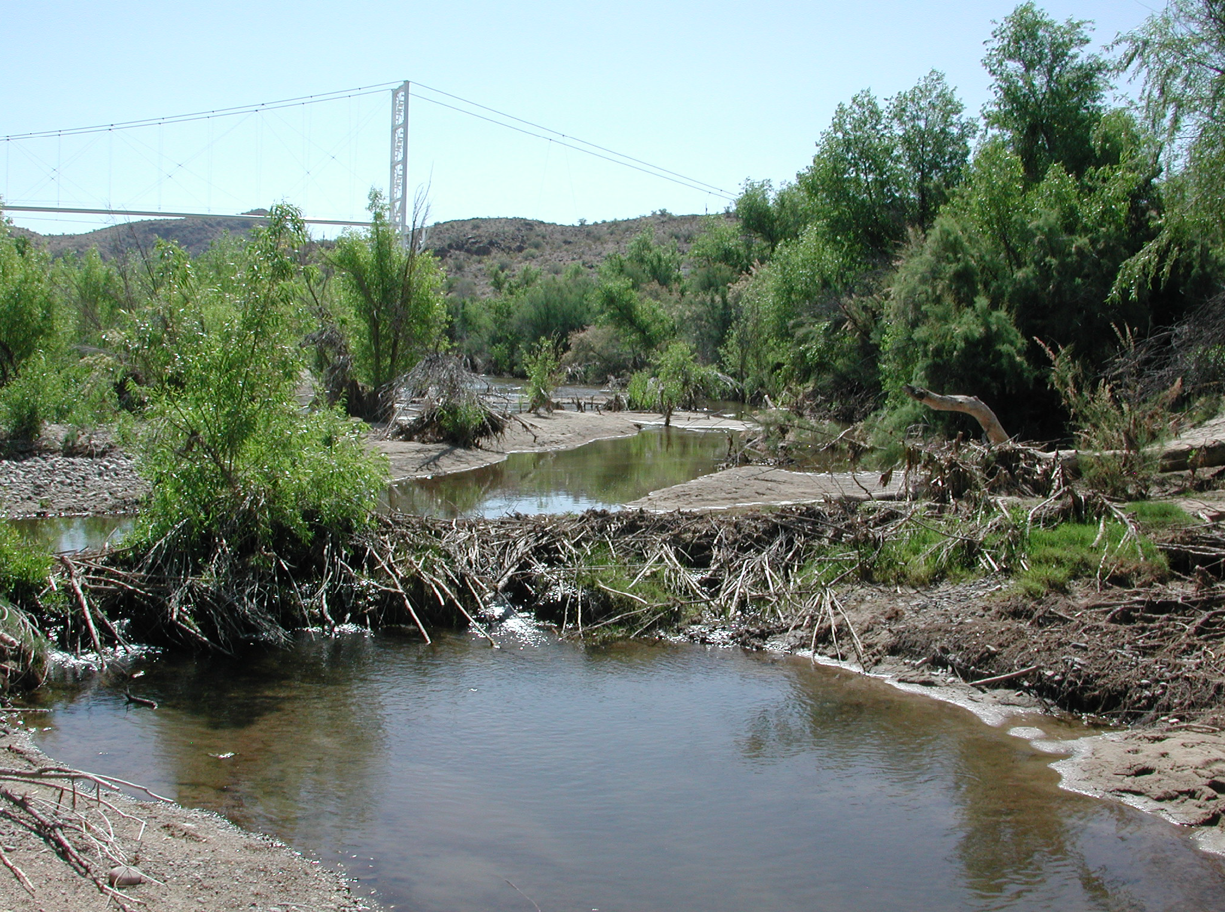
how much do beavers build dams in the desert?
HYPOTHESES
in arid and semiarid ecosystems:
beaver dams are less abundant and show a more patchy distribution
dams tend to be ephemeral rather than perennial landscape features
Notes:
This is the question behind a lot of my interest in this question.
Most research about beavers is from the NE of North America, very different ecosystems, beavers can be really densely populated there.
But as I’ve been reading a lot about beaver ecology in arid regions, my feeling is that beaver distribution is a lot different there, and thus will probably have different ecosystem effects.
These hypotheses are my subjective impression from the literature. I do not propose to fully address any of these hypotheses today; this is just a guide for the sort of questions that I imagine applying these issues of scale to.

Slide 3
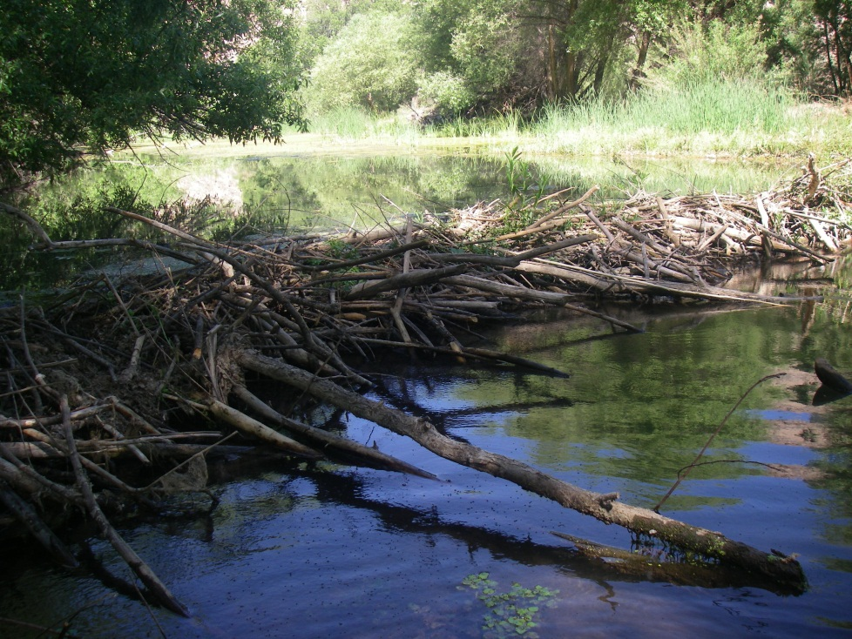
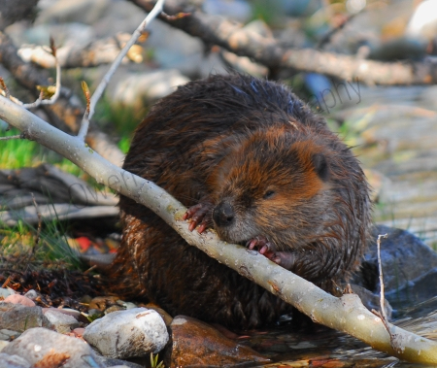
how busy are beavers?
scope of beaver influence on ecosystems
problems of scale
approaches to measuring dam abundance
Notes:
Anyway, this is what I do want to talk about.
Part of the difficulty in assessing how much beaver activity there is, is that beaver influence ecosystems at so many different scales, so I want to discuss that briefly.
Then I’ll talk about some simple problems of scale that came up in my own research particularly, and possible ways to think about them.
[and yes, one great thing about beavers as a study subject is the license to troll the internet for cute animal phots.]

Slide 4
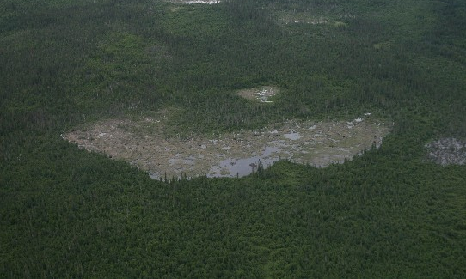
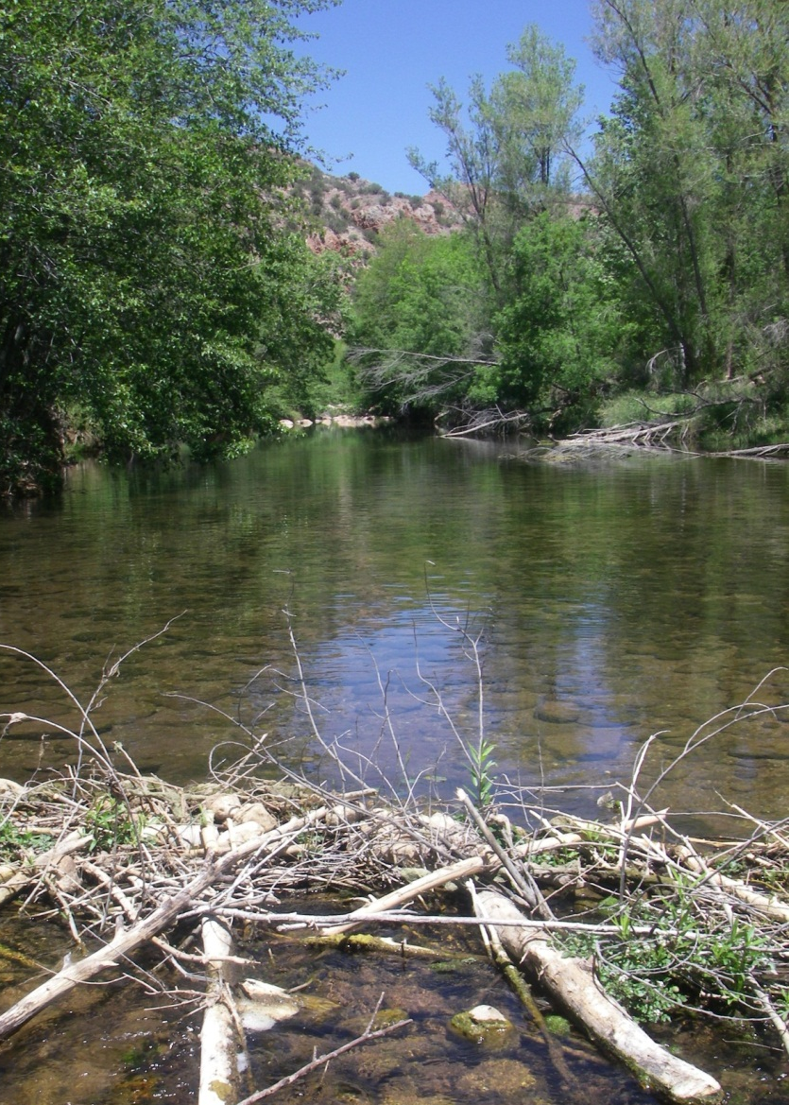
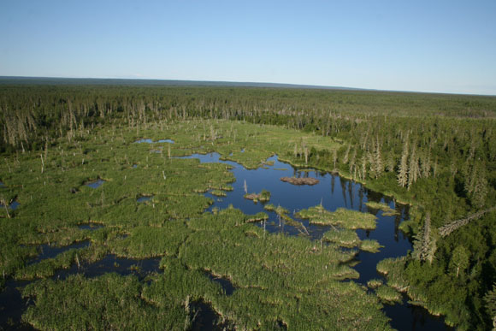
BEAVER DAMS
dam length (m)
Notes:
The size of the beaver dam itself is highly variable.
They can be very small – this is one I found in Arizona.
…or, they can be huge
World’s largest beaver dam in Alberta: over half a mile long, twice the length of the Hoover Dam, and, famously, it can be seen from space.
Presumably these different dams have different ecosystem effects.

Slide 5
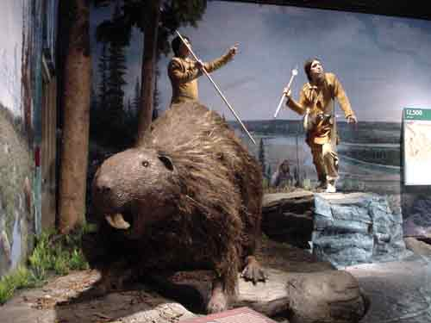
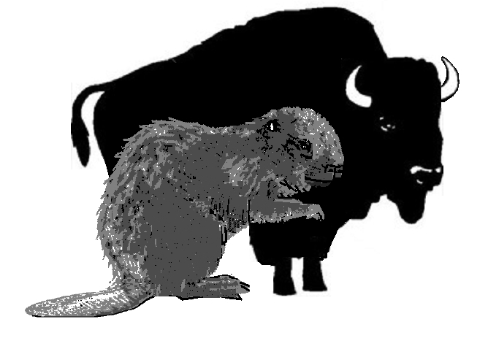
speaking of scale…
beaver length (m)
giant beavers?
Notes:
This is an irrelevant aside, but I just think it’s cool.
But just because I think it’s cool, I will infrom you that one member of the Pleistocene megafauna was an enormous beaver, which apparently is in fact called the “Ancient Giant Beaver”.
-2.5 meters long
-unfortunately, they don’t’ think that this creature built dams – instead it ate aquatic vegetation and was more like a hippo.

Slide 6
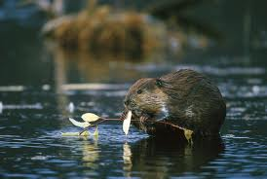
abundance and distribution of dams
extent of beaver modification (m)
Density of beaver dams (and, presumably, their effects) varies widely among regions and basins.
Notes:
So you have the scale of the individual dam, and then you have the cumulative effects of beaver dams throughout the watershed. That might depend on how many dams there are, and how they’re distributed.
We know that there are some places where beaver are, or were before they were wiped out by trapping, literally damming up almost every available piece of stream; in other watersheds you just have a few dams here and there. That’s going to affect observed responses to beaver activity – especially some of the classic geomorphic effects of beaver activity, like raising the water table, increasing groundwater storage, reduction of flow velocity.

Slide 7
large scale effects
extent of beaver modification (m)
“The abundance of beavers is key to their function.” (Wild 2011)
Notes:
I do want to say something about extra large scale effects, since I think this is one of the most fascinating this about beaver ecology.
Beaver might have had a bigger impact on the landscape than we realize.
I’ve read suggestion that extirpation of beaver could be considered the first major land-use change by white settlers.
The landscape could have looked totally different back when beaver were enormously abundant in some places.
One theory is that long term deposition behind beaver dams helped geomorphically shape flat valley floors like the one in this picture.
Another theory is that what we think of as a typical western stream – fast water, open banks – is a recent creation, casued by widescale removal of beaver. (“We are worshipping a false landscape”)
the point being,t hat when studying beaver impacts, we might be just completely at the wrong scale to see some of the most important impacts, or potential impacts.

Slide 8
extent of beaver activity in TIME
extent of beaver modification (years)
A single dam can last less for less than a year, or for more than a century
Dams may fill in with sediment and develop into other landforms, such as beaver meadow.
In some systems, especially arid systems, the number of dams varies widely with time.
Notes:
-dam itself can last a long time
-beaver occupancy is often cyclical: ponds are abandoned and recolonized, and this has been shown to have effects for fish e.g.
So, assessing the effects of beaver activity is going to have a very large scope in terms of time.;

Slide 9
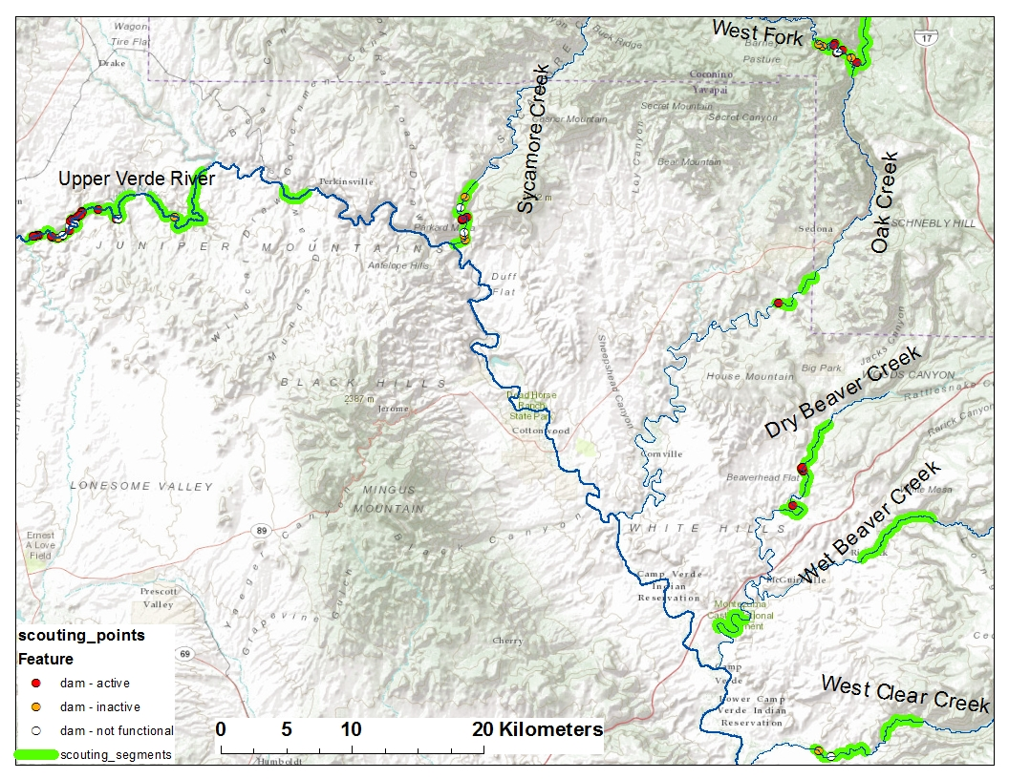
beavers in the Verde River basin, Arizona
Notes:
[animate in photos if time]
So, these scopes were things I was thinking about when I started my field research.
One of the first things I did was search along streams in my general study area for beaver dams.
I did find some. Up here in the upper Verde Riverthere were a lot of big beaver dams, and big ponds.
In other streams there were a decent number of dams, but they tended to be small and not having so much effect on the stream.
And in many streams there were very few, if any, dams.
Are beaver actually having much effect here? How many dams/ how big/etc are needed to impact system of interest (in my case, fish).
How does this rate of occupancy compare with other regions?
I am specifically studying beavers in arid regions.
There are a lot of reasons to think that beaver dams might be less common and less important here than in the Eastern US or the mountains – even in historic times.
Beavers here don’t always build dams; often they just live in the banks.
Flow regimes tend to be variable, flahsy, big floods; dams have a much shorter life (Demmer and Beshcta found that ponds rarely last >2yrs).
Riparian veg is sometimes more limited; water may be more intermittent.
I’ve seen a lot of dubiously scientific papers like this one, where people try to predict the effects of reintroducing beaver into an arid region system. But they tend to be using studies from Minnesota, Alaska, Massachusetss, where beaver occupancy can be very dense. Presumably it will be different here. But we need a good way to describe or predicet beaver occupancy and density.

Slide 10
Notes:
Going back to my own data: how can I quantify the level of beaver activity in my tributaries, in order to compare then to one another and to compare with what people have found on other streams?
[put in dam densities if time]
[zoomed in on Upper Verde if possible?]
The obvious answer is basic density, dams per river kilometer, and this is usually how people report it.
However, this has some obvious problems.
First, the distribution of dams is highly clumped.
upper Verde; dense dams probably have a big effect but they’re “diluted” by those empty downstream miles.
Similarly: this is the problem that Christian brought up in one lecture.
measure small area = high density.
measure big area = low density.
If I had kept searching, density would probably have gotten even lower. “Density” is thus an artifact of area searched.
My searches were not random – they were focused around areas with high probability of dams, since I needed to find some.

Slide 11
area searched vs beaver dam density
Notes:
This is a very simple illustration of the idea that that “beaver dam density” is a scale-dependent property.
chart is a very general stab at the idea.
I collected values from the literature where people reported a beaver dam density. Unfortunately they often didn’t report the area covered so I couldn’t use those values.
Clearly more data points would be helpful, but the general idea is that “beaver dam density” is a scale-dependent property.
Beavers often tend to build dams together in colonies; if you count number of dams over a short distance you can get a high density. For looking at small-scale processes, that would be appropriate.
For looking at wider basin scale questions, though, you’d need to use a larger scale beaver dam density. And this also makes it clear that the extent is maybe as important as the observed density when trying to compare the extent of beaver occupancy among regions.
[people do have other ways of trying to report beaver density. Some that I’ve seen:
-Colony density (rather than dam density) – because dams tend to clump together in colonies, and that may be more important and more objective than actual number of dams.
-% beaver modified
-beaver dam occupancy by a certain set length. --this is interesting, I’d like to try it for my data.
Of course, simple density may be more effective where beaver activity is distributed relatively homogenously throughout a watershed, as I understand it often is in NE watersheds, when beaver populations are unexploited. I wonder, if I had more data points, if we’d see a different relationship for arid/western watershed vs humid eastern ones.

Slide 12
effective density: standard population density weighted by number of organisms
Notes:
I do want to say something about extra large scale effects, since I think this is one of the most fascinating this about beaver ecology.
Beaver might have had a bigger impact on the landscape than we realize.
I’ve read suggestion that extirpation of beaver could be considered the first major land-use change by white settlers.
The landscape could have looked totally different back when beaver were enormously abundant in some places.
One theory is that long term deposition behind beaver dams helped geomorphically shape flat valley floors like the one in this picture.
Another theory is that what we think of as a typical western stream – fast water, open banks – is a recent creation, casued by widescale removal of beaver. (“We are worshipping a false landscape”)
the point being,t hat when studying beaver impacts, we might be just completely at the wrong scale to see some of the most important impacts, or potential impacts.

Slide 13
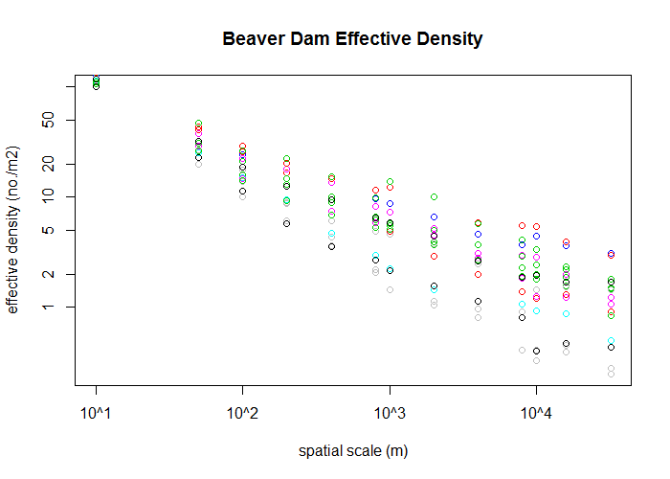
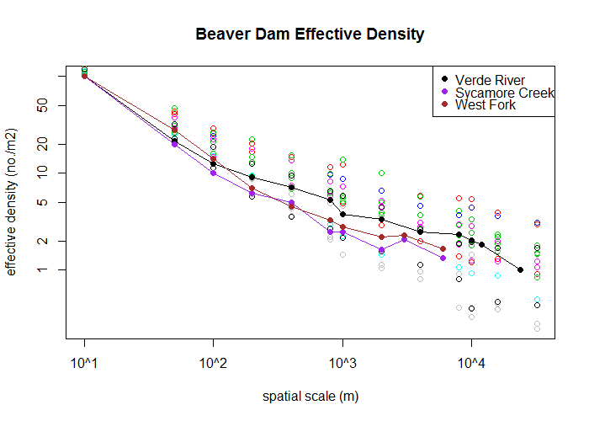
Notes:
So, I calculated effective density for some of my survey data and for another basin to compare.
Amazing dataset:
-knew it must exist because of paper
-After what was probably a couple of hours of internet searching, my faith that it must be on the internet somewhere was rewarded, and I found exactly what I was looking for.
-17 years of complete beaver dams surveys along the same 32km stretch of stream, the location of every dam marked in GIS, and they even have the age of all dams.
So really, this is just an aside, to praise high scope data.
Figure:
All the colors show 17yrs worth of data for a single stream.
-Scale changes effective density: steepness reflects heterogeneity of distribution: maybe it would be less steep in a mesic region?
-Lots of variation between years (min 8 dams, max 98, in 32km)
-The bigger the scale, the greter the variability; dams are rarely closer together than about 100m, so it becomes meaningless before 50.
Add my data:
Here is data from some of my streams overlaid (the streams that actually had more than one dam).
-In general effective density for my streams is lower than for Bridge Ck sites: consistent with the idea that occupancy is lower here.
-Note at small scale, my small stream shows a higher effective density than the others; reflects fact that dams actually are close together there?
-*most important: subjective impression is that Verde River had by far the most beaver activity in its upper section. Simple density calculation puts it lower than the other two tribs; but this has it consistently higher than the others, reflecting the high density in the headwaters section. Whether that is desirable or not will of course depend on the question.
Overall use of this approach:
-Allows for comparing among basins and among sampling extents in a semi-standardized way (at 1km scale…).
-Could also be used to establish scale for study question of choice. Maybe we think 1km scale is important for fish habitat; then we can say that fish experience an effective density of x number of dams.
-I’d love to be able to compare with a mesic region version.

Slide 14
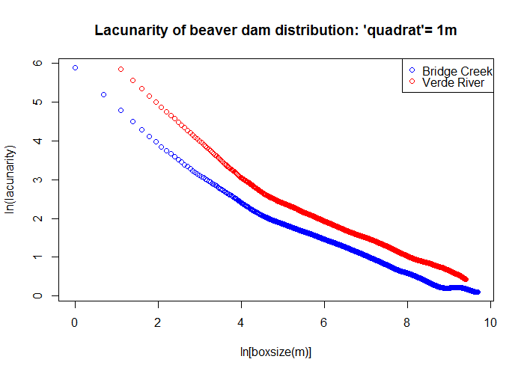

Slide 15
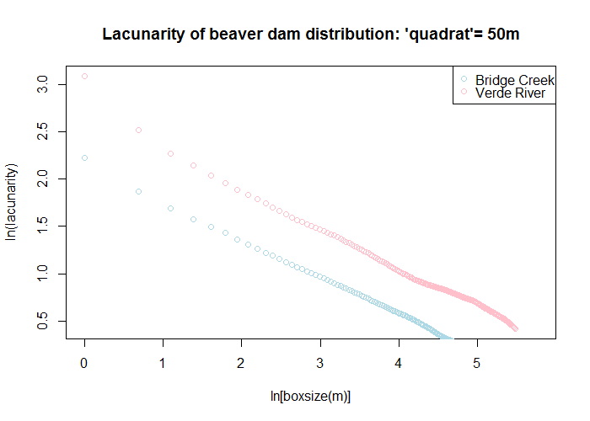

Slide 16
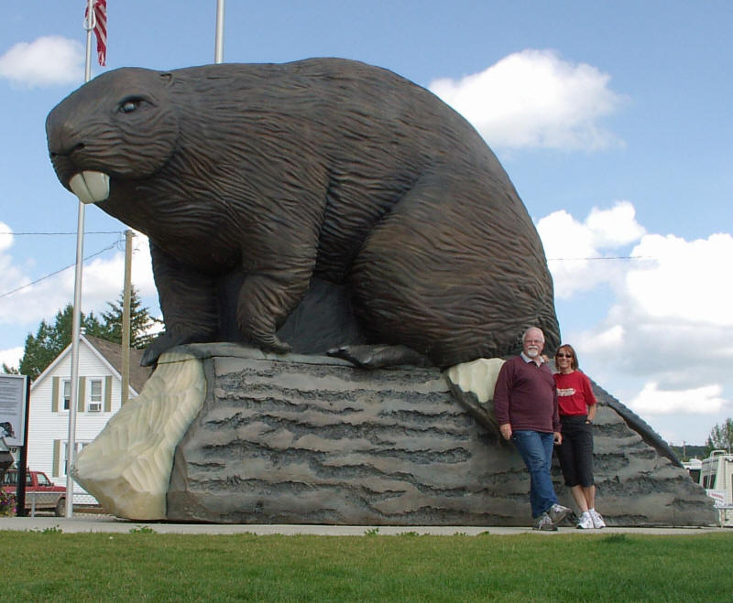
when scale goes awry…
Notes:
That’s it, except for a reminder, that when scale isn’t taken into account, things can get a little weird…

