Slide 1
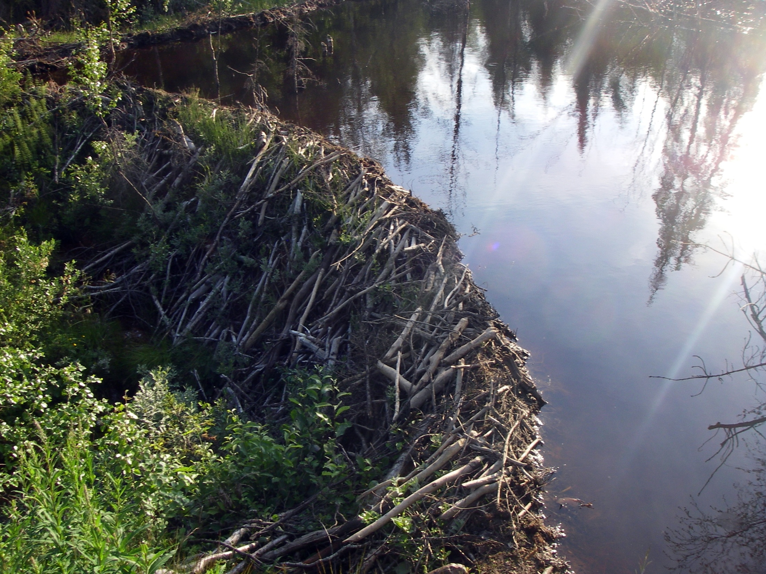
Using Beavers to Address Problems of Scale
Benjamin Dittbrenner
Ecological Scaling
Dec 2013

Slide 2
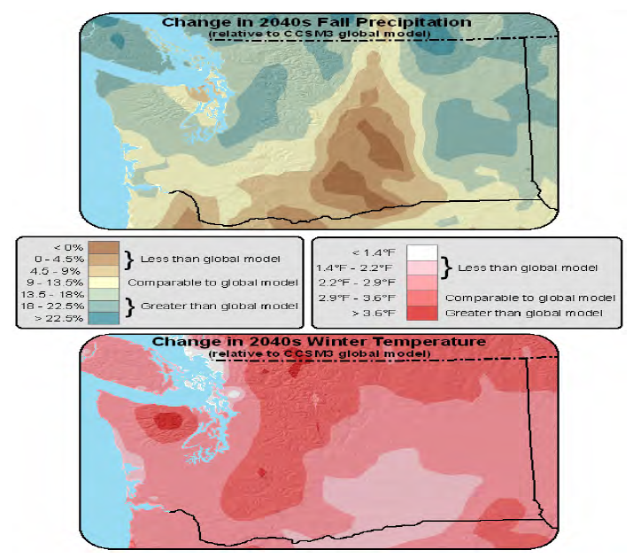
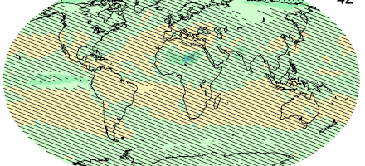
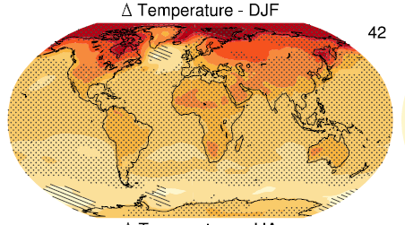
Spatial Scales: Global & WA Climate Models
Increase in model resolution (grain size ) yields different regional predictions than global
Regional predictions Global model Region model
Fall Precip: ↑ 11.7% ↑ spatial variability
Winter Temp: ↑3.6°F ↑ 2.6°F, variable, ↑ alpine areas
Value of regional models for identifying sub-regional patterns and differences.
Global Climate model
Regional Climate model
Change in 2035 Fall Precipitation (RCP 4.5)
Change in 2035 Winter Temperature (RCP 4.5)
Littell, et al. 2009
IPCC 2013
Notes:
The global model produces a regionally averaged 11.7% increase in precipitation, but the regional model provides more detail (top), projecting some areas of increase (green) and some of decrease (brown) compared to the global model.
The global model produces a 3.6°F (2.0°C) statewide averaged increase in winter temperature, while the regional model produces a statewide average 2.6°F (1.4°C) warming. Greater increases (darker red) occur at higher elevations and windward slopes, particularly the Olympic Mountains, North Cascades, and central Cascades. These differences illustrate the value of regional climate models for identifying sub-regional patterns and differences.
large increases are seen on windward (west and southwest) slopes and smaller increases on leeward (east and northeast) slopes.

Slide 3
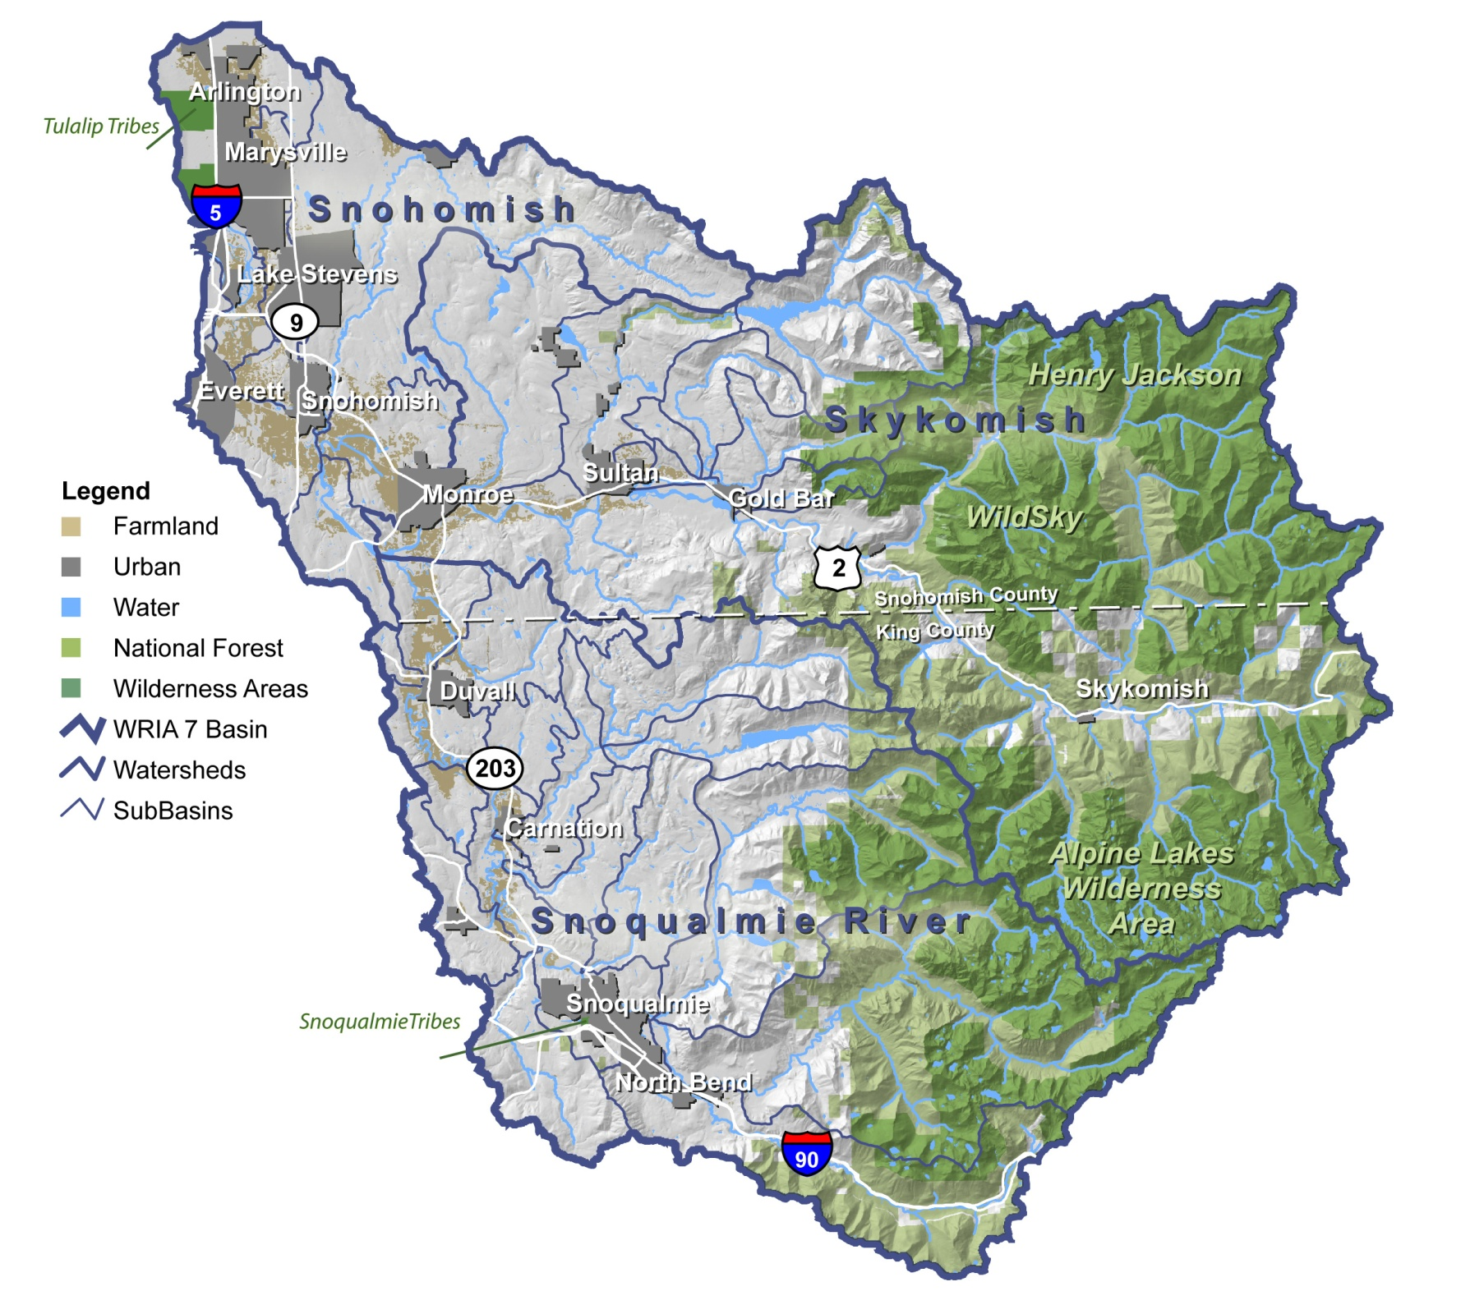
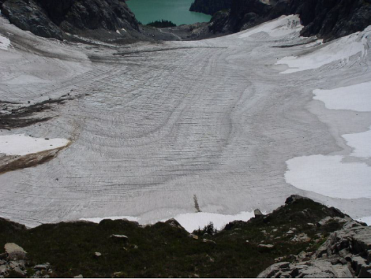
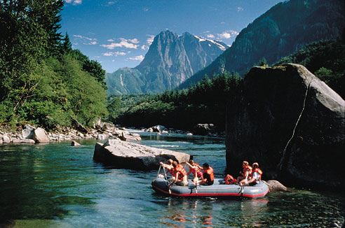
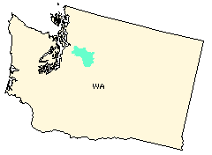
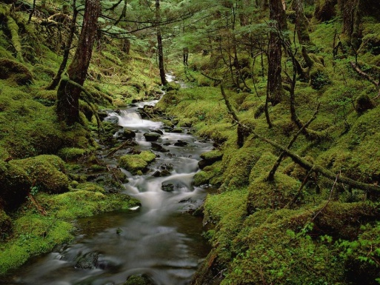
Research Scale Skykomish River Watershed Snohomish Basin
Notes:
2nd largest salmon-producing river in P.S.
All 5 species of salmon present
Representative of Watersheds west-slope Cascades
Development
Political constraints
Ecosystems

Slide 4
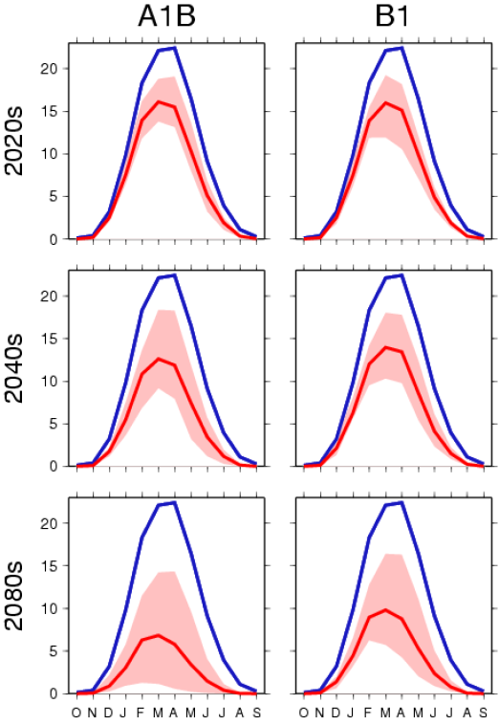
Temporal Scale, Long Term: Climate Projections for Study Area by 2070
Snow Water Equivalent (in), Skykomish River, WA
↑ 14% annual average precipitation
↑ storm intensity
2.0 to 8.5°F warming
↓ snow accumulation
↓ Stream baseflow & groundwater
Dalton et al. 2013
Hamlet et al. 2010

Slide 5
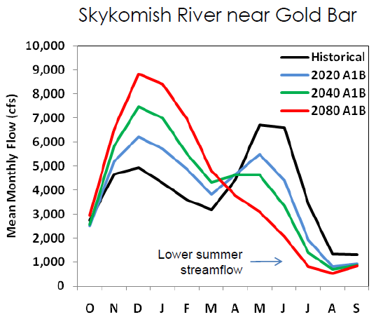
Temporal Scale, Short Term Inter-annual changes to hydrology
↓ ~34% summer precip
↑ winter Precip
Transition of snow to rain-dominated basins
Results
Earlier peak flow
Increased winter flow intensity
Decreased summer base flow
Dalton et al. 2013
Elsner et al. 2009
Notes:
Up to 34% decrease in summer precipitation
↓summer base flow
Increased winter Precipitation and lowland flooding
Transition of snow dominated basins to rain dominated basins
Earlier peak flow
Increased winter flow
Decreased summer base flow

Slide 6
Scales of Impact: Ecological Effects at Different Habitat Scales
Goudie 2006
Microhabitat | Pool/Riffle | Reach | Segment | Stream System | Watershed
10⁻¹ m 10⁰ m 10¹ m 10² m 10³ m 10⁴ m

Slide 7
Scales of Impact: Ecological Effects at Different Habitat Scales
Goudie 2006
Microhabitat | Pool/Riffle | Reach | Segment | Stream System | Watershed
Desynchronized flow timing
↓ base flow during critical life stages
10⁻¹ m 10⁰ m 10¹ m 10² m 10³ m 10⁴ m

Slide 8
Scales of Impact: Ecological Effects at Different Habitat Scales
Goudie 2006
Microhabitat | Pool/Riffle | Reach | Segment | Stream System | Watershed
Desynchronized flow timing
Redd scouring
Amphibian reproductive cycles
Desynchronized flow timing
↓ base flow during critical life stages
10⁻¹ m 10⁰ m 10¹ m 10² m 10³ m 10⁴ m

Slide 9
Scales of Impact: Ecological Effects at Different Habitat Scales
Goudie 2006
Microhabitat | Pool/Riffle | Reach | Segment | Stream System | Watershed
Desynchronized flow timing
Redd scouring
Amphibian reproductive cycles
Desynchronized flow timing
↓ base flow during critical life stages
↑ winter peak intensity
Disconnect stream from floodplain
↑ Sediment transport, scour, erosion
↓ spawning gravels
↑ disturbance frequency ~ loss of specialist species
Decreased base flow
↑ stream temp, surpassing lethal threshold for sensitive species
10⁻¹ m 10⁰ m 10¹ m 10² m 10³ m 10⁴ m

Slide 10
Scales of Impact: Ecological Effects at Different Habitat Scales
Goudie 2006
Microhabitat | Pool/Riffle | Reach | Segment | Stream System | Watershed
Desynchronized flow timing
Redd scouring
Amphibian reproductive cycles
Desynchronized flow timing
↓ base flow during critical life stages
↑ winter peak intensity
Disconnect stream from floodplain
↑ Sediment transport, scour, erosion
↓ spawning gravels
↑ disturbance frequency ~ loss of specialist species
Decreased base flow
↑ stream temp, surpassing lethal threshold for sensitive species
Decreased base flow
Less refugia for aquatic species
↓ Summer precip
Drought-stressed forests, vulnerable to insects and disease
Vegetation
Transition to fire resistant species
10⁻¹ m 10⁰ m 10¹ m 10² m 10³ m 10⁴ m

Slide 11
Scales of Impact: Ecological Effects at Different Habitat Scales
Goudie 2006
Microhabitat | Pool/Riffle | Reach | Segment | Stream System | Watershed
Desynchronized flow timing
Redd scouring
Amphibian reproductive cycles
Desynchronized flow timing
↓ base flow during critical life stages
↑ winter peak intensity
Disconnect stream from floodplain
↑ Sediment transport, scour, erosion
↓ spawning gravels
↑ disturbance frequency ~ loss of specialist species
Decreased base flow
↑ stream temp, surpassing lethal threshold for sensitive species
Decreased base flow
Less refugia for aquatic species
↓ Summer precip
Drought-stressed forests, vulnerable to insects and disease
Vegetation
Transition to fire resistant species
Decrease in summer precipitation
2.5 x ↑ forest fires by 2040
Vegetation
Change succession trajectory and equilibrium
10⁻¹ m 10⁰ m 10¹ m 10² m 10³ m 10⁴ m

Slide 12
Scales of Impact: Ecological Effects at Different Habitat Scales
Goudie 2006
Microhabitat | Pool/Riffle | Reach | Segment | Stream System | Watershed
Desynchronized flow timing
Redd scouring
Amphibian reproductive cycles
Desynchronized flow timing
↓ base flow during critical life stages
↑ winter peak intensity
Disconnect stream from floodplain
↑ Sediment transport, scour, erosion
↓ spawning gravels
↑ disturbance frequency ~ loss of specialist species
Decreased base flow
↑ stream temp, surpassing lethal threshold for sensitive species
Decreased base flow
Less refugia for aquatic species
↓ Summer precip
Drought-stressed forests, vulnerable to insects and disease
Vegetation
Transition to fire resistant species
Decrease in summer precipitation
2.5 x ↑ forest fires by 2040
Vegetation
Change succession trajectory and equilibrium
↑ Warming
↓ Soil moisture
↑ insect outbreaks
↑ Evapo – transpiration
10⁻¹ m 10⁰ m 10¹ m 10² m 10³ m 10⁴ m

Slide 13
Is Existing Restoration Paradigm Sufficient to Address Impacts of Climate Change?
Human restoration
Constrained by political, legal issues, and land ownership
Often fragmented across landscape
Often restore available areas instead of most appropriate areas.
Often single species-focused
May lack integration into regional efforts

Slide 14
Success of Human Restoration by Habitat Scale
Excellent
Good
Satisfact.
Poor
Unlikely
Human Restoration
Level of Restoration Success
10⁻¹ m 10⁰ m 10¹ m 10² m 10³ m 10⁴ m

Slide 15
Restoration Alternative? American Beaver
Endemic & common through most of North America
Ecosystem engineers & Keystone species
Modify aquatic environment
Reduce peak storm intensity
Hold water high in the watershed
Increase summer base flow
Effects are long lasting and largely beneficial

Slide 16
How Does Beaver-Assisted Restoration Compare to human restoration Success?
Beaver –assisted Restoration
Excellent
Good
Satisfact.
Poor
Unlikely
Human Restoration
Level of Restoration Success
10⁻¹ m 10⁰ m 10¹ m 10² m 10³ m 10⁴ m

Slide 17
Financial Scales: Cost of Human vs Beaver-Assisted Restoration
Avg cost 100m reach restoration:
Avg cost for beaver relocation & equivalent ecosystem services:
Added benefit to higher scale habitat subsystems
$50-100 K
$1-5 K
Excellent
Good
Satisfact.
Poor
Unlikely
Human Restoration
Beaver –assisted Restoration
Level of Restoration Success
10⁻¹ m 10⁰ m 10¹ m 10² m 10³ m 10⁴ m

Slide 18
Conclusions
Beaver Assisted Restoration
Beaver offer:
Cost savings over human restoration
They maintain sites continuously (>100 yr)
Reproduce!
Restore functions of higher scale habitat than humans are able
Increase resilience
Beaver much cuter than humans

Slide 19
References
Thank You. Questions?
Dalton, M. M., Mote, P. W., & Snover, A. K. (2013). Climate Change in the Northwest. Seattle.
Elsner, MMG., J Littell, LCW Binder - 2009 . The Washington climate change impacts assessment: evaluating Washington's future in a changing climate, Climate Impacts Group, Seattle, WA.
Frissell, C.A,, WJ Liss, CE Warren, MD Hurley, 1986. A Hierarchical Framework for Stream Habitat Classification: Viewing Streams in a Watershed Context. Environmental Management. Vol 10, No.2.
Goudie, A. 2006. Global warming and fluvial geomorphology. Geomorphology 79:384– 394.
Hamlet, A.F., P. Carrasco, J. Deems, M.M. Elsner, T. Kamstra, C. Lee, S-Y Lee, G. Mauger, E. P. Salathe, I. Tohver, L. Whitely Binder, 2010, Final Project Report for the Columbia Basin Climate Change Scenarios Project,http://warm.atmos.washington.edu/2860/report/
Intergovernmental Panel on Climate Change (IPCC), 2013. Fifth Assessment Report Climate Change 2013: The Physical Sicence Basis, Geneva , Switzerland.
Littell, J.S., M. McGuire Elsner, L.C. Whitely Binder, A. Snover (editors). 2009. The Washington Climate Change Impacts Assessment: Evaluating Washington's Future in a Changing Climate - Executive Summary. In: The Washington Climate Change Impacts Assessment: Evaluating Washington's Future in a Changing Climate, Climate Impacts Group, University of Washington, Seattle, Washington. Available at: http://www.cses.washington.edu/db/pdf/wacciaexecsummary638.pdf

