Slide 1
Issues of scale modeling the ocean migration of Pacific salmon
Chloe Bracis
May 11, 2009

Slide 2
Objectives
Model: ocean migration = advection by ocean currents + fish swimming behavior
Behavior rules
how fish process information using multiple gradients and signals based on realistic fish sensory abilities
Use the model to examine spring run Columbia River Chinook salmon, including the effects of interannual variability in ocean currents and what variability among stocks in arrival timing suggests in terms of probable ocean distributions

Slide 3
Single simulation
Daily time step
Magnetic model
Date
Etc.
Ocean model
OSCURS
Behavior rules
Multiple starting parameters
Analysis
Year
Start location
Start date
Speed
Magnetic sensitivity
Ocean current velocities
Fish swimming velocity
Successful or not?
Distribution in space and time by parameter value
Stock specific starting locations?
Fish track

Slide 4
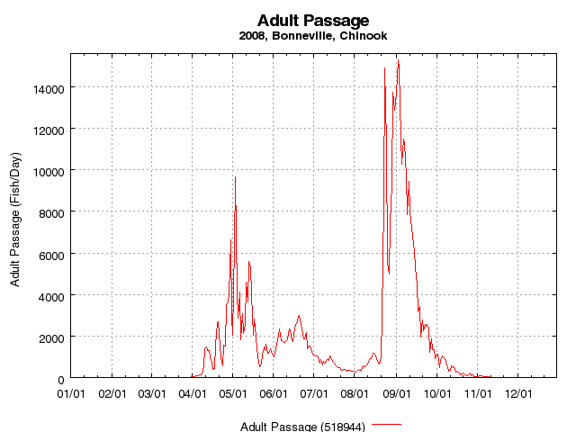
Data, what data?

Slide 5
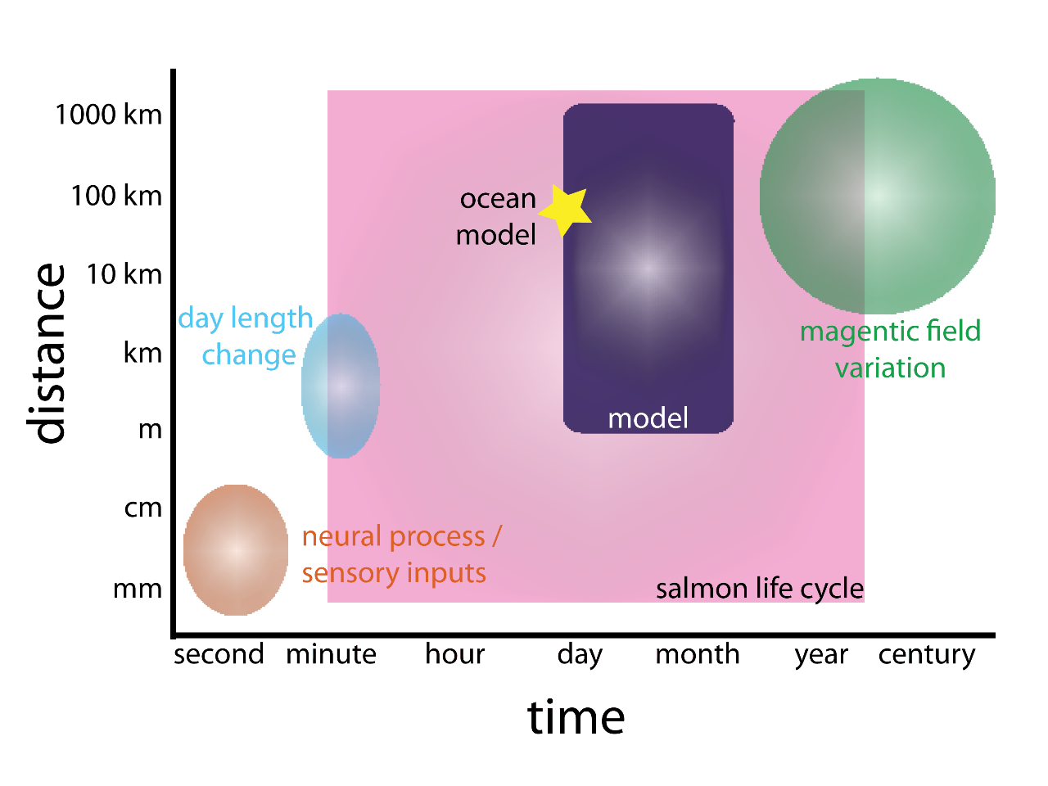

Slide 6
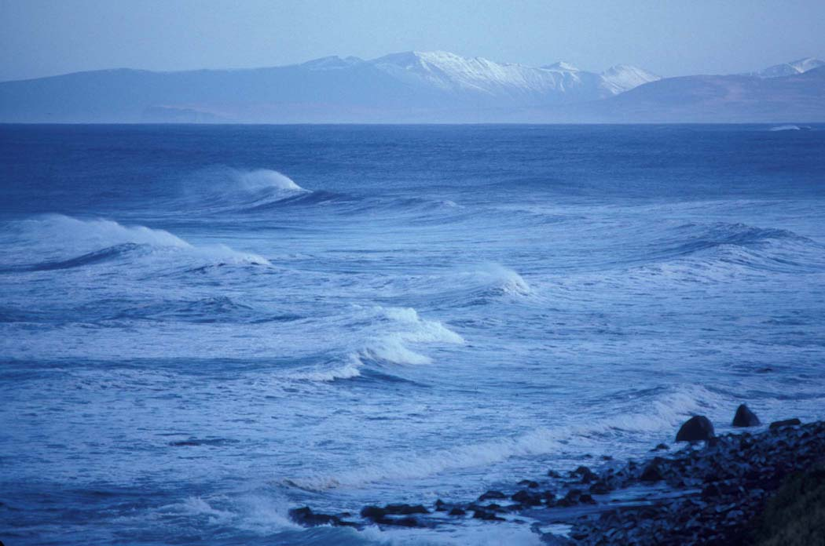
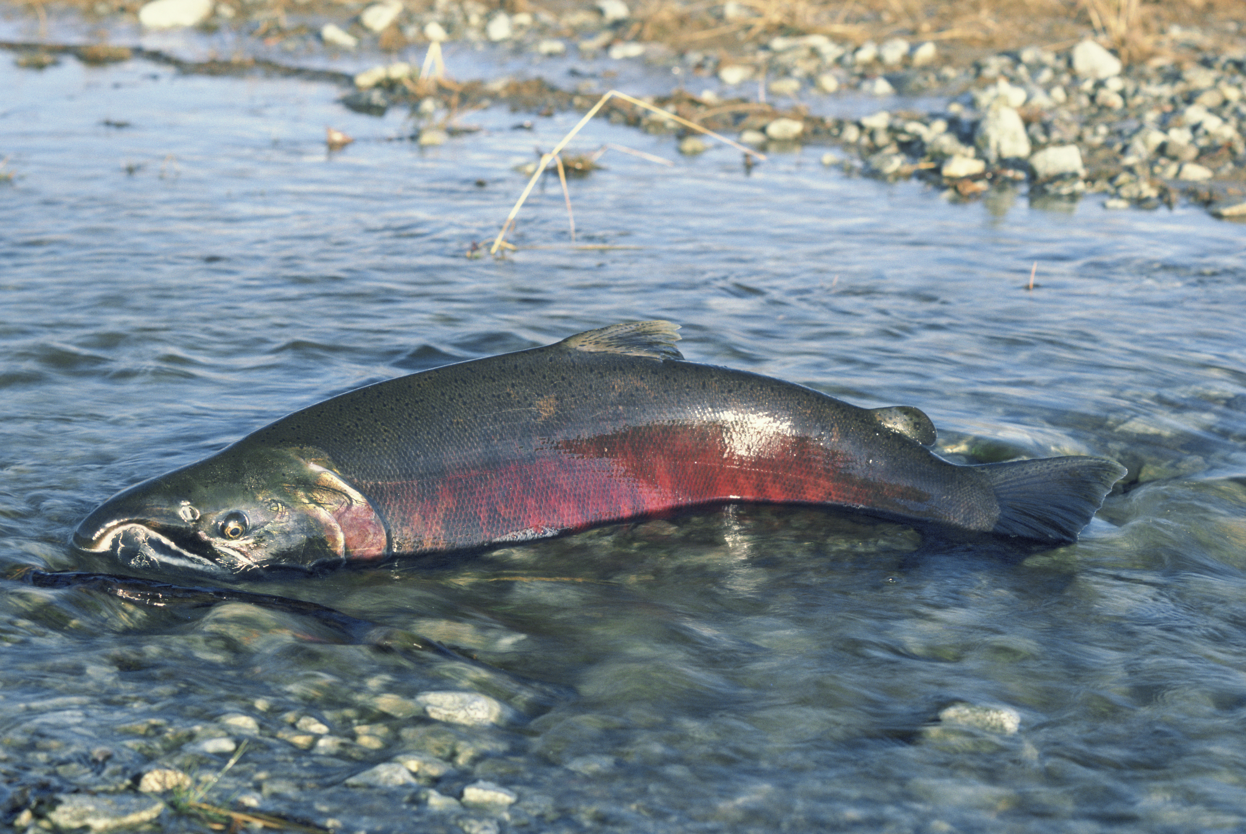
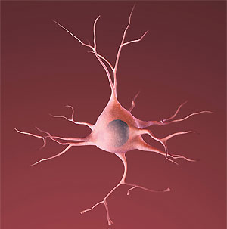
Issues of scale

Slide 7
Time
Model uses a daily time step
Neurological processes underlying behavior rule happen at shorter time scales
What would be different with a longer time step?
Right extent in time for questions we’re looking at?

Slide 8
Space
Model is 2D (surface mixed layer layer: top 10–30 m in summer and 50– 100 m in winter)
Ignore exhibit dive/ascent behavior
Right extent in space for questions we’re looking at?

Slide 9
Questions?

