Slide 1
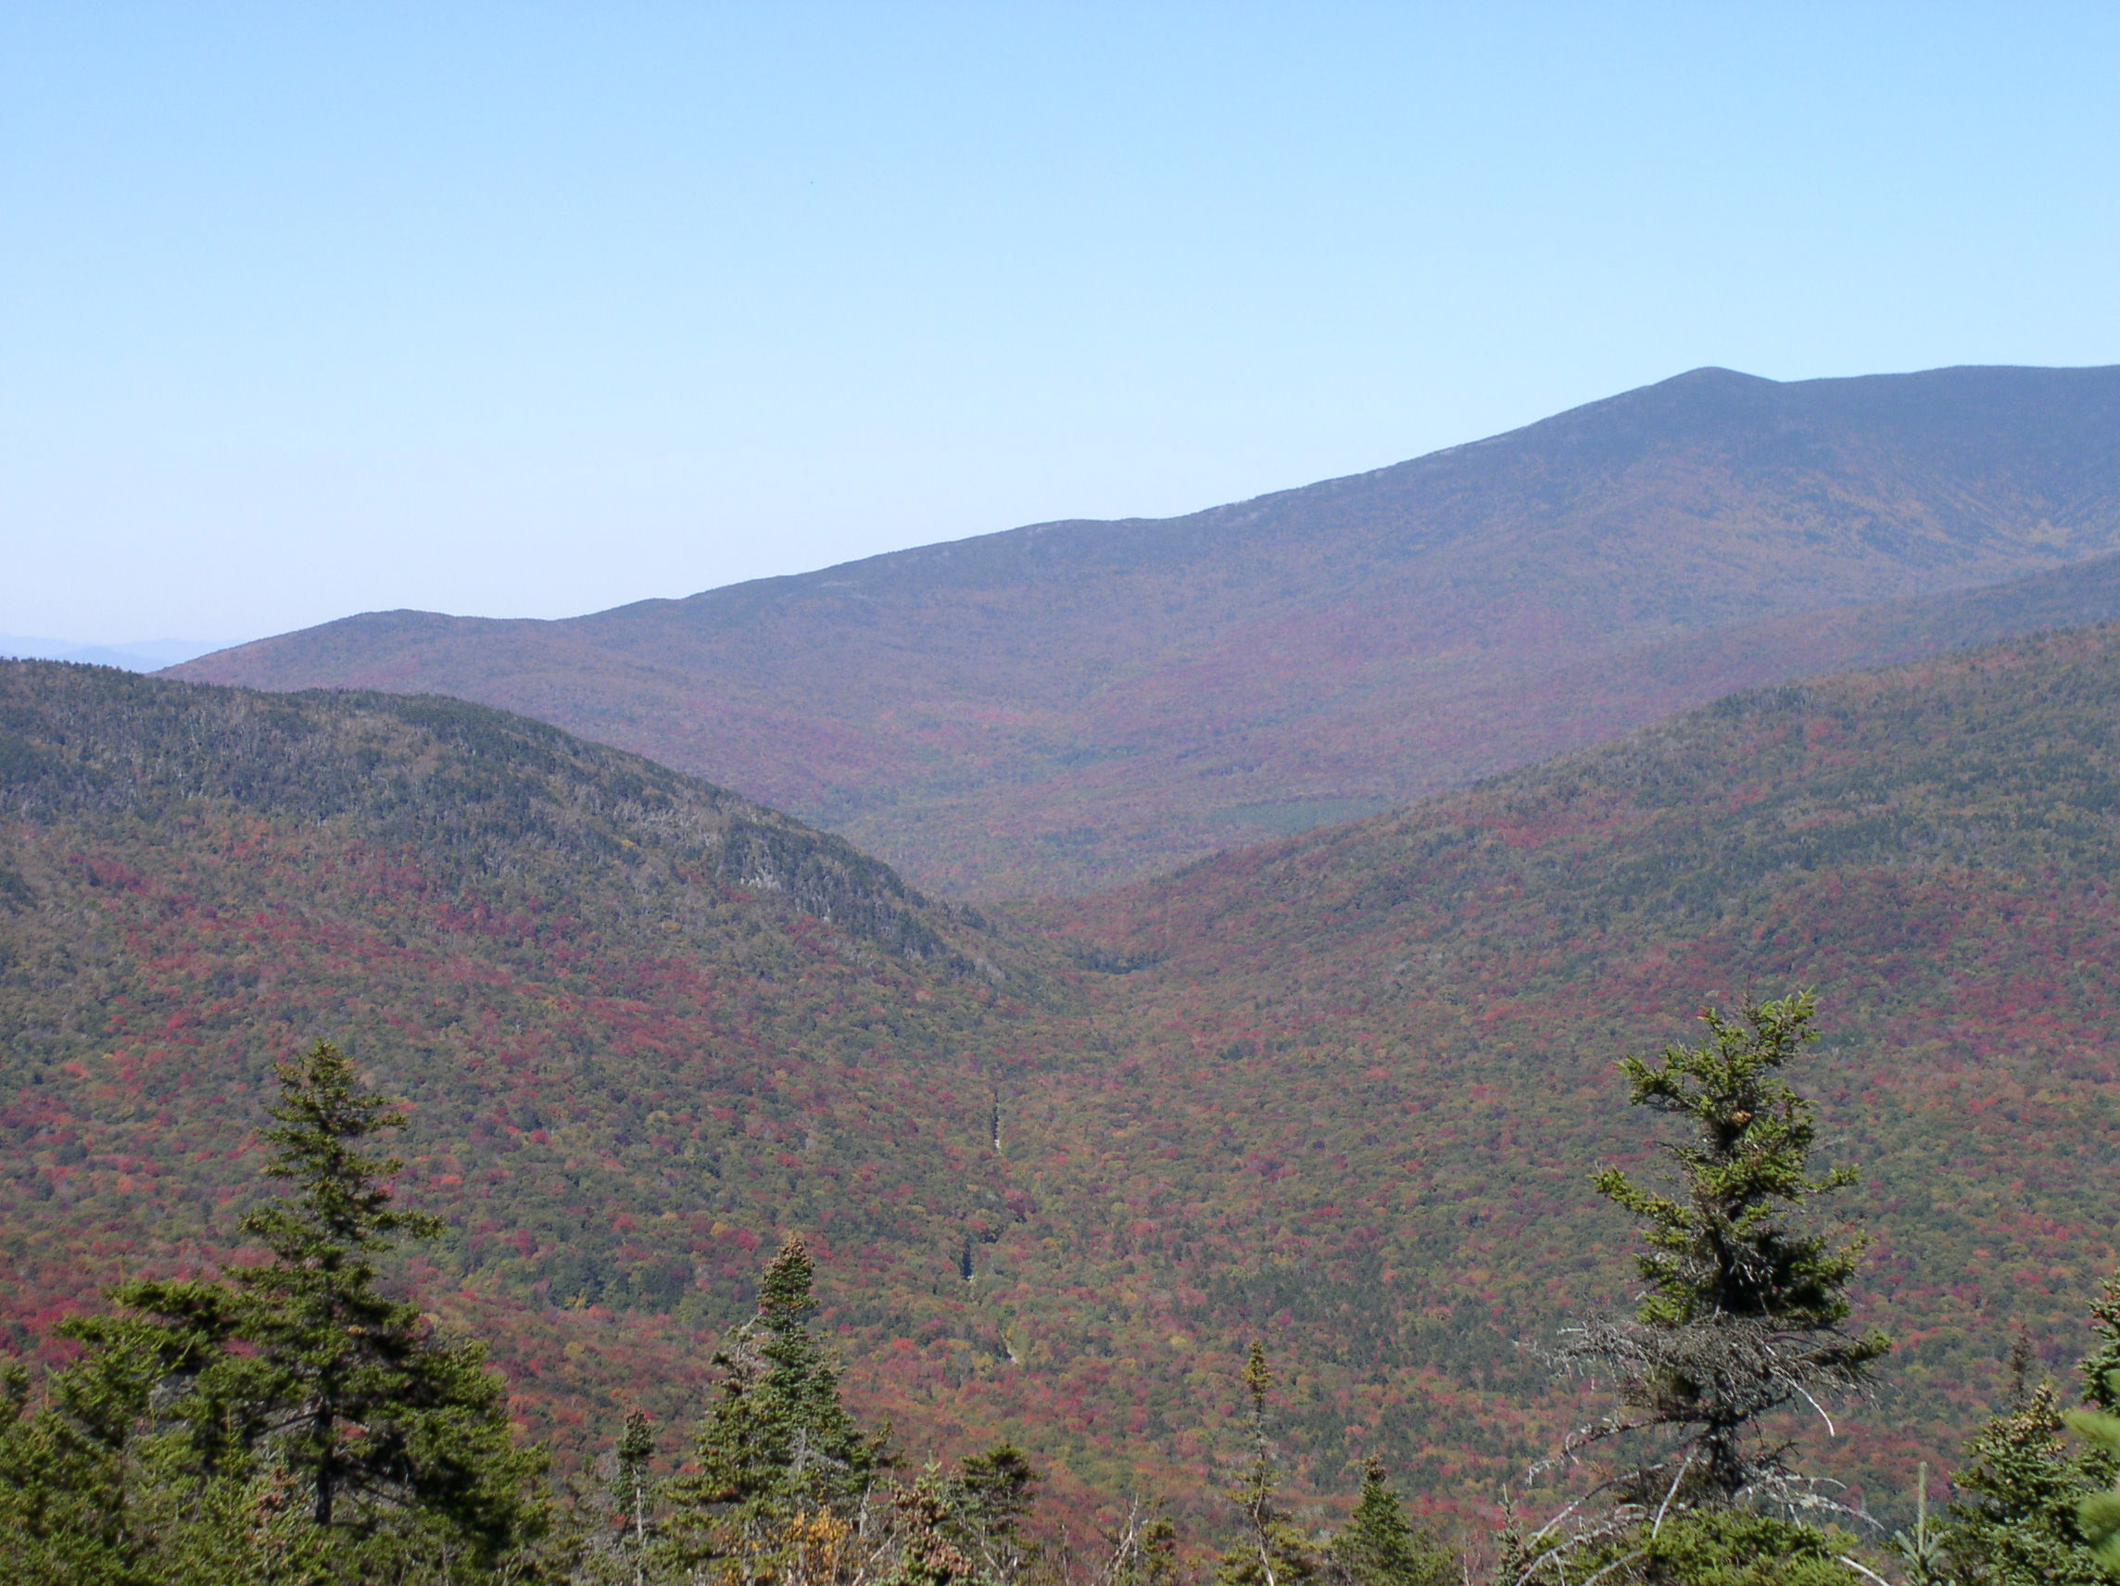

The Fourth Paradigm and data-driven discovery in riverine science
Christian E. Torgersen
USGS Forest and Rangeland Ecosystem Science Center,
Cascadia Field Station
School of Environmental and Forest Sciences,
University of Washington, Seattle
U.S. Department of the Interior
U.S. Geological Survey

Slide 2
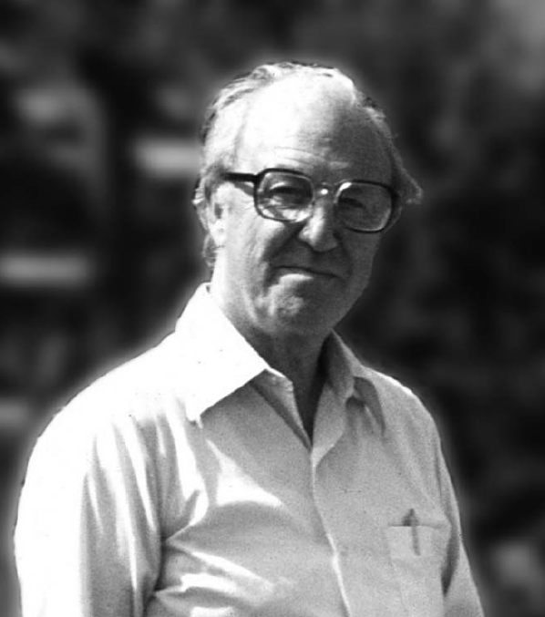
H.B. Noel Hynes
A problem has been that the ecology of flowing water has been very difficult to conceptualize.
We have only a partial picture of the biota and their interactions.
Hot spots are important but difficult to sample.
(Hynes 1989)
“in every respect, the valley rules the stream.” (Hynes 1975)

Slide 3
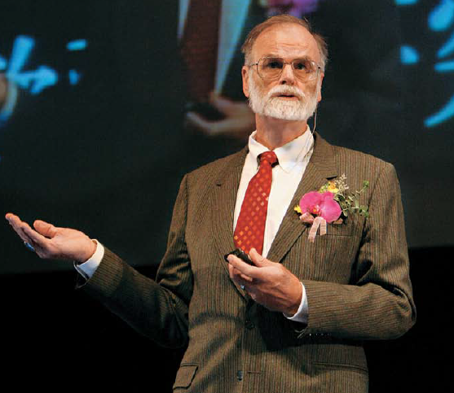
The Fourth Paradigm and data-intensive discovery (2009)
Data deluge!
Scientific methods have to change.
Massive datasets are changing the way we think and how we do science.
2007
Jim Gray (1944 – lost at sea in 2007)

Slide 4
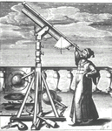
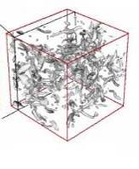

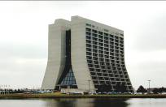
Science Paradigms (Gray 2007)
Thousand years ago:
science was empirical
  describing natural phenomena
Last few hundred years:
theoretical branch
  using models, generalizations
Last few decades:
a computational branch
  simulating complex phenomena
Today:
data exploration (eScience)
  unify theory, experiment, and simulation
  Data captured by instruments
  Or generated by simulator
  Processed by software
  Information/Knowledge stored in computer
  Scientist analyzes database / files
  using data management and statistics
Notes:
4

Slide 5
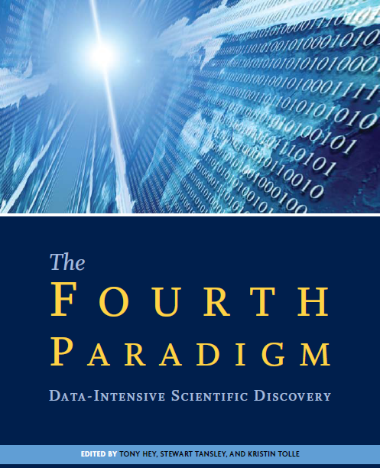
Earth and environment
Health and wellbeing
Scientific infrastructure
Scholarly communication
2009
Notes:
5

Slide 6
Earth and environment
Data-centric computing
Environmental applications
Redefining ecological science
Ocean science
Astronomy
Sensor networks
2009
Notes:
6

Slide 7
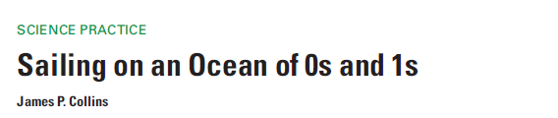
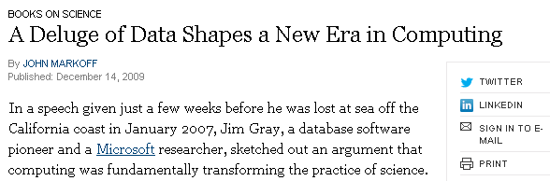
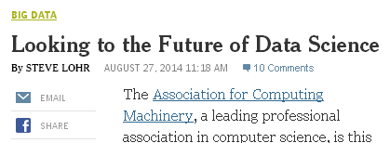
Big data tidal wave?
Nature
Science Magazine
New York Times
Notes:
7

Slide 8







5-year $37.8 million
Notes:
8

Slide 9
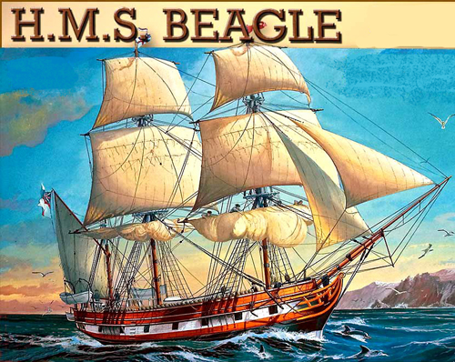
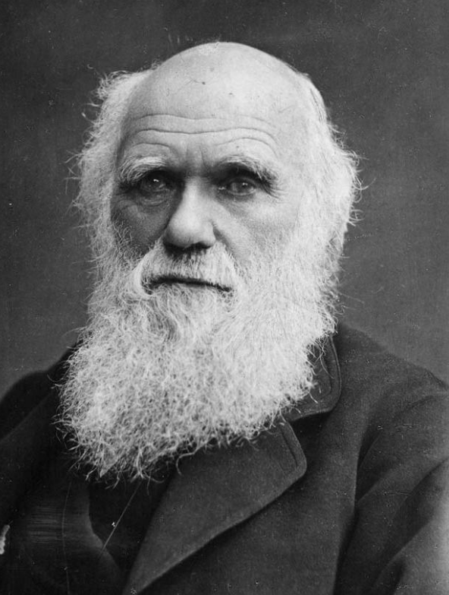
Charles Darwin
http://verhaallijnen.nl/weblog/2013/05/10/elke-dag-op-ontdekkingsreis/
Travels by sea and land:
Substitution of space for time on a grand scale
http://greatmindsoftheworld.com/charles-darwin/
Notes:
9

Slide 10
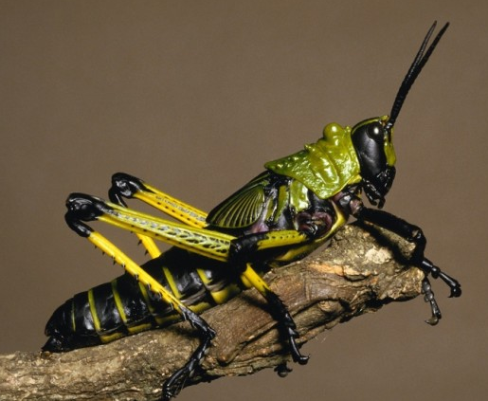
H.B. Noel Hynes
"we spent time putting arrows on maps for each month of the year, showing where we had been informed that migrating red, or mature yellow, locusts had been observed. These were the fruit of hundreds of enquiries we had made of locals as we travelled about.”
"we had accomplished a great deal. The role of the country in the pattern of seasonal locust movement was now understood, we had located the only breeding area and started up an effective control organisation in a region” (Hynes 2001)
Notes:
10

Slide 11
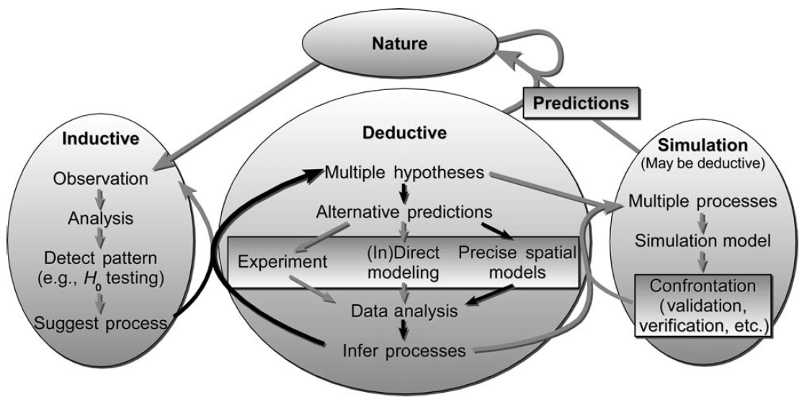
Beyond description: Inferring processes from spatial patterns
(McIntire and Fajardo 2009)
Notes:
11

Slide 12
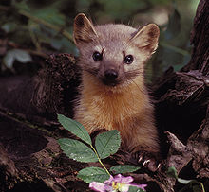
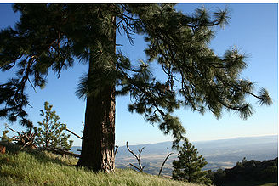
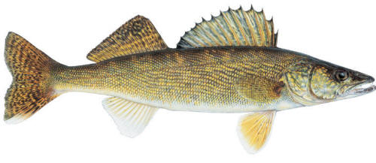
Using space (or time) as a surrogate for unmeasured processes
A merging of three components:
Precise implementation of ecological theory and/or knowledge,
A priori inference, and
Precise application of spatial analytical tools.
(McIntire and Fajardo 2009)
http://en.wikipedia.org/
http://www.ontariofishspecies.com
Notes:
12

Slide 13
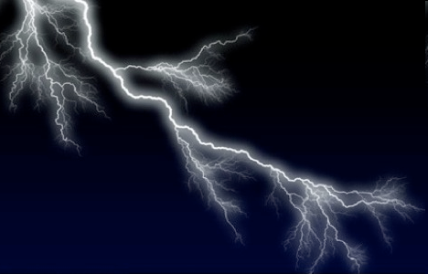
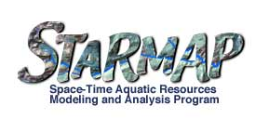
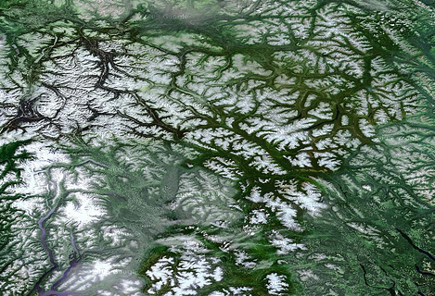
Networks unleashed…
Fisher (1997). Creativity, idea generation, and the functional morphology of streams. JNABS.
FLoWS GIS Toolbox
Ver Hoef et al. (2006); Peterson and Ver Hoef (2010); Ver Hoef and Peterson (2010)

Slide 14

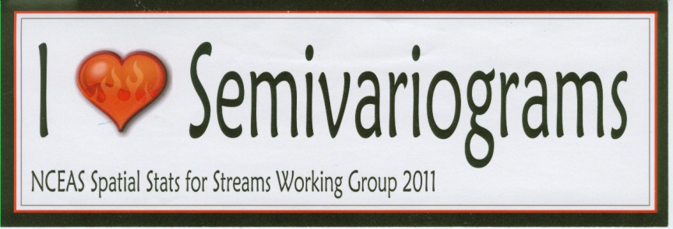
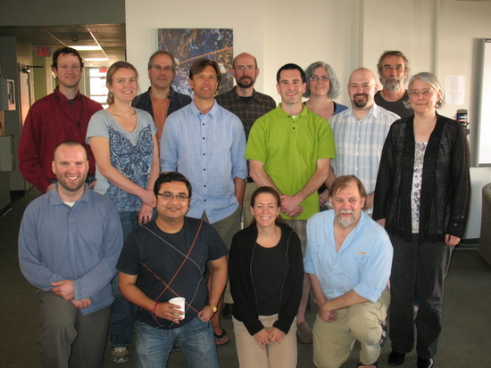
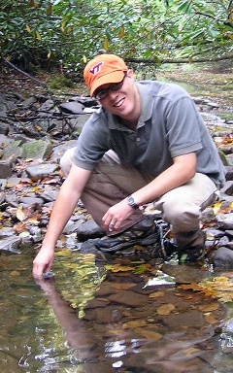
Spatial statistical models for stream networks: Synthesis and new directions
Kevin McGuire

Slide 15
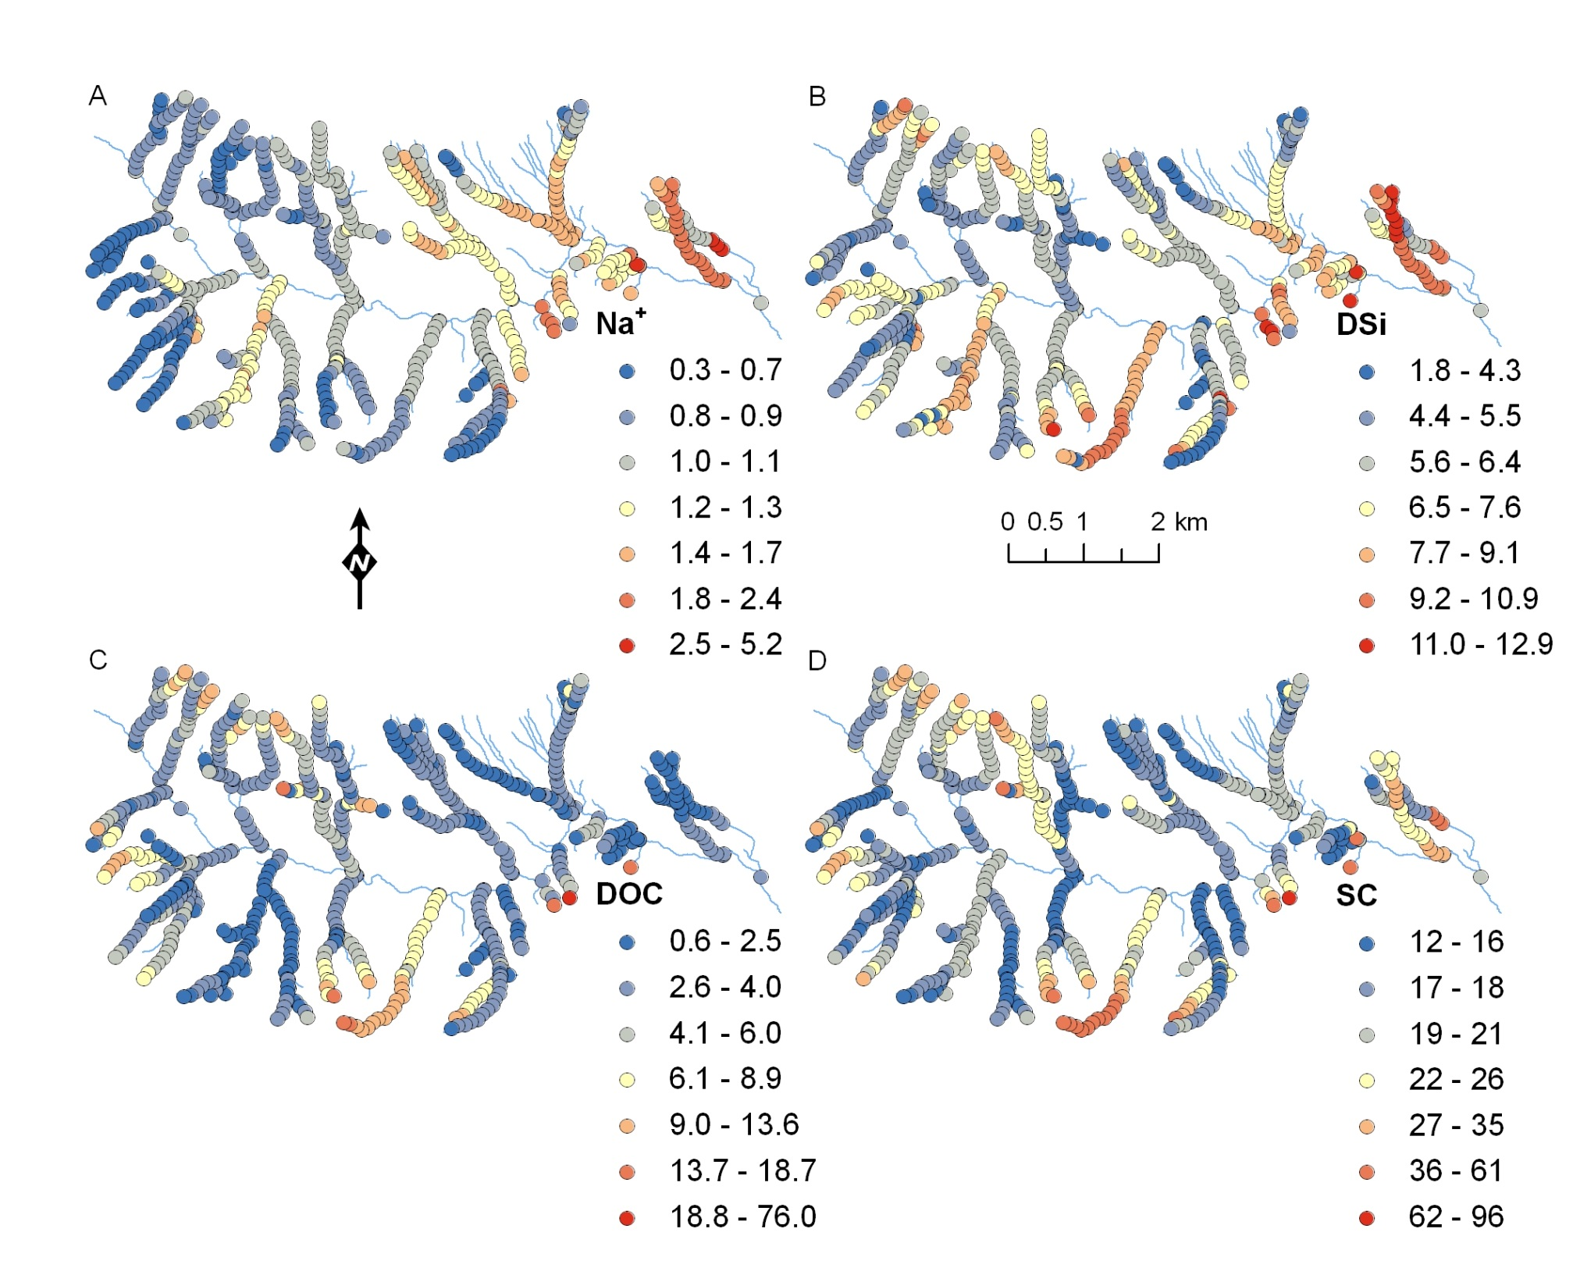
(McGuire et al. 2014)
Notes:
15

Slide 16
Distance, connectedness, and flow direction
Euclidean vs. instream distance
?
(Torgersen et al. 2004)

Slide 17
Distance, connectedness, and flow direction
Euclidean vs. instream distance
?
(Torgersen et al. 2004)

Slide 18
‘Torgegrams’ based on
Flow- connected vs. “flow-unconnected” distance
?
(Peterson et al. 2013, Isaak et al. 2014)
SSN: An R Package for Spatial Statistical Modeling on Stream Networks

Slide 19
‘Torgegrams’ based on
Flow- connected vs. “flow-unconnected” distance
?
(Peterson et al. 2013, Isaak et al. 2014)
SSN: An R Package for Spatial Statistical Modeling on Stream Networks

Slide 20
Anatomy of the semivariogram
Sill
Semivariance
Slope
Nugget
Range
Separation distance
“Half the average squared difference between points separated by a given distance.” (Palmer 2002)

Slide 21
Variograms and spatial patterns
Random, homogeneous
Large-scale, continuous gradient
Small-scale
patchiness
Nested heterogeneity
(Ettema and Wardle 2002)

Slide 22
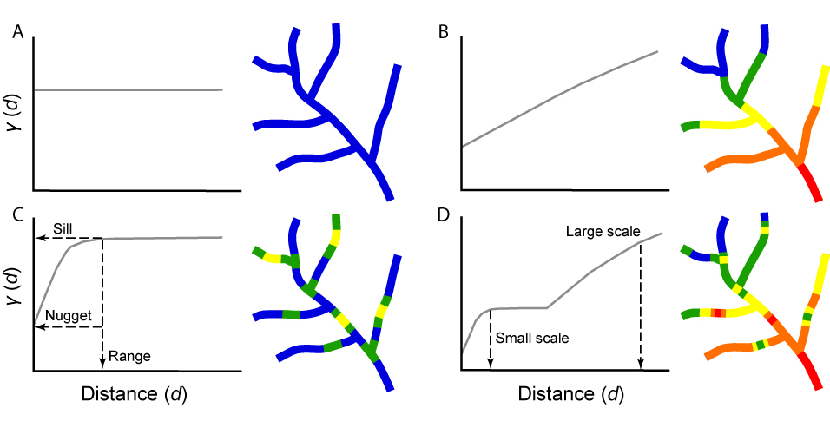
Variograms and spatial patterns in stream networks
(McGuire et al. 2014)
Notes:
22

Slide 23
(McGuire et al. 2014)
Notes:
23

Slide 24
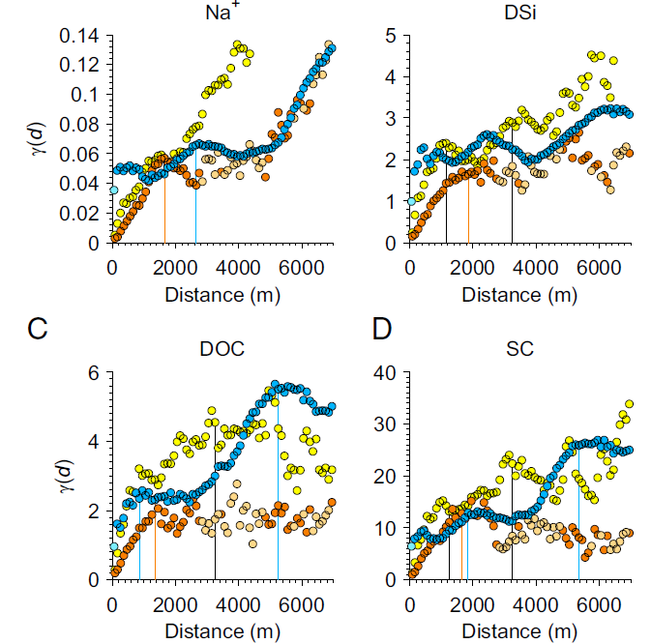
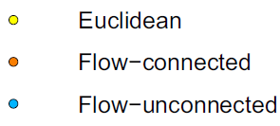
(McGuire et al. 2014)
Notes:
24

Slide 25
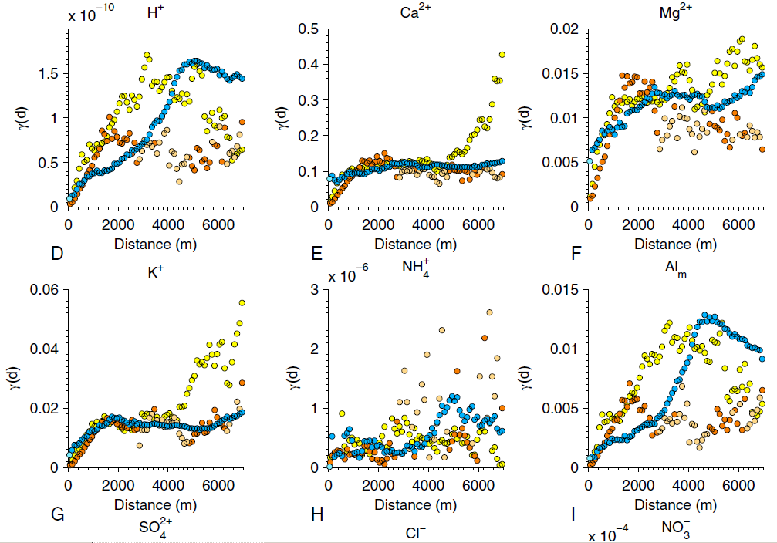
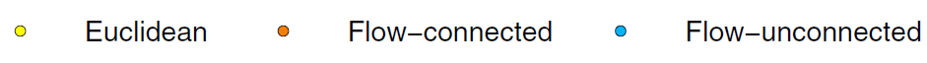
Notes:
25

Slide 26
The stream and its valley
Precipitation
Vegetation
Network flow/connectivity
Geology/soils

Slide 27
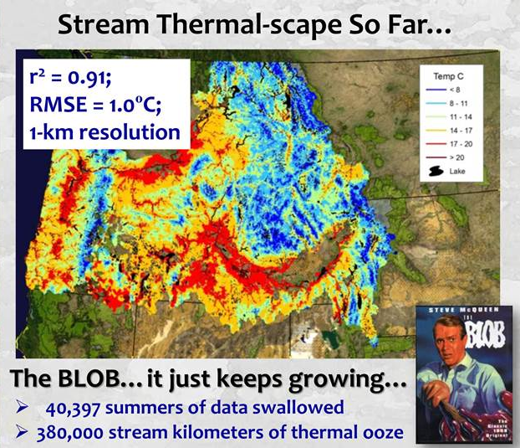
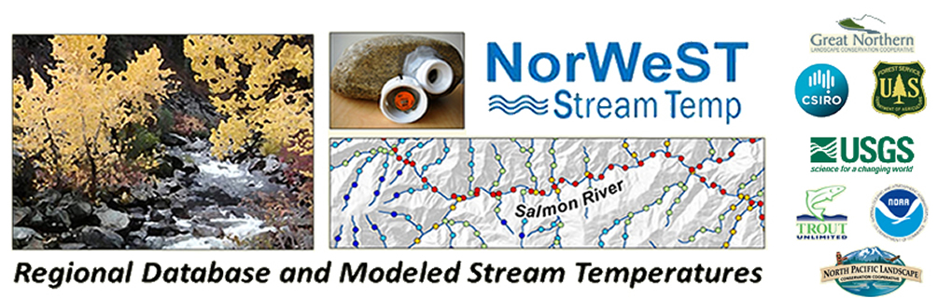
Modeling and simulation
Modeling and simulation through space
(Dan Isaak and others)
Notes:
27

Slide 28
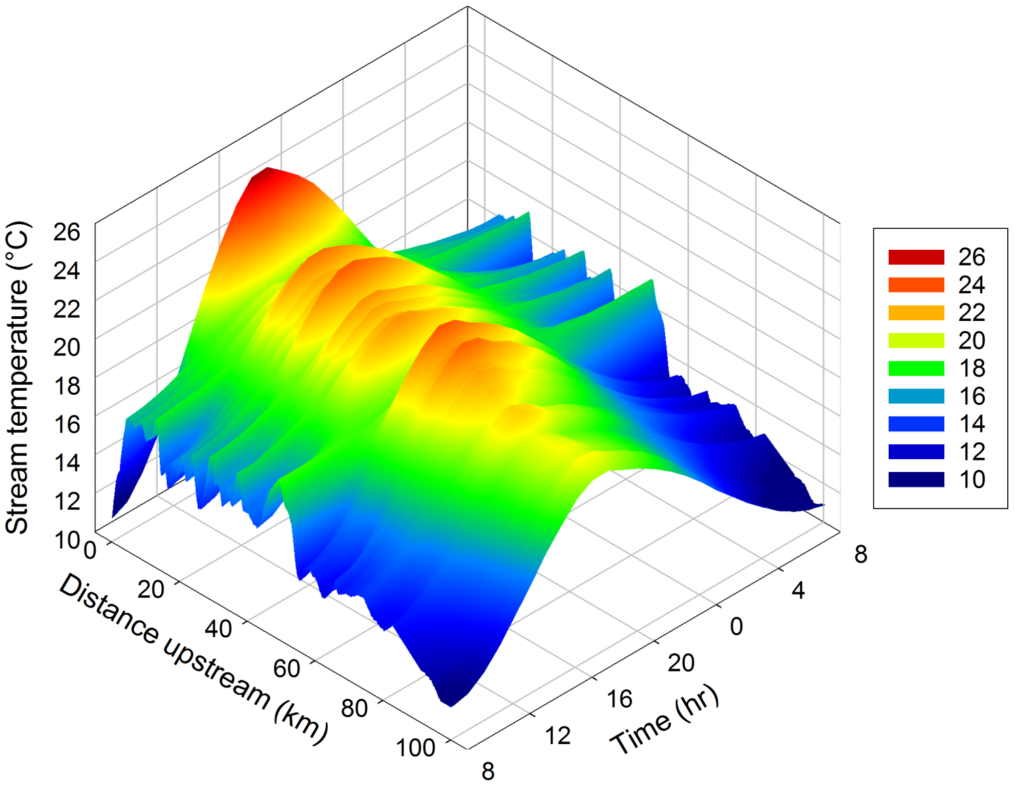
Modeling and simulation through space and time
(Vatland et al., accepted with revisions)
Notes:
28

Slide 29
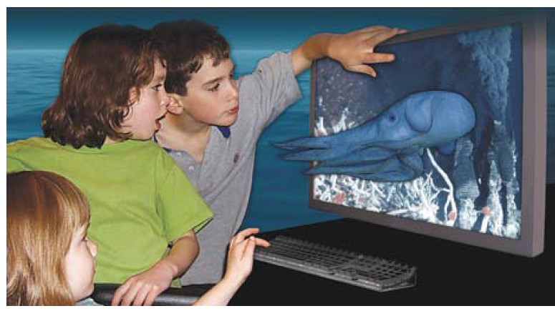
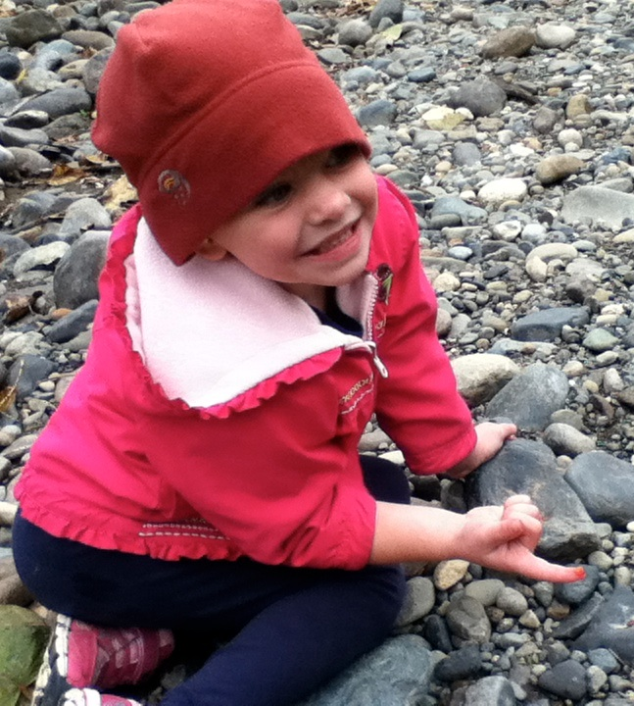
Data-driven discovery for future generations
http://research.microsoft.com/en-us/collaboration/fourthparadigm/
“I’m a scientist inside, Dad. All children are scientists inside.”
Notes:
29

Slide 30
Big challenges for “big” data in riverine science
(1) Retraining of the “scientist inside”
Notes:
30

Slide 31
Big challenges for “big” data in riverine science
(1) Retraining of the “scientist inside”
(2) Complementary use of all four science paradigms (sensu Jim Gray):
Empirical
Theoretical
Modeling and simulation
Data-intensive discovery
Notes:
31

Slide 32
Big challenges for “big” data in riverine science
(1) Retraining of the “scientist inside”
(2) Complementary use of all four science paradigms (sensu Jim Gray):
Empirical
Theoretical
Modeling and simulation
Data-intensive discovery
(3) Internalizing and refining the approach of using “space and/or time as a surrogate for unmeasured processes”
Notes:
32

Slide 33
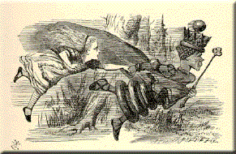
“Now, here, you see, it takes all the running you can do to, to keep in the same place. If you want to get somewhere else, you must run at least twice as fast as that!”
L. Carroll, Through the Looking-Glass

Slide 34
Acknowledgments
"I said that much of what I was being rewarded for was work done by my associates, and I also pointed out that much of what we had published had been shown to be not quite right. I developed the theme that that is how science is supposed to work…” (Hynes 2001)
Notes:
34

Slide 35
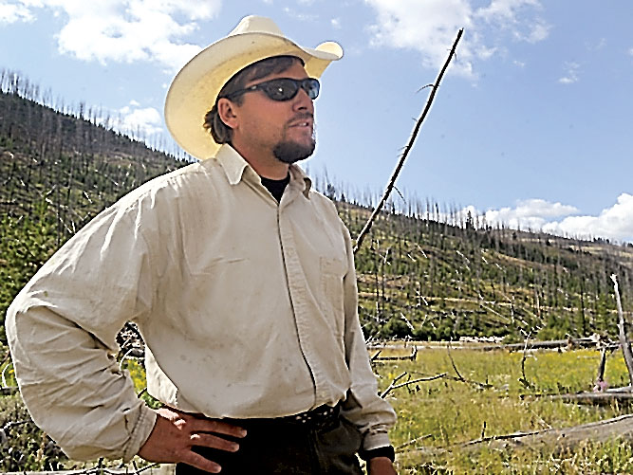
Colden Baxter (Idaho State Univ.)
http://www.idahostatejournal.com/
Notes:
35

Slide 36

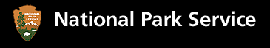






U.S. Geological Survey
Notes:
36

