Slide 1
Exciting Quantized Vortex Rings
in a Superfluid Unitary Fermi Gas
Aurel Bulgac
University of Washington
Collaborators: Michael M. Forbes (Seattle, now Washington State U-Pullman)
Yuan-Lung (Alan) Luo (Seattle)
Michelle M. Kelley (Urban-Champaign)
Piotr Magierski (Warsaw/Seattle)
Kenneth J. Roche (PNNL/Seattle)
Yongle Yu (Wuhan, PRC)
Gabriel Wlazlowski (Warsaw/Seattle)
Funding: DOE, NSF
Computing:
Athena UW Cluster Hyak UW cluster,
Jaguar Titan, NCCS
Original pptx slides with movies, a related talk given by M.M. Forbes and other related
materials can be downloaded at
http://www.phys.washington.edu/users/bulgac/media_files/VR/

Slide 2
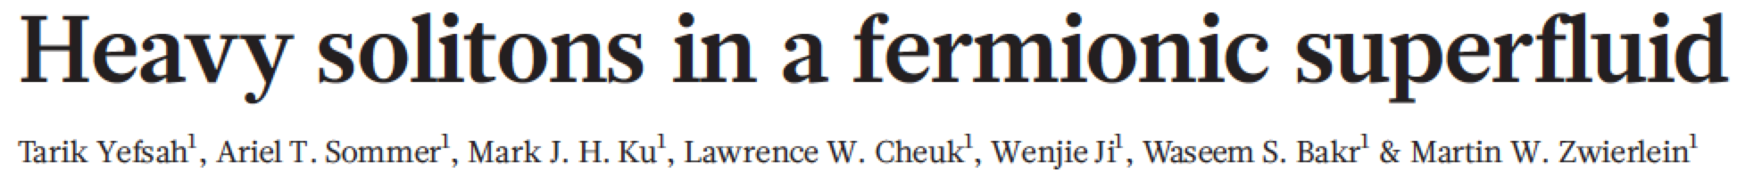
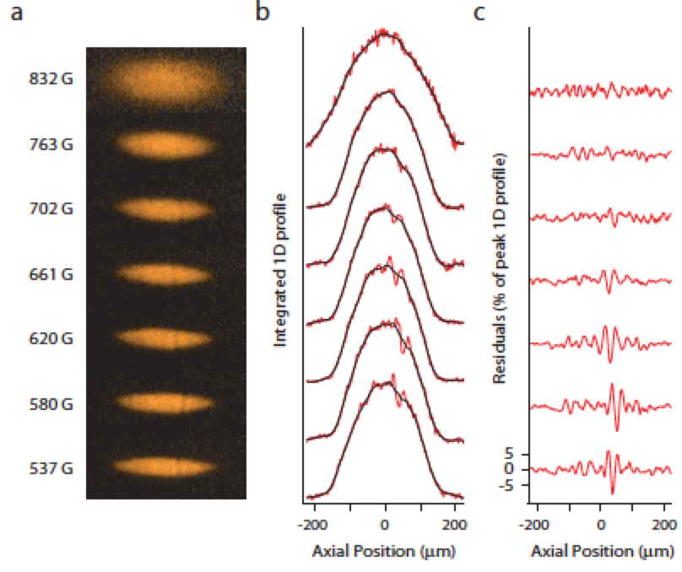
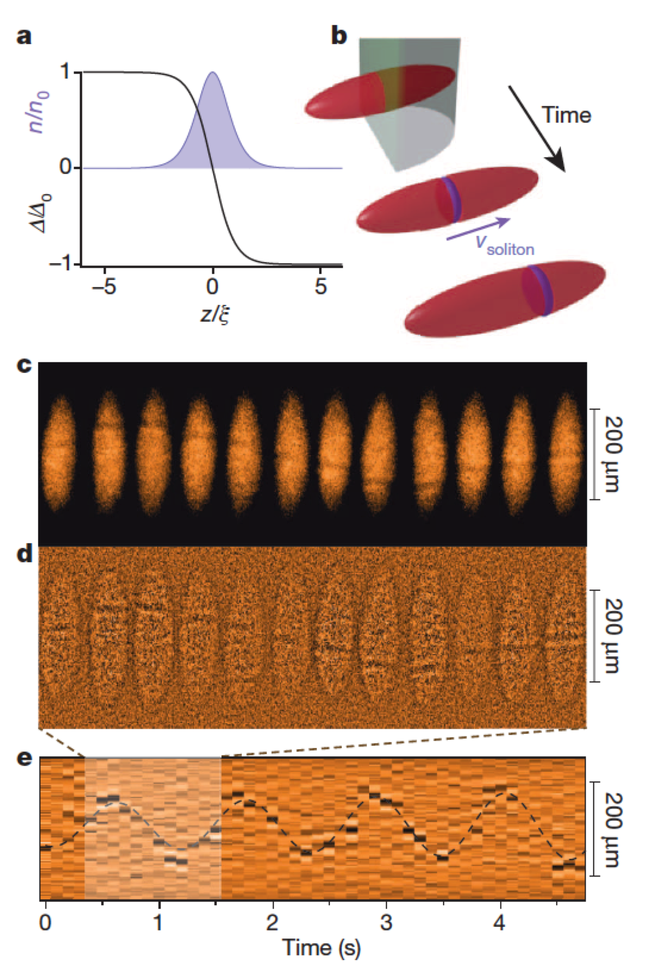
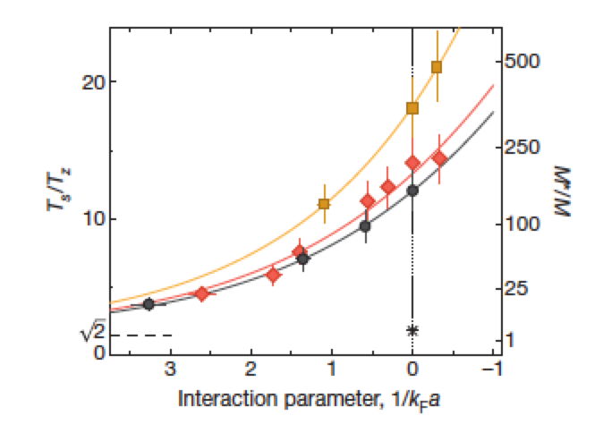
The Challenge put forward by experiement
Axially symmetric trap!
The observed ‘’heavy solitons”
are about ten times wider than
a vortex core or domain wall
(dark soliton)
The ‘’heavy solitons” move about
ten times slower than a domain
wall (dark soliton)

Slide 3
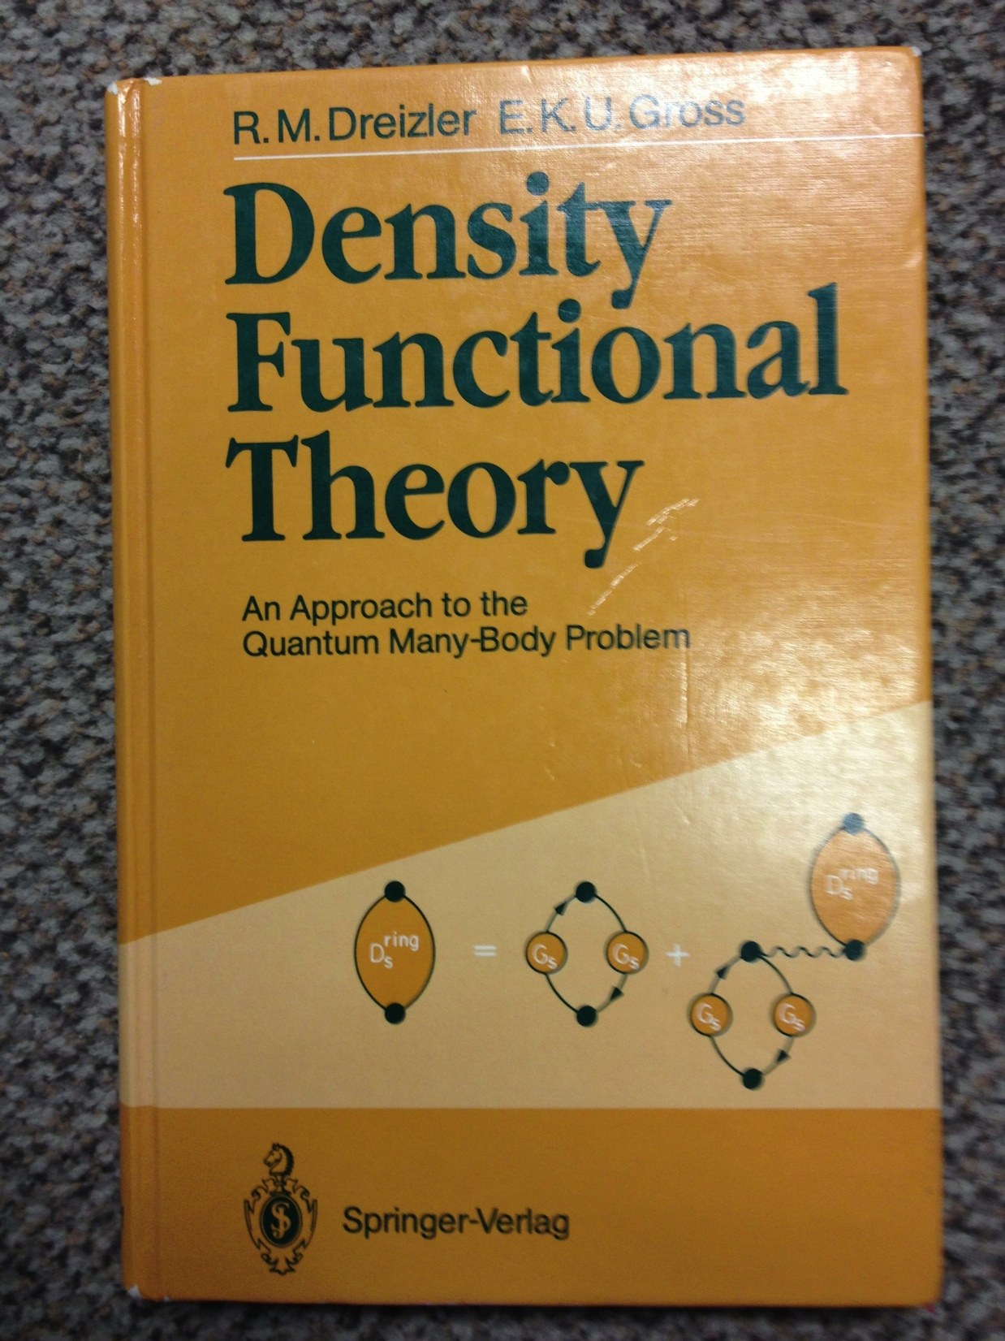
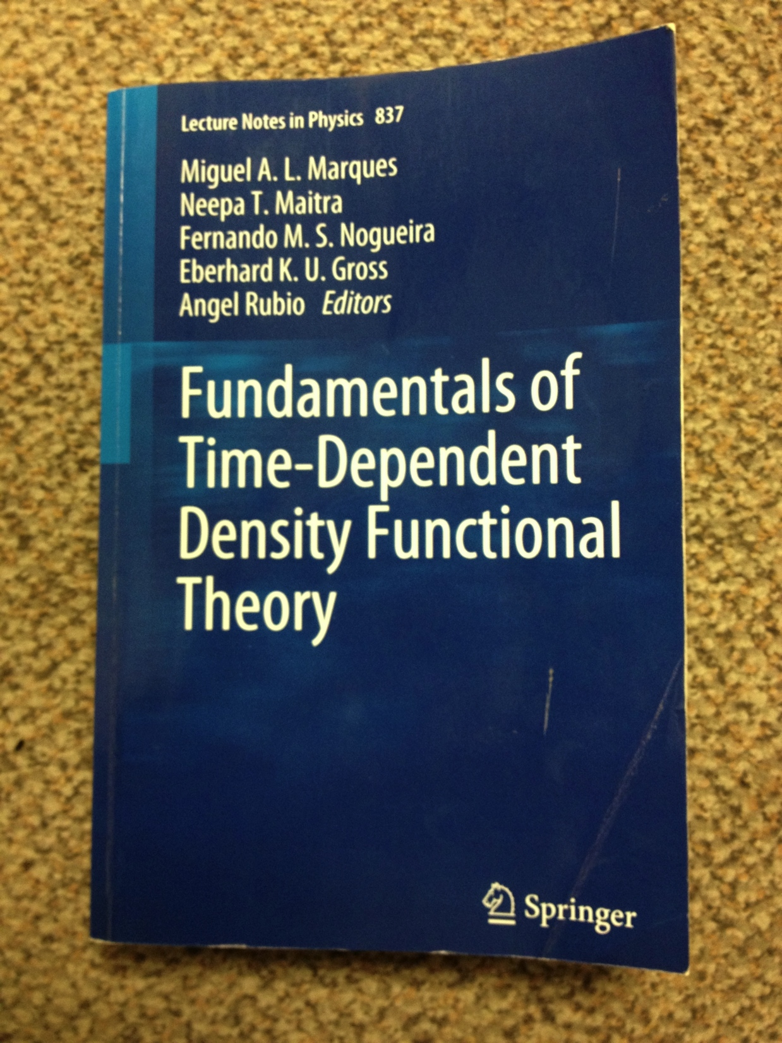
Main Theoretical Tool
2012
1990
DFT has been developed and used mainly to describe normal (non-superfluid) electron
systems
A new local extension of DFT to superfluid systems and time-dependent phenomena was developed
Review: A. Bulgac, Time-Dependent Density Functional Theory and Real-Time Dynamics of Fermi Superfluids, Ann. Rev. Nucl. Part. Sci. 63, 97 (2013)

Slide 4
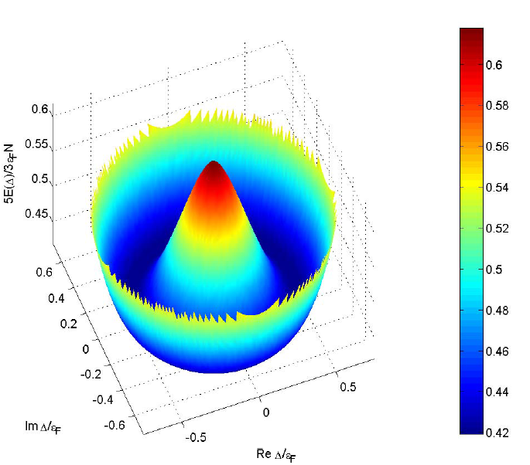
Energy of a Fermi system as a function of the pairing gap
Landau’s hydrodynamics
No Planck’s constant!
Ginzburg-Landau-like equation

Slide 5
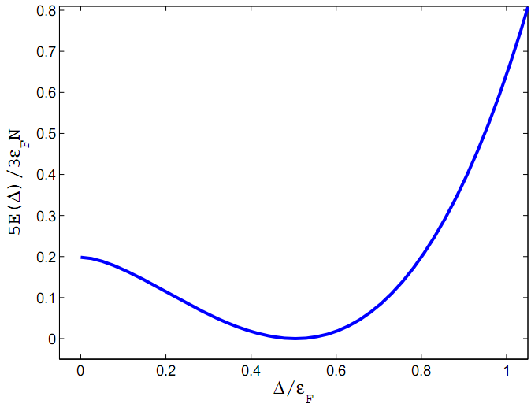
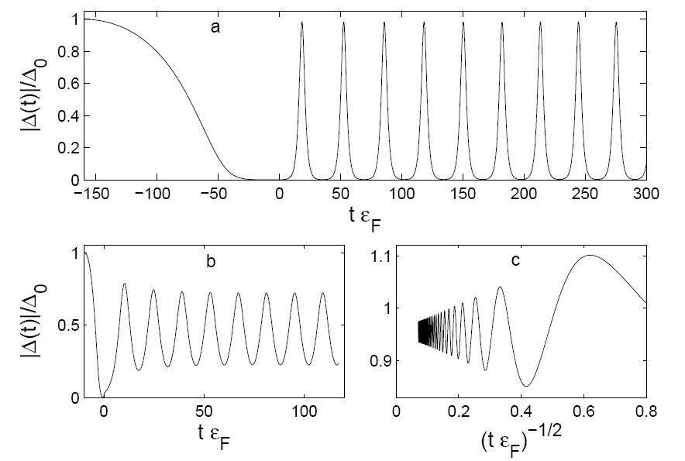
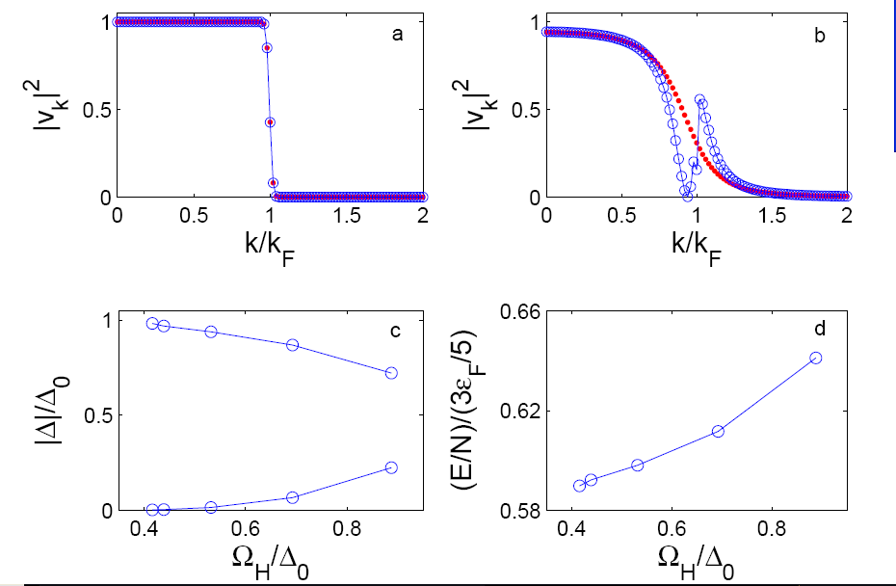
Response of a unitary Fermi system to changing
the scattering length with time
All these modes have a very low frequency below the pairing gap,
a very large amplitude and very large excitation energy, and no spatial dependence
None of these modes can be described either within two-fluid hydrodynamics
or Ginzburg-Landau like approaches
Bulgac and Yoon, Phys. Rev. Lett. 102, 085302 (2009)

Slide 6
What is Density Functional Theory?
Kohn-Sham theorem (1965)
Injective map
(one-to-one)
Universal functional of particle density alone
Independent of external potential
Normal Fermi systems only!
However, not everyone is normal!

Slide 7
The SLDA (DFT) energy density functional at unitarity
for equal numbers of spin-up and spin-down fermions
Dimensional arguments, renormalizability, Galilean invariance, and
symmetries (translational, rotational, gauge, parity) determine the functional (energy density)
Three dimensionless constants α, β, and γ (which enters in the definition of the pairing gap)
determining the functional are extracted from QMC for homogeneous systems by fixing the
total energy, the pairing gap and the effective mass
SLDA has been verified and validated against a large number of quantum Monte Carlo
results for inhomogeneous systems and experimental data as well

Slide 8
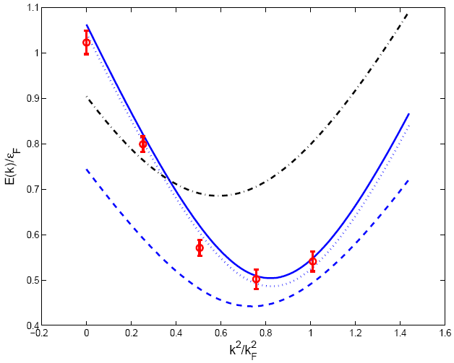
Quasiparticle spectrum in homogeneous matter
solid/dotted blue line - SLDA based on homogeneous GFMC due to Carlson et al
red circles - GFMC due to Carlson and Reddy
dashed blue line - SLDA, homogeneous MC due to Juillet
black dashed-dotted line – meanfield at unitarity
Bulgac, PRA 76, 040502(R) (2007)

Slide 9
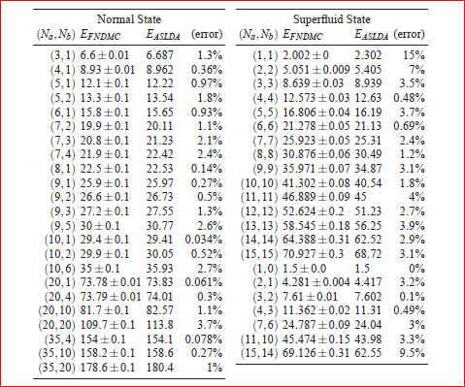
SLDA predictions vs Quantum Monte Carlo results for finite systems in traps
Bulgac, Forbes, and Magierski, Lecture Notes in Physics (2012)

Slide 10
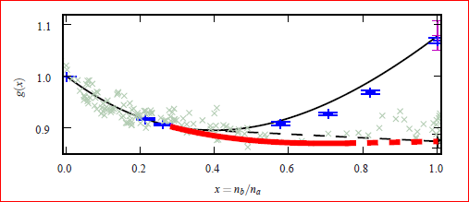
EOS for spin polarized systems
Red line: Larkin-Ovchinnikov phase (unitary Fermi supersolid)
Black line: normal part of the energy density
Blue points: DMC calculations for normal state, Lobo et al, PRL 97, 200403 (2006)
Gray crosses: experimental EOS due to Shin, Phys. Rev. A 77, 041603(R) (2008)
Bulgac and Forbes,
Phys. Rev. Lett. 101, 215301 (2008)

Slide 11
Formalism for Time-Dependent Phenomena
“The time-dependent density functional theory is viewed in general as a reformulation of the exact quantum mechanical time evolution of a many-body system when only one-body properties are considered.” http://www.tddft.org
A.K. Rajagopal and J. Callaway, Phys. Rev. B 7, 1912 (1973)
V. Peuckert, J. Phys. C 11, 4945 (1978)
E. Runge and E.K.U. Gross, Phys. Rev. Lett. 52, 997 (1984)
For time-dependent phenomena one has to add currents.
Galilean invariance determines the dependence of the functional on currents.
For spin excitations one needs to introduce spin densities and currents.

Slide 12
TDSLDA equations in full glory
Basic Numerical and Computational Details
The system is placed on a large 3D spatial lattice, Discrete Variable Representation of wave functions (this insures both UV and IR cutoff exponential convergence)
Derivatives are computed with FFTW/CUFFT (this insures machine accuracy) and is very fast
Fully self-consistent treatment with fundamental symmetries respected (isospin for nuclear systems, gauge, Galilean, rotation, translation, parity)
Adams-Bashforth-Milne 5th order predictor-corrector-modifier integrator (effectively 6th) or operator-split method, with an enhancement to ensure that time-reversal symmetry is satisfied
No symmetry restrictions
Number of non-linear coupled 3D+1T PDEs is of the order of the number of spatial lattice points
– from 10,000s to a fraction of 1,000,000 determined by the dimension of the Hilbert space
Initial state is the ground state of the SLDA (formally like HFB/BdG)
The code was implemented on Jaguar, Titan, Franklin, Hopper, Edison, Hyak, Athena
Initially Fortran 90, 95, 2003 …, presently C, and obviously MPI, pthreads, etc. CUDA using GPUs
Strong scaling down to single qpwf per MPI process; bottleneck – global reduction; advanced use of Lustre for I/O and stop/restart,

Slide 13
Time propagation
Only 2 evaluations (shown in red) of the right-hand side per step

Slide 14
Size of the problem (present):
Spatial lattice size N_{x}N_{y}N_{z} ≈ 32³… 64³
4-component quasiparticle (complex) wave functions
Number of quasiparticle wave functions ≈ N_{x}N_{y}N_{z}/2
Number of bytes per time step to represent qpwfs ≈ 2x10¹²
total memory required (wfs, TD derivatives, potentials, etc.) ≈ 50x10¹²
Number of time-steps ≈ O(10⁶)
This is one of the largest Direct Numerical Simulation problems ever attempted
and requires capability computing
Theoretical peak on 4096 nodes on Titan (maximum number of nodes 18,688):
5.942 Petaflops = 5.366 Petaflops (GPUs) + 0.576 Petaflops (CPUs)
Measured speed-up GPUs (hybrid code) vs CPU (distributed memory): 16.5
261,144 nonlinear coupled 3D+1 PDEs on 64³ spatial lattice, on 4096 nodes on Titan
Why? Hybrid MPI+CUDA. Only I/O and global reductions on CPUs. Better utilization of FP units on GPUs for CUFFT, use of batches, threads, Gemini network fast, partial reduction performed on GPUs, less data transfer between nodes

Slide 15
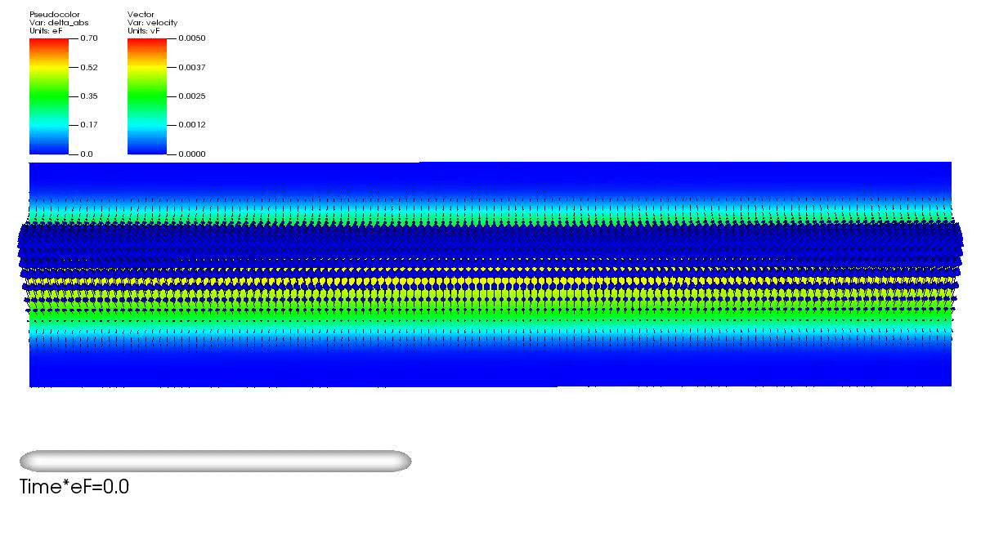
TDSLDA
Construction of ground state (adiabatic switching with quantum friction), generation of a
domain wall using an optical knife, followed by the spontaneous formation of a vortex ring.
Approximately 1270 fermions on a 48x48x128 spatial lattice, ≈ 260,000 complex PDEs,
≈ 309,000 time-steps, 2048 GPUs on Titan, 27.25 hours of wall time (initial code)
A. Bulgac, M.M. Forbes, M.K. Kelley, K.J. Roche, and G. Wlazłowski, Phys. Rev. Lett. 112, 025301 (2014)

Slide 16
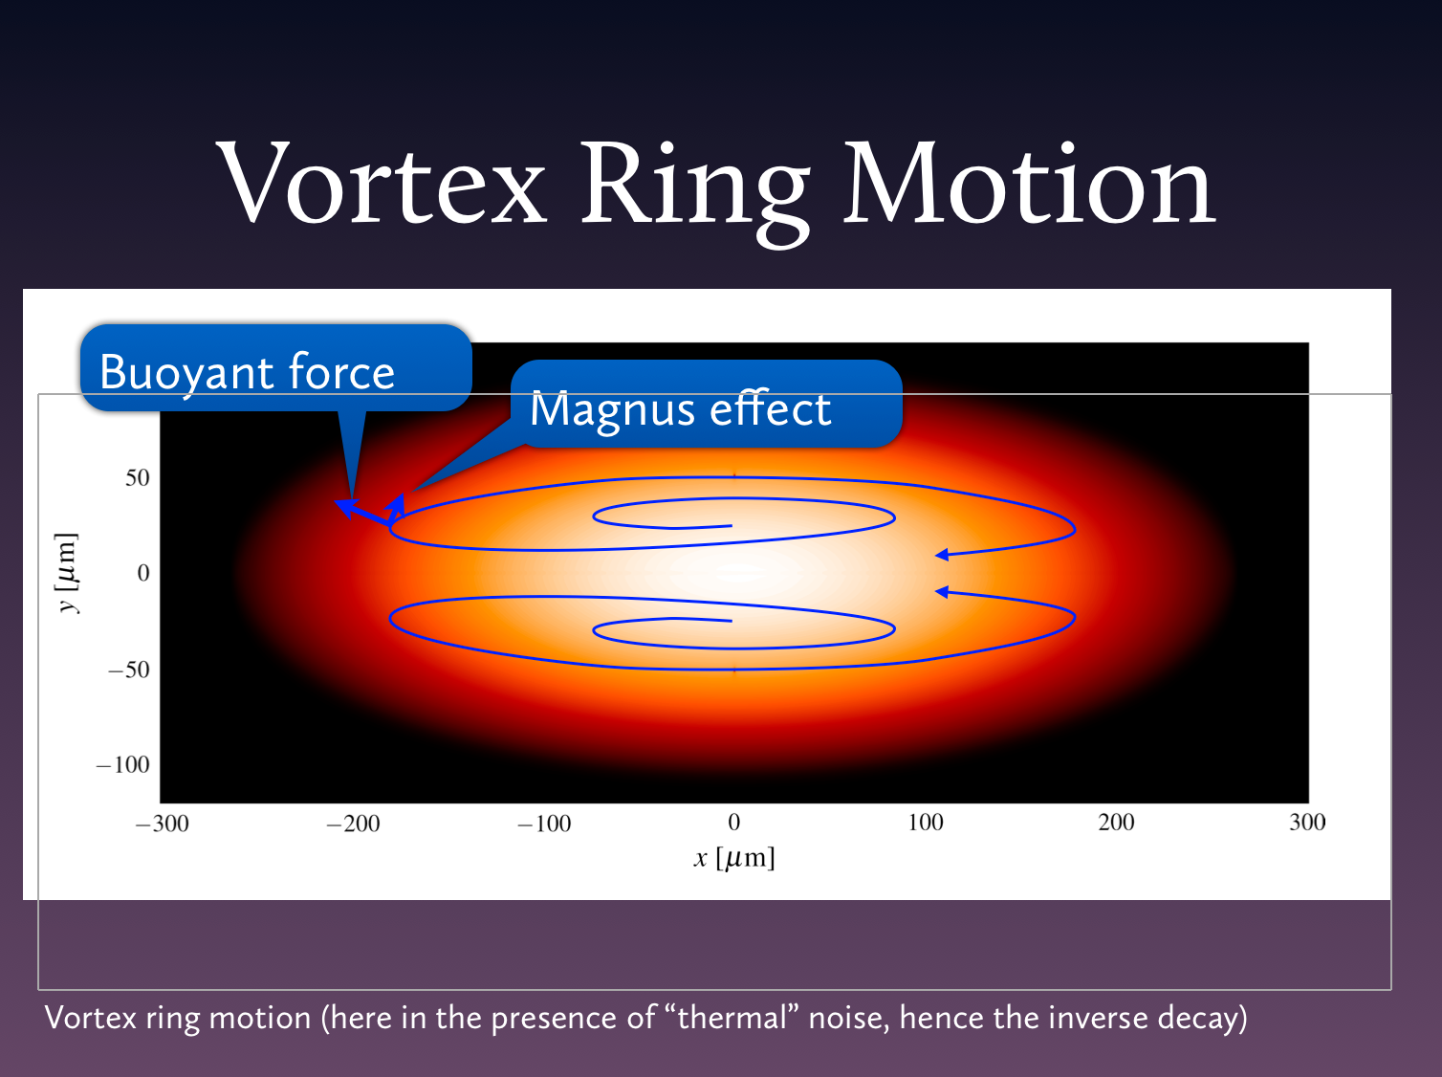

Slide 17
TDSLDA
Very narrow trap
Wider trap

Slide 18
Vortex rings
The bigger the vortex ring is the slower it moves

Slide 19
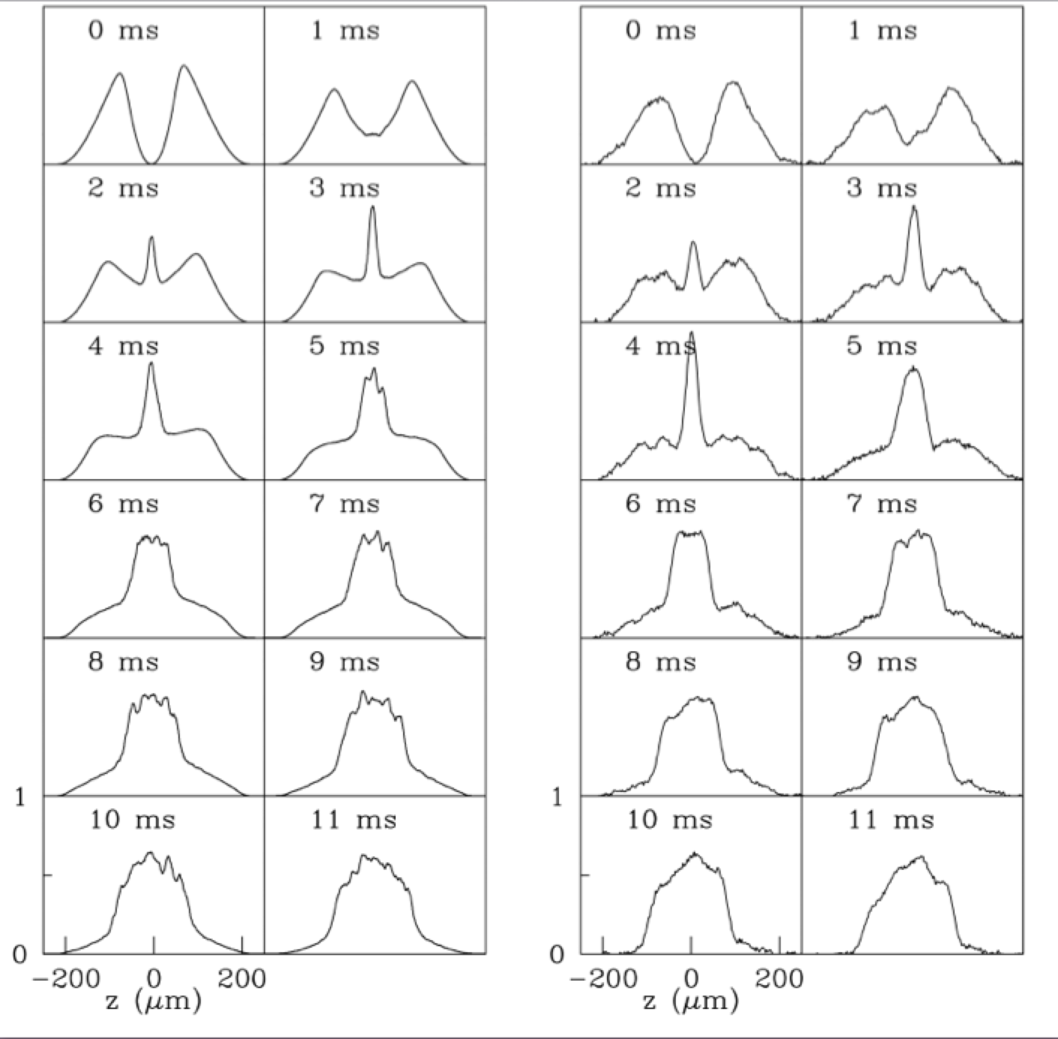
Extended Thomas-Fermi model
(simulate larger systems)
Accurate Equation of State state for a>0,
speed of sound, phonon dispersion, static
Response, respects Galilean invariance
Ambiguous role played by the ‘’wave
function,’’ as it describes at the same
time both the number density and the
order parameter.
Density depletion at vortex/soliton core exaggerated!
Systematically underestimates time scales by a factor of close to 2
Extended TF: Anciloto, Salasnich, and Toigo,
Phys. Rev. 85, 063612 (2012)
Versus
Experiment: Joseph, Thomas, Kulkarni, Abanov
Phys. Rev. Lett. 106, 150401 (2011)

Slide 20
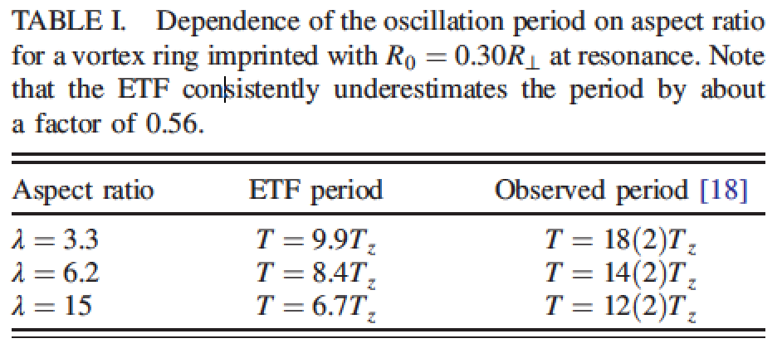
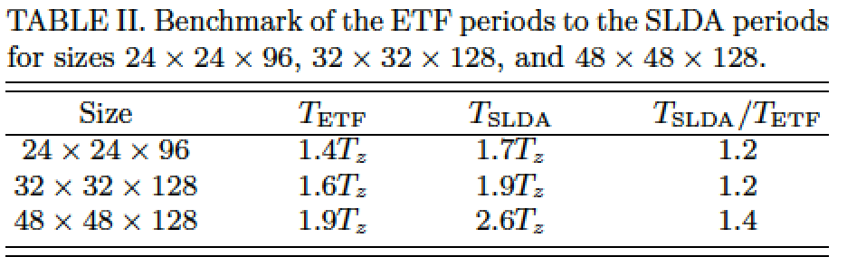
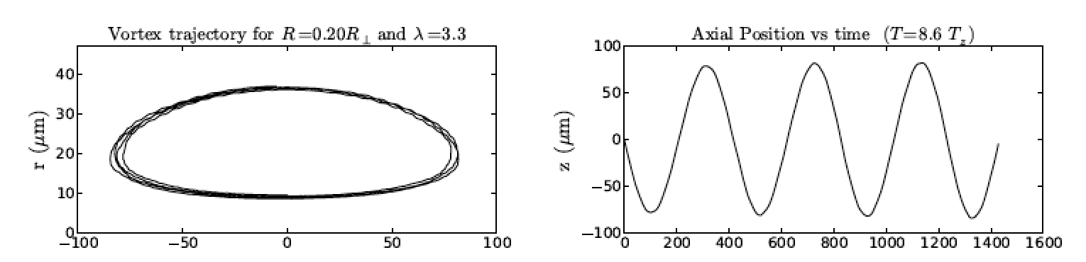

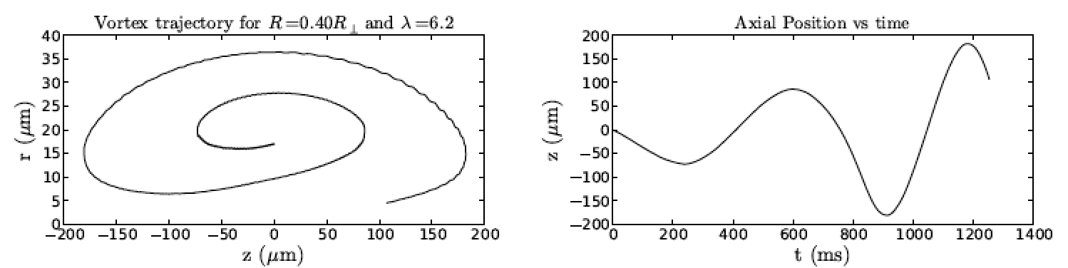
Near harmonic motion close to T=0
(very small number of phonons)
Anti-damping of the motion in the presence
of a considerable number of phonons
TDSLDA (movie)

Slide 21
Imaging the vortex ring in experiment (movie)
Large ring
Small ring
Too large B_{min}

Slide 22
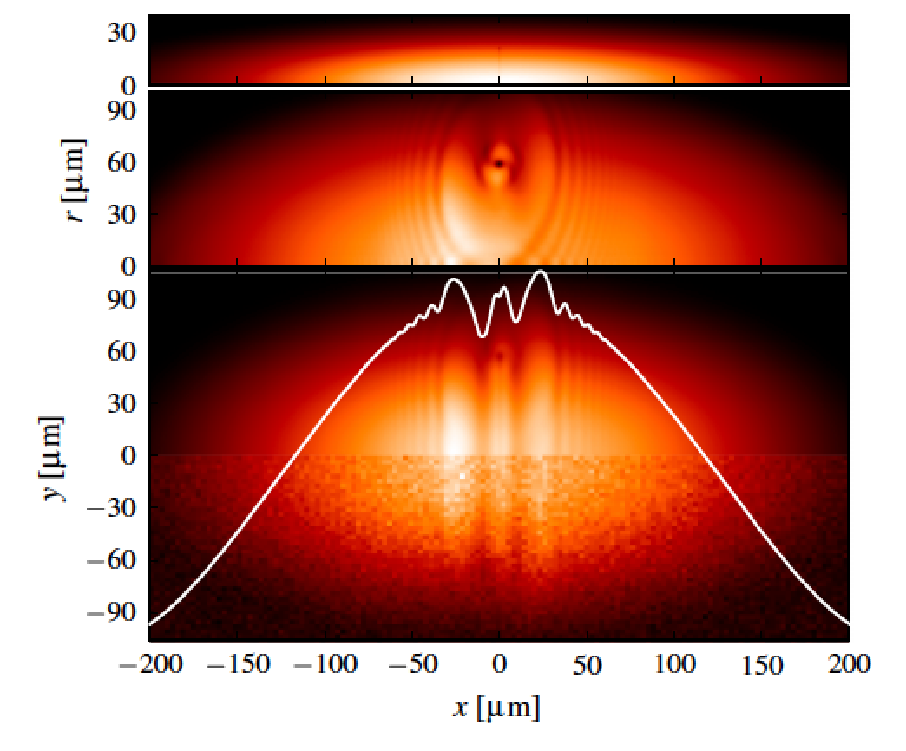
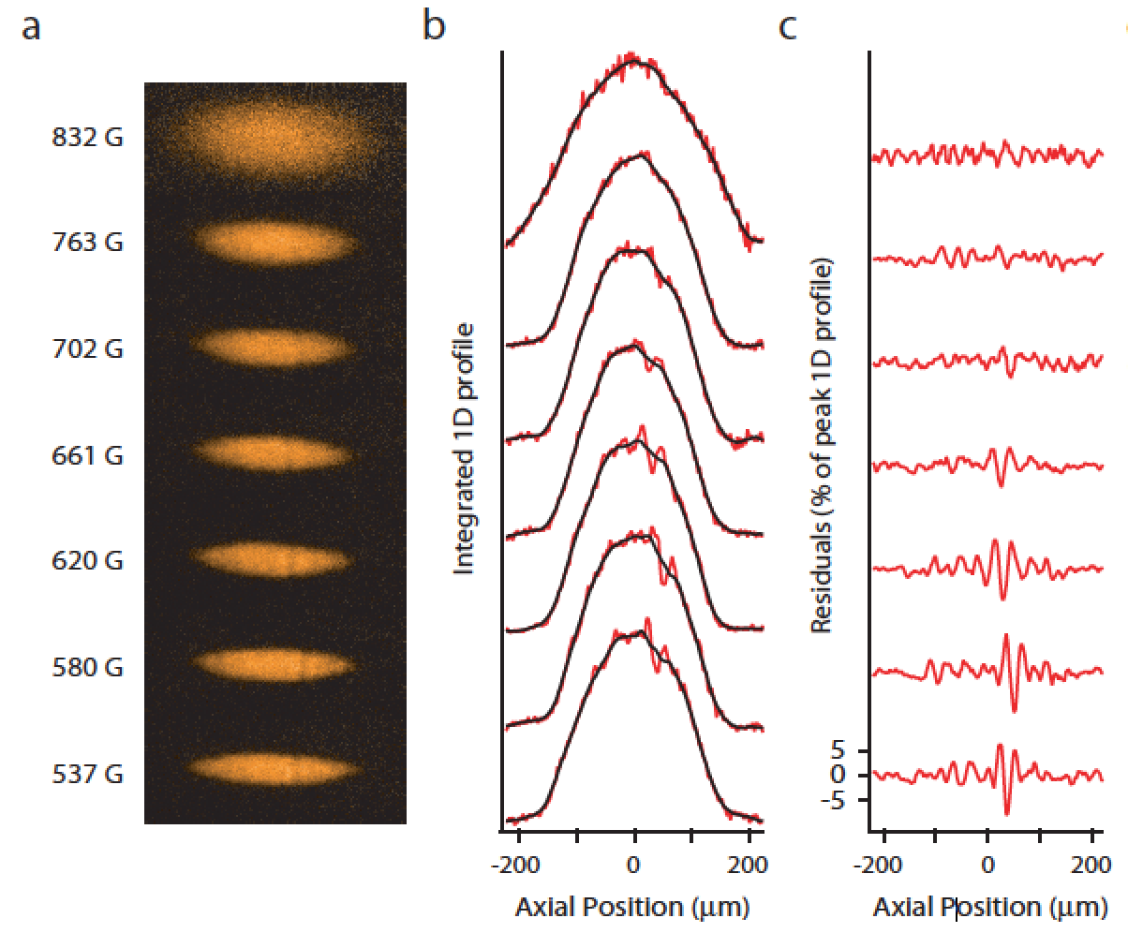
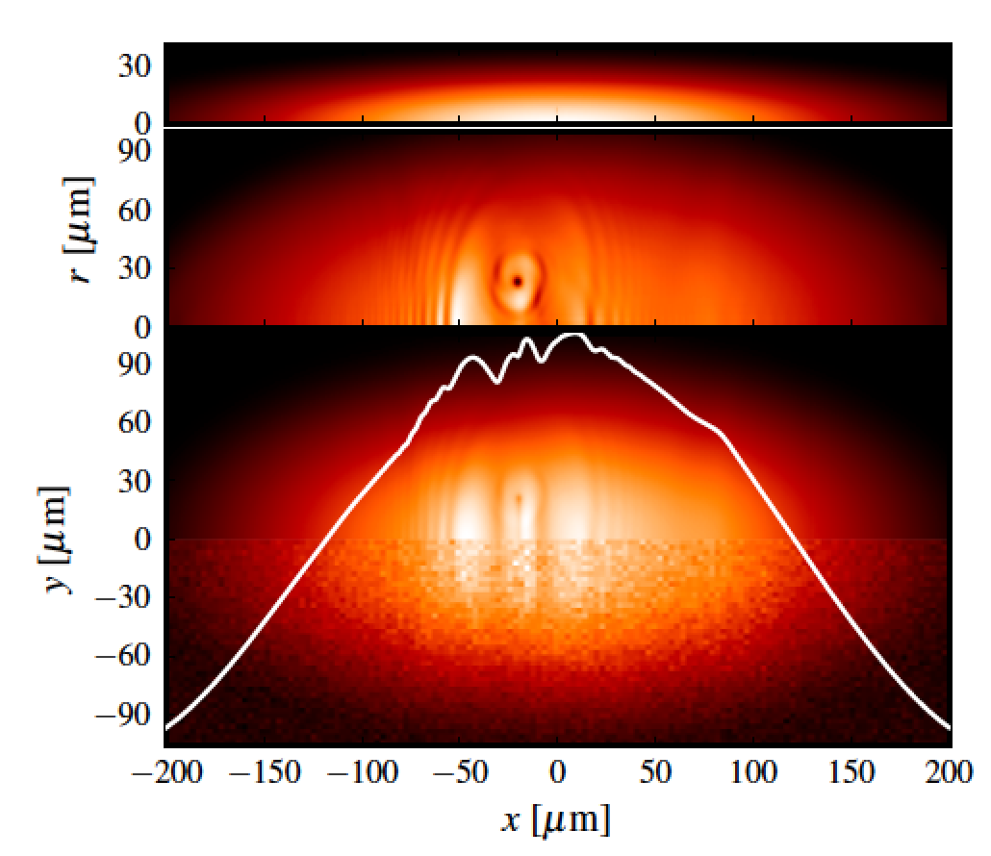
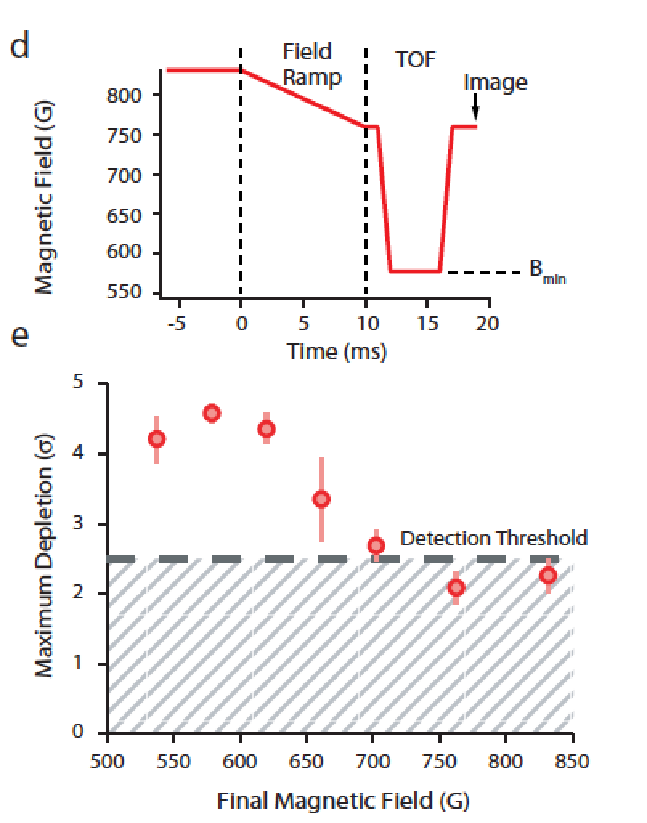
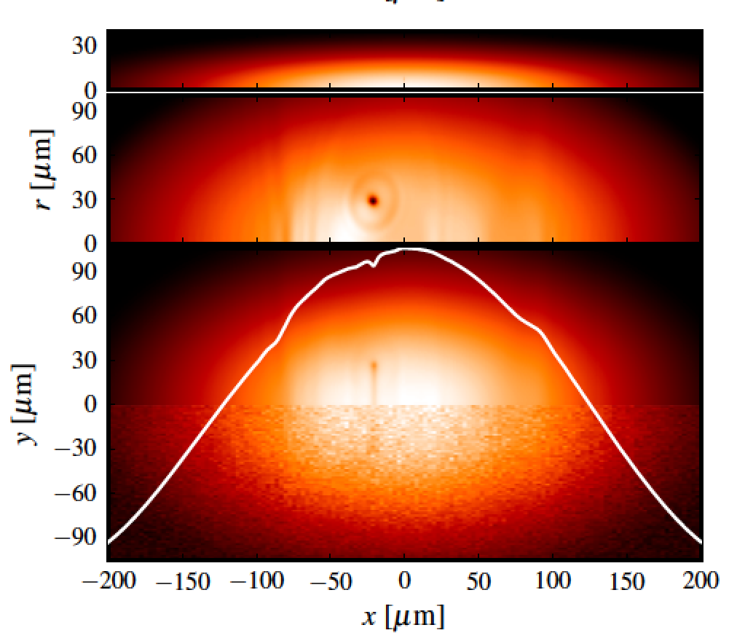
Large ring
Small ring
Insufficient ramping
of magnetic field

Slide 23
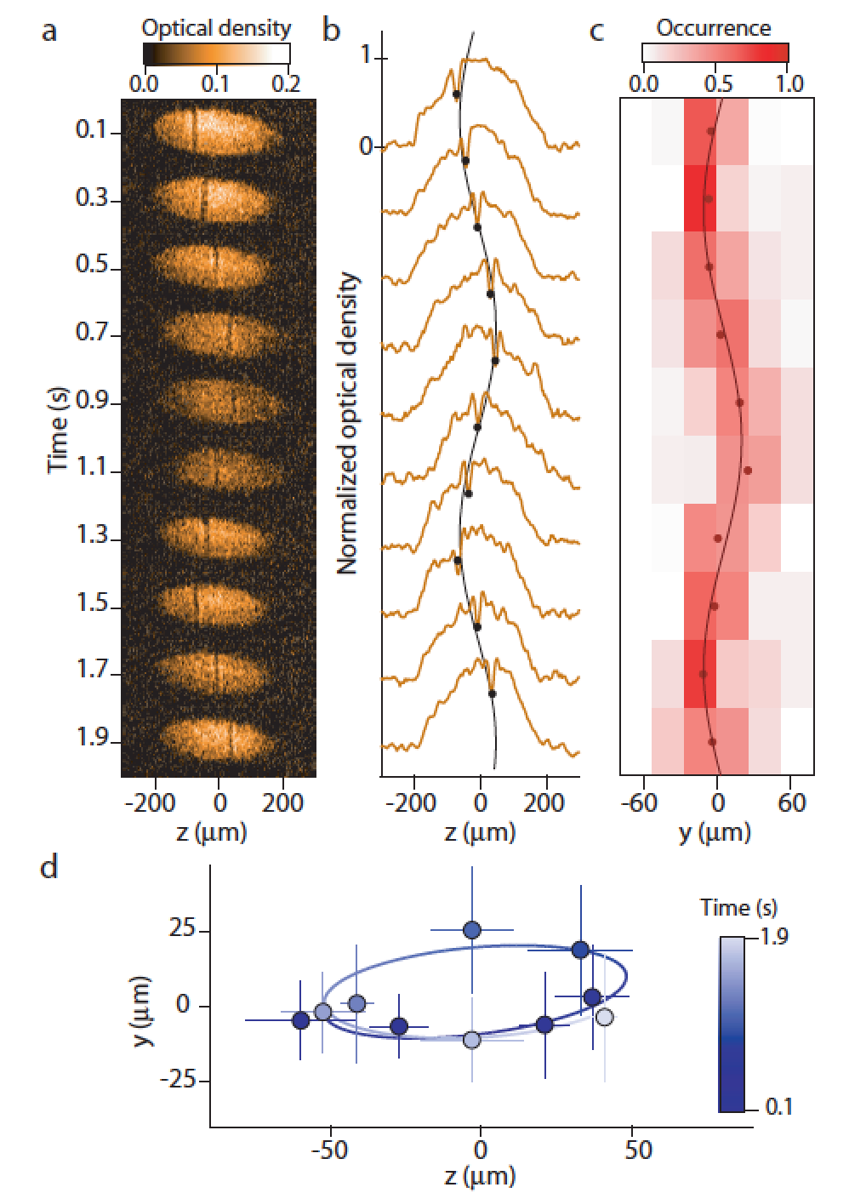
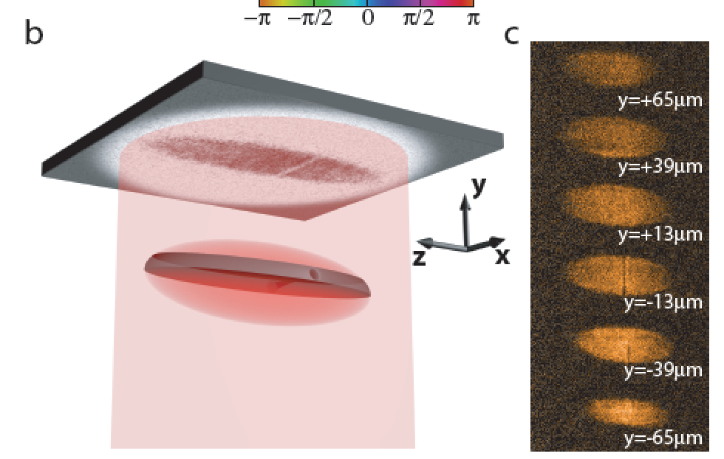
The 2014 MIT experiment:
Motion of a Solitonic Vortex in the BEC-BCS Crosover
Ku, Ji, Mukherjee, Guardado-Sanchez, Cheuk, Yefsah, Zwierlein
arXiv:1402.7052, 2/26/2014
In this case the trap is triaxial, the long and medium
axes horizontal
The excitation in this case has the width of a vortex line
(it is not wide as it was in the previous experiment,
different imaging procedure) and it is a horizontal vortex
aligned with the medium axis
The period is again much larger than that of a domain wall
Motion is again almost harmonic and the trajectory is
very similar to that of the vortex ring

Slide 24
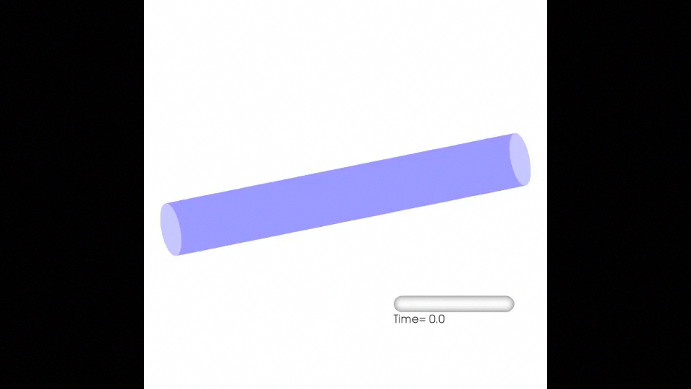
Geometry is essential! Here vortices are excited when axial symmetry is present
(as in the 2013 MIT experiment)
See online supplemental material to Bulgac, Luo, Magierski, Roche, and Yu,
Science, 332, 1288 (2011)
http://www.phys.washington.edu/groups/qmbnt/UFG/
Movie

Slide 25
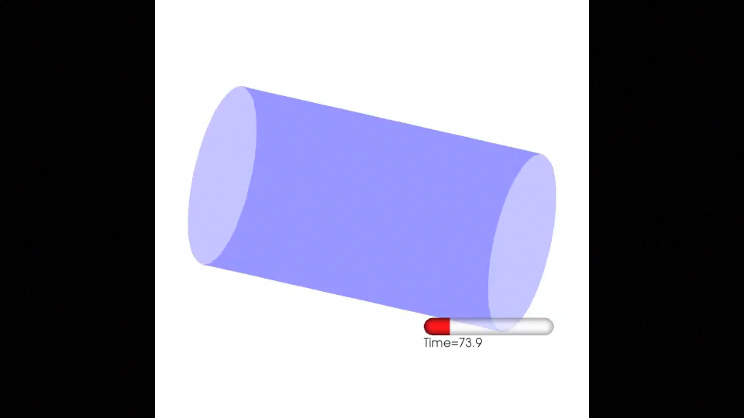
Here axial symmetry is slightly broken!
See online supplemental material to Bulgac, Luo, Magierski, Roche, and Yu,
Science, 332, 1288 (2011)
http://www.phys.washington.edu/groups/qmbnt/UFG/
Movie

Slide 26
What TDSLDA tells us in the case of an axially non-symmetric trap,
similar to the 2014 MIT experiment? (movie)
In agreement with the new experiment, when axial symmetry is broken a
domain wall, converts to a vortex ring, which shortly becomes a vortex line.

Slide 27
View along the long axis
(y-axis vertical, movie)
In a slightly different geometry
one can put directly in evidence
in great detail the crossing and
reconnection of vortex lines, the
mechanism envisioned by Feynman
in 1955 as the route to Quantum
Turbulence (movie)

Slide 28
Conclusions
Virtually all aspects of both MIT experiments (2013, 2014) are explained by vortices:
Full description of the entire experiment, starting with phase imprinting, following
the dynamics of the excitations, and the imagining procedure:
The birth, life and death of vortices
The slowness of the dynamics
The dependence on the aspect ratio
The role of trap geometry
The anti-damping at finite temperatures
The peculiarities of the imagining protocol, the role of magnetic field ramping
and of the expansion
The experiment provides a very strong validation of TDSLDA
Demonstrated how one can now directly visualize the emergence of Quantum
Turbulence envision by Feynman (1955)
TDSLDA incorporates dissipation (so called one-body dissipation, equivalent to Landau
Damping and Cooper pair braking )of the collective mode into non-collective ones, unlike
the ETF approach
Highly efficient use of GPUs on Titan to solve an extremely large system of 3D+1
coupled nonlinear PDEs, one of the largest DNS performed so far

