Slide 1
Generation and Dynamics of Vortices in a Superfluid Unitary Gas
Aurel Bulgac
University of Washington, Seattle, WA
Collaborators: Yuan Lung (Alan) Luo (Seattle)
Piotr Magierski (Warsaw/Seattle)
Kenneth J. Roche (PNNL/Seattle)
Yongle Yu (Seattle Lund Wuhan)
Michael Forbes (Seattle LANL Seattle)
Joaquin E. Drut (Seattle OSU LANL)
Achim Schwenk (Seattle TRIUMF GSI )
Gabriel Wlazlowski (Warsaw)
Sukjin Yoon (Seattle)
Funding: DOE grants No. DE-FG02-97ER41014 (UW NT Group)
DE-FC02-07ER41457 (SciDAC-UNEDF)

Slide 2
Outline:
What is a unitary gas?
DFT extension to superfluid systems and its further
extension to time-dependent phenomena
A rare excitation mode in unitary Fermi gases:
The Higgs mode
The birth and life of vortices in a unitary Fermi gas
in real time

Slide 3
Why would one want to study a unitary gas?
One reason:
(for the nerds, I mean the hard-core theorists,
not for the phenomenologists)
Bertsch’s Many-Body X challenge, Seattle, 1999
What are the ground state properties of the many-body system composed of spin ½ fermions interacting via a zero-range, infinite scattering-length contact interaction.

Slide 4
What are the scattering length and the effective range?
If the energy is small only the s-wave is relevant.

Slide 5
Let us consider a very old and simple example:
the hydrogen atom.
The ground state energy could only be a function of:
Electron charge
Electron mass
Planck’s constant
and then trivial dimensional arguments lead to
Only the factor ½ requires some hard work.

Slide 6
Let us turn now to dilute fermion matter
The ground state energy is given by a function:
Taking the scattering length to infinity and the range
of the interaction to zero, we are left with:
Pure number
(dimensionless)

Slide 7
What are the ground state properties of the many-body system composed of
spin ½ fermions interacting via a zero-range, infinite scattering-length contact
interaction.
Why? Besides pure theoretical curiosity, this problem is relevant to neutron stars!
In 1999 it was not yet clear, either theoretically or experimentally,
whether such fermion matter is stable or not! A number of people argued that
under such conditions Fermionic matter is unstable.
- systems of bosons are unstable (Efimov effect)
- systems of three or more fermion species are unstable (Efimov effect)
Baker (LANL, winner of the MBX challenge) concluded that the system is stable. See also Heiselberg (entry to the same competition)
Carlson et al (2003) Fixed-Node Green Function Monte Carlo
and Astrakharchik et al (2004) FN-DMC provided the best theoretical
estimates for the ground state energy of such systems.
Carlson et al (2003) have also shown that the system has a huge pairing gap !
Thomas’ Duke group (2002) demonstrated experimentally that such systems
are (meta)stable.

Slide 8
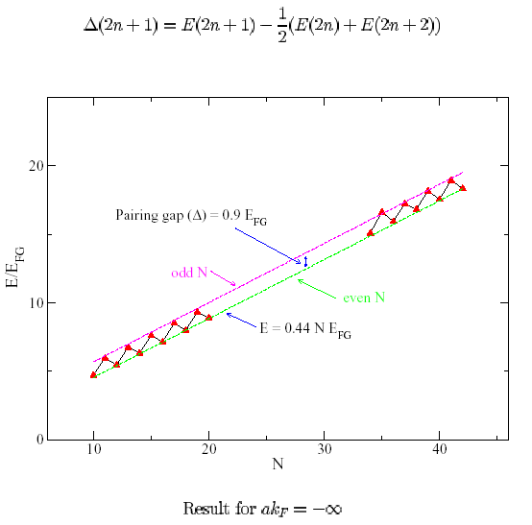
Green Function Monte Carlo with Fixed Nodes
Chang, Carlson, Pandharipande and Schmidt, PRL 91, 050401 (2003)

Slide 9
The initial Bertsch’s Many Body challenge has evolved over time
and became the problem of Fermions in the Unitary Regime
And this is part of the BCS-BEC crossover problem
The system is very dilute, but strongly interacting!
n r₀³  1
n |a|³  1
n - number density
r₀  n^{-1/3} ≈ _{F} /2  |a|
r₀ - range of interaction
a - scattering length

Slide 10
Phases of a dilute Fermi gas in the BCS-BEC crossover
T
High T, normal atomic (plus a few molecules) phase
Strong interaction
?
weak interaction
between dimers
weak interaction
between fermions
Molecular BEC and
Atomic+Molecular Superfluids
BCS Superfluid
1/a
a<0
no 2-body bound state
a>0
shallow 2-body bound state

Slide 11
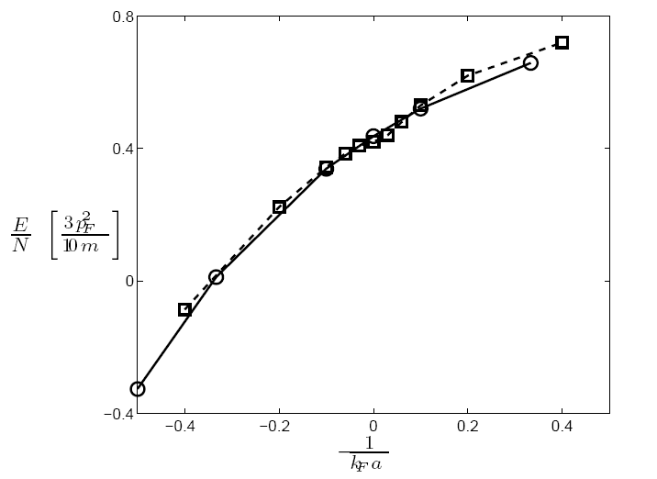
BEC side
BCS side
Solid line with open circles – Chang et al. PRA, 70, 043602 (2004)
Dashed line with squares - Astrakharchik et al. PRL 93, 200404 (2004)

Slide 12
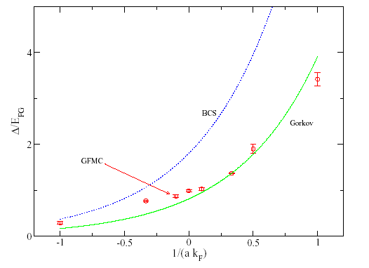
Fixed node GFMC results: S.-Y. Chang et al. PRA 70, 043602 (2004)

Slide 13
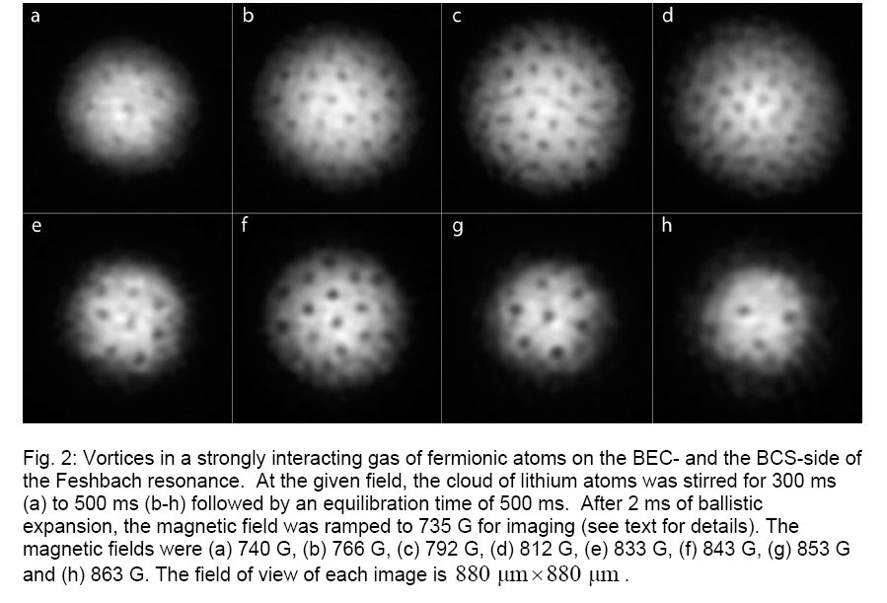
Zweirlein et al. Nature 435, 1047 (2005)

Slide 14
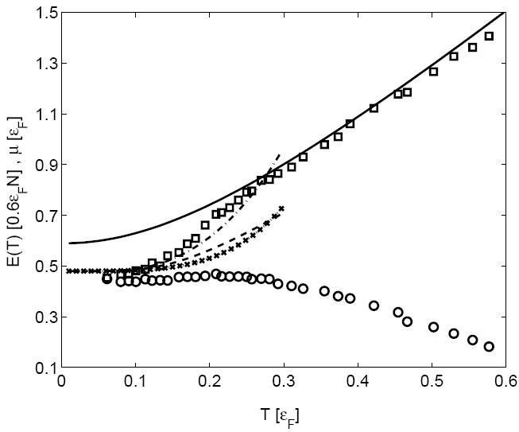
Finite temperature properties from QMC
a = ±∞
Normal Fermi Gas
(with vertical offset, solid line)
Bogoliubov-Anderson phonons
and quasiparticle contribution
(dot-dashed line )
Bogoliubov-Anderson phonons
contribution only
Quasi-particles contribution only
(dashed line)
µ - chemical potential (circles)
Bulgac, Drut, and Magierski
Phys. Rev. Lett. 96, 090404 (2006)

Slide 15
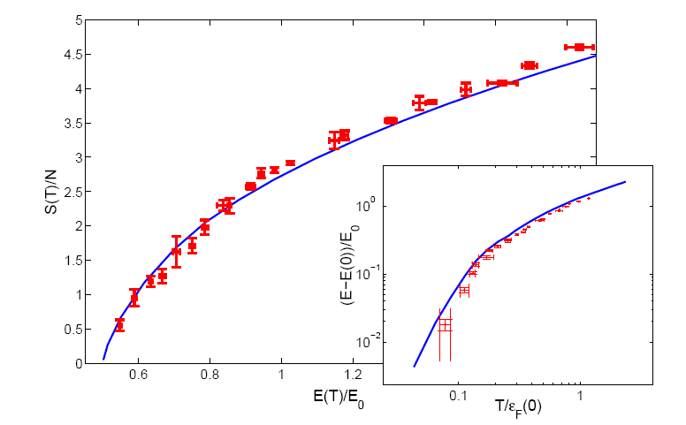
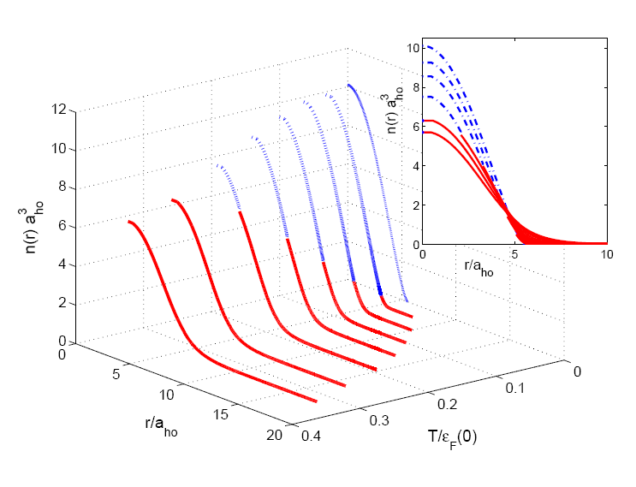
Experiment (about 100,000 atoms in a trap):
Measurement of the Entropy and Critical Temperature of a Strongly Interacting Fermi Gas,
Luo, Clancy, Joseph, Kinast, and Thomas, Phys. Rev. Lett. 98, 080402 (2007)
Full ab initio theory (no free parameters)
Bulgac, Drut, and Magierski, Phys. Rev. Lett. 99, 120401 (2007)

Slide 16
From a talk given by C. Salomon, June 2nd, 2010, Saclay

Slide 17
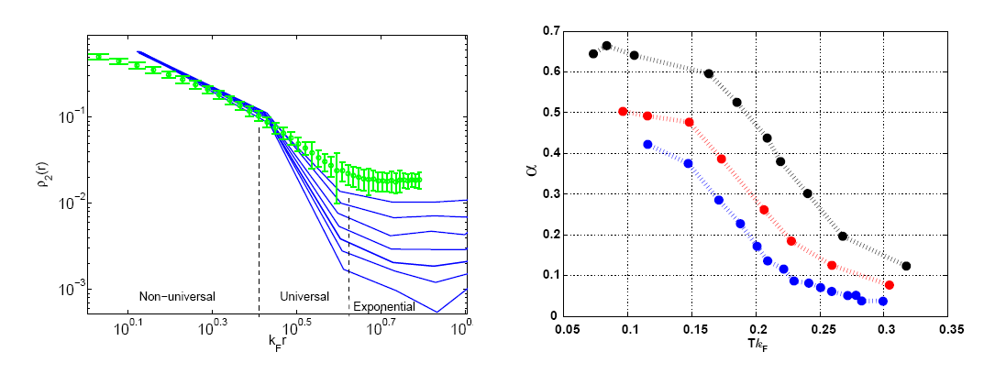
Long range order, superfluidity and condensate fraction
O. Penrose (1951), O. Penrose and L. Onsager (1956), C.N. Yang (1962)
Bulgac, Drut, and Magierski, Phys. Rev. A 78, 023625 (2008)

Slide 18
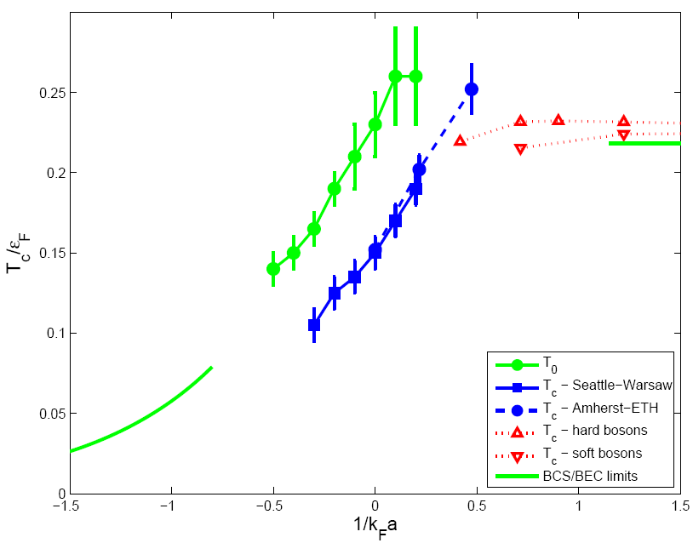
Critical temperature for superfluid to normal transition
Bulgac, Drut, and Magierski, Phys. Rev. A 78, 023625 (2008)
Amherst-ETH: Burovski et al. Phys. Rev. Lett. 101, 090402 (2008)
Hard and soft bosons: Pilati et al. PRL 100, 140405 (2008)

Slide 19
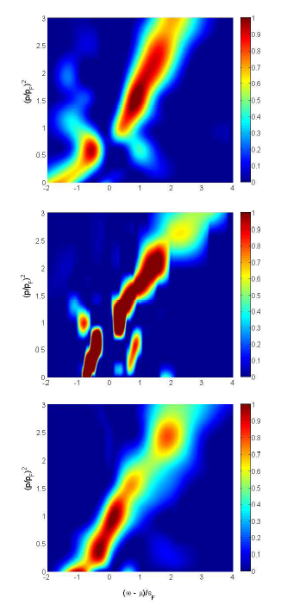
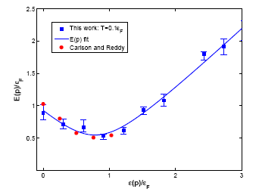
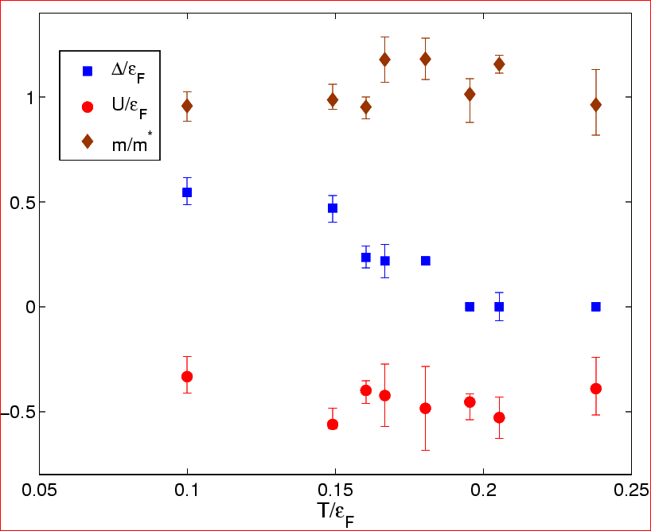
Magierski, Wlazlowski, Bulgac, and Drut
Phys. Rev. Lett. 103, 210403 (2009)
The pseudo-gap vanishes at  T₀

Slide 20
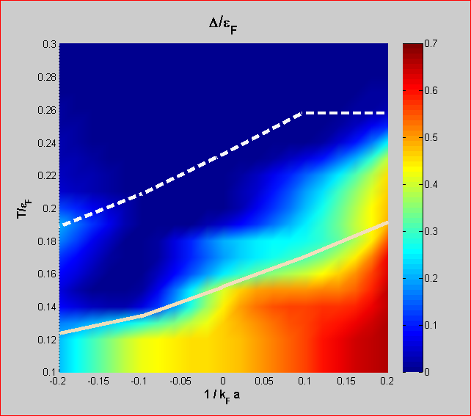
The pseudogap around the unitary point
Onset around

Slide 21
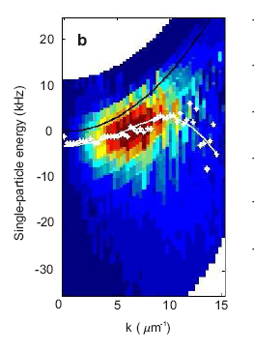
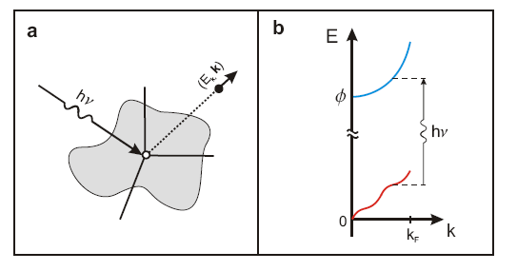
Using photoemission spectroscopy to probe a strongly interacting Fermi gas
Stewart, Gaebler, and Jin, Nature, 454, 744 (2008)

Slide 22
What happens when there are not enough partners
for everyone to pair with?
What theory tells us?

Slide 23
Green – Fermi sphere of spin-up fermions
Yellow – Fermi sphere of spin-down fermions
LOFF/FFLO solution (1964)
Pairing gap becomes a spatially varying function
Translational invariance broken
Muether and Sedrakian (2002)
Translational invariant solution
Rotational invariance broken

Slide 24
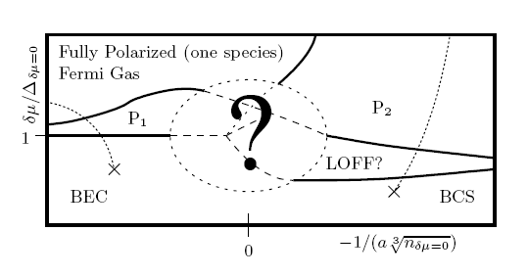
What we think is happening in spin imbalanced systems?
Induced P-wave superfluidity
Two new superfluid phases where before they were not expected
One Bose superfluid coexisting with one P-wave Fermi superfluid
Two coexisting P-wave Fermi superfluids
Bulgac, Forbes, Schwenk, Phys. Rev. Lett. 97, 020402 (2006)

Slide 25
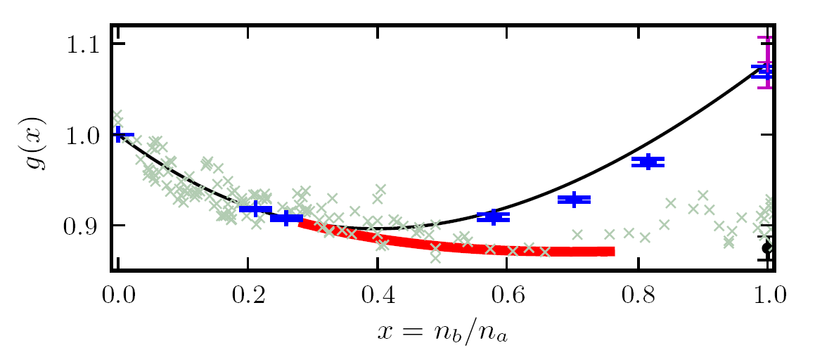
A refined EOS for spin unbalanced systems
Red line: Larkin-Ovchinnikov phase
Bulgac and Forbes,
Phys. Rev. Lett. 101, 215301 (2008)
Black line: normal part of the energy density
Blue points: DMC calculations for normal state, Lobo et al, PRL 97, 200403 (2006)
Gray crosses: experimental EOS due to Shin, Phys. Rev. A 77, 041603(R) (2008)

Slide 26
We need also to treat inhomogeneous systems!
Monte Carlo (feasible for small particle numbers only)
Density Functional Theory (large particle numbers)
1) one needs to find an Energy Density Functional (EDF)
and 2) to extend DFT to superfluid phenomena

Slide 27
Density Functional Theory (DFT)
Hohenberg and Kohn, 1964
Local Density Approximation (LDA) Kohn and Sham, 1965
particle density only!
The energy density is typically
determined in ab initio calculations
of infinite homogeneous matter.
Kohn-Sham equations

Slide 28
Kohn-Sham theorem
Injective map
(one-to-one)
Universal functional of particle density alone
Independent of external potential
Normal Fermi systems only!

Slide 29
However, not everyone is normal!

Slide 30
Superconductivity and superfluidity in Fermi systems
Dilute atomic Fermi gases T_{c}  10⁻⁹ eV
Liquid ³He T_{c}  10⁻⁷ eV
Metals, composite materials T_{c}  10⁻³ – 10⁻² eV
Nuclei, neutron stars T_{c}  10⁵ – 10⁶ eV
QCD color superconductivity T_{c}  10⁷ – 10⁸ eV
units (1 eV  10⁴ K)

Slide 31
SLDA - Extension of Kohn-Sham approach to
superfluid Fermi systems
Mean-field and pairing field are both local fields!
(for sake of simplicity spin degrees of freedom are not shown)
There is a little problem! The pairing field  diverges.

Slide 32
The SLDA (renormalized) equations
Position and momentum dependent running coupling constant
Observables are (obviously) independent of cut-off energy (when chosen properly).

Slide 33
The SLDA (DFT) energy density functional at unitarity
for equal numbers of spin-up and spin-down fermions
Only this combination is cutoff independent
can take any positive value,
but the best results are obtained when  is fixed by the qp-spectrum

Slide 34
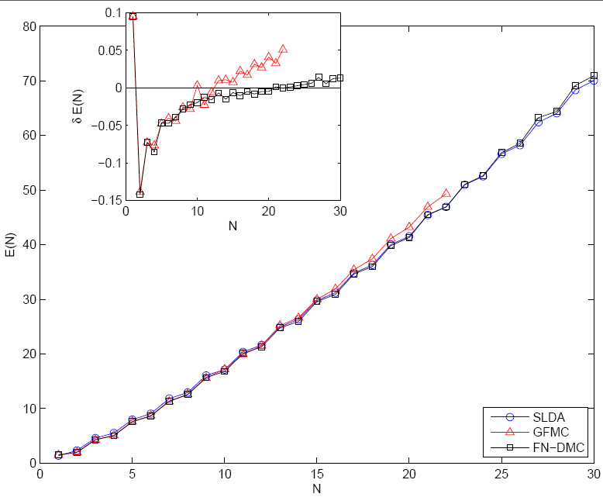
Fermions at unitarity in a harmonic trap
Total energies E(N)
GFMC - Chang and Bertsch, Phys. Rev. A 76, 021603(R) (2007)
FN-DMC - von Stecher, Greene and Blume, PRL 99, 233201 (2007)
PRA 76, 053613 (2007)
Bulgac, PRA 76, 040502(R) (2007)

Slide 35
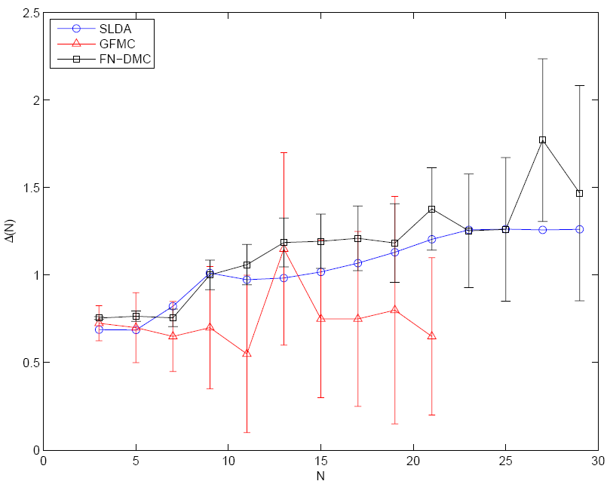
Fermions at unitarity in a harmonic trap
Pairing gaps
GFMC - Chang and Bertsch, Phys. Rev. A 76, 021603(R) (2007)
FN-DMC - von Stecher, Greene and Blume, PRL 99, 233201 (2007)
PRA 76, 053613 (2007)
Bulgac, PRA 76, 040502(R) (2007)

Slide 36
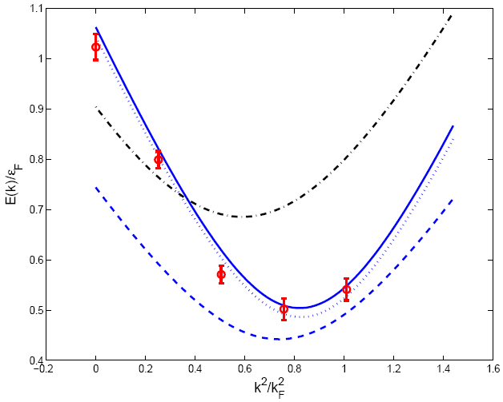
Quasiparticle spectrum in homogeneous matter
NB! In DFT one does not try to reproduce the single-particle spectrum (
only the Fermi level)
solid/dotted blue line - SLDA, homogeneous GFMC due to Carlson et al
red circles - GFMC due to Carlson and Reddy
dashed blue line - SLDA, homogeneous MC due to Juillet
black dashed-dotted line – meanfield at unitarity
Bulgac, PRA 76, 040502(R) (2007)

Slide 37
EOS for spin polarized systems
Red line: Larkin-Ovchinnikov phase (unitary Fermi supersolid)
Black line: normal part of the energy density
Blue points: DMC calculations for normal state, Lobo et al, PRL 97, 200403 (2006)
Gray crosses: experimental EOS due to Shin, Phys. Rev. A 77, 041603(R) (2008)
Bulgac and Forbes,
Phys. Rev. Lett. 101, 215301 (2008)

Slide 38
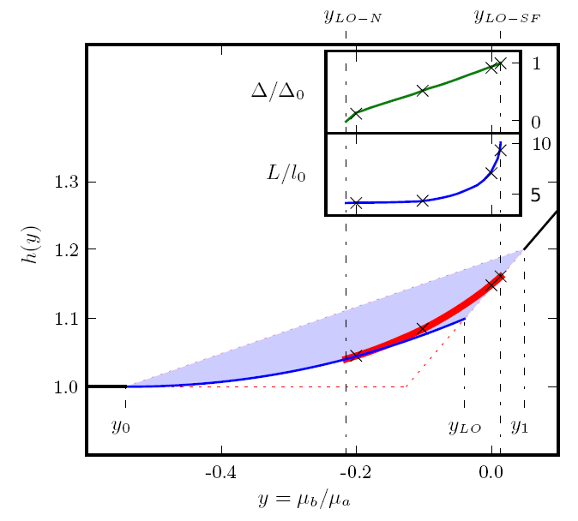
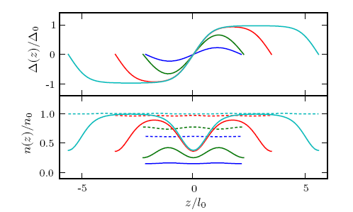
A Unitary Fermi Supersolid:
the Larkin-Ovchinnikov phase
Bulgac and Forbes
PRL 101, 215301 (2008)

Slide 39
Formalism for Time Dependent Phenomena
The time-dependent density functional theory is viewed in general as a reformulation of the exact quantum mechanical time evolution of a many-body system when only one-body properties are considered.
A.K. Rajagopal and J. Callaway, Phys. Rev. B 7, 1912 (1973)
V. Peuckert, J. Phys. C 11, 4945 (1978)
E. Runge and E.K.U. Gross, Phys. Rev. Lett. 52, 997 (1984)
http://www.tddft.org
For time-dependent phenomena one has to add currents.

Slide 40
A rare excitation mode:
the Higgs pairing mode.

Slide 41
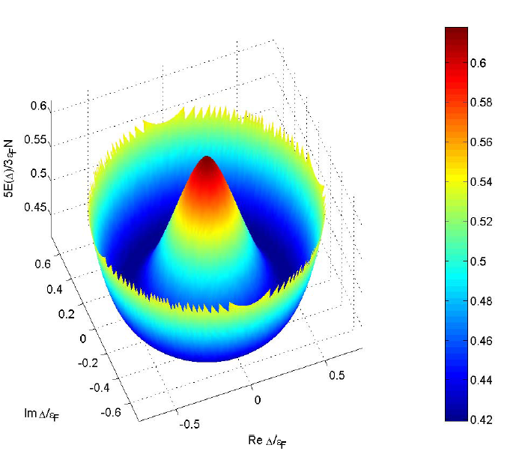
Energy of a Fermi system as a function of the pairing gap
Quantum hydrodynamics
“Landau-Ginzburg” equation

Slide 42
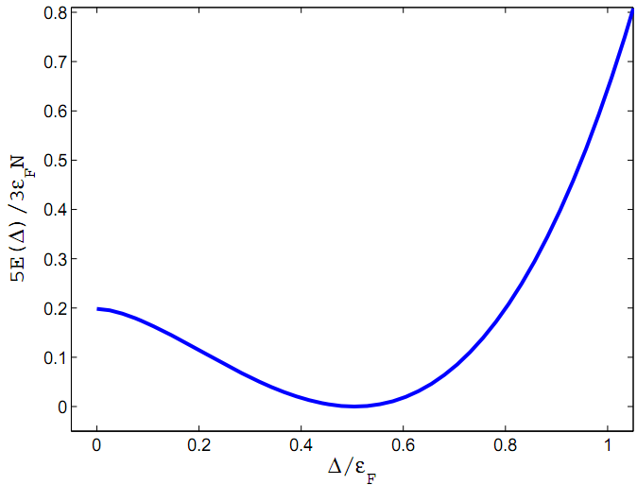
Higgs mode
Small amplitude oscillations of the modulus of
the order parameter (pairing gap)
This mode has a bit more complex character
cf. Volkov and Kogan (1972)

Slide 43
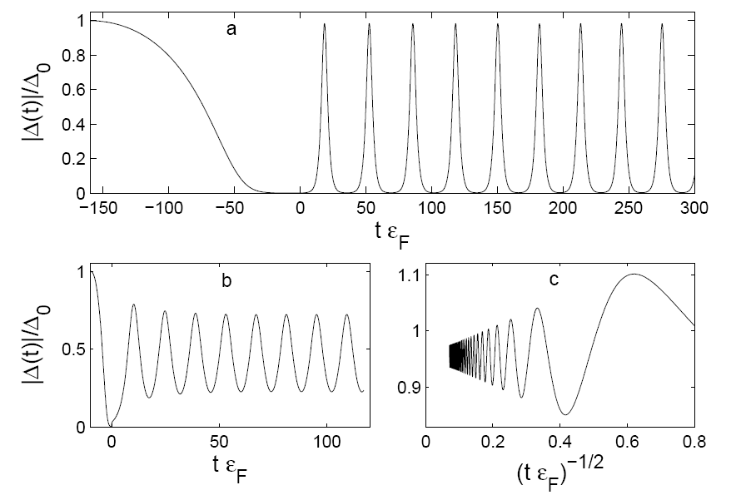
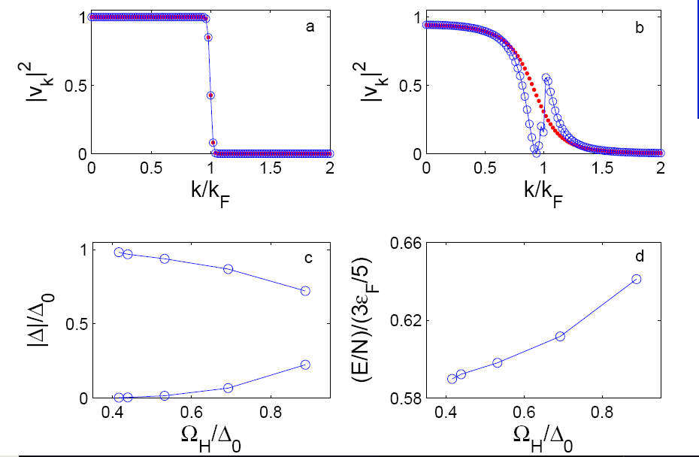
Response of a unitary Fermi system to changing
the scattering length with time
All these modes have a very low frequency below the pairing gap
and a very large amplitude and very large excitation energy
None of these modes can be described either within Quantum Hydrodynamics
or Landau-Ginzburg like approaches
Bulgac and Yoon, Phys. Rev. Lett. 102, 085302 (2009)

Slide 44
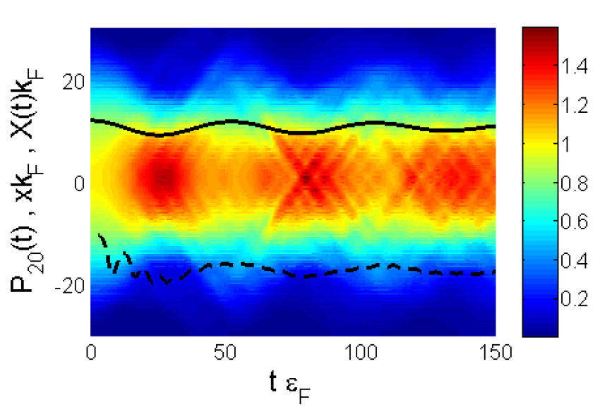
3D unitary Fermi gas confined to a 1D ho potential well (pancake)
New qualitative excitation mode of a superfluid Fermi system
(non-spherical Fermi momentum distribution)
Black solid line – Time dependence of the cloud radius
Black dashed line – Time dependence of the quadrupole moment of momentum distribution
Bulgac and Yoon, Phys. Rev. Lett. 102, 085302 (2009)

Slide 45
Full 3D implementation of TD-SLDA is a petaflop problem
and has been completed by now.
Bulgac and Roche, J. Phys. Conf. Series 125, 012064 (2008)

Slide 47
TDSLDA
(equations look like TDHFB/TDBdG)
The system is placed on a 3D spatial lattice
Derivatives are computed with FFTW
Fully self-consistent treatment with Galilean invariance
No symmetry restrictions
Number of quasiparticle wave functions is of the order of the number of spatial
lattice points
Initial state is the ground state of the SLDA (formally like HFB/BdG)
The code was implementation on JaguarPf (NCCS) and Franklin (NERSC)

Slide 48
I will present a few short movies, illustrating the complex
time-dependent dynamics in 2D/3D of a unitary Fermi superfluid
excited with various external probes.
In each case we solved on JaguarPf or Franklin the TDSLDA equations for a 32³ and 48³ spatial lattices (approximately for 30k to 40k quasiparticle wavefunctions) for about 10k to 100k time steps using from about 30k to 40k PEs
Fully unrestricted calculations!
All the movies will be eventually posted at
http://www.phys.washington.edu/groups/qmbnt/index.html

Slide 49
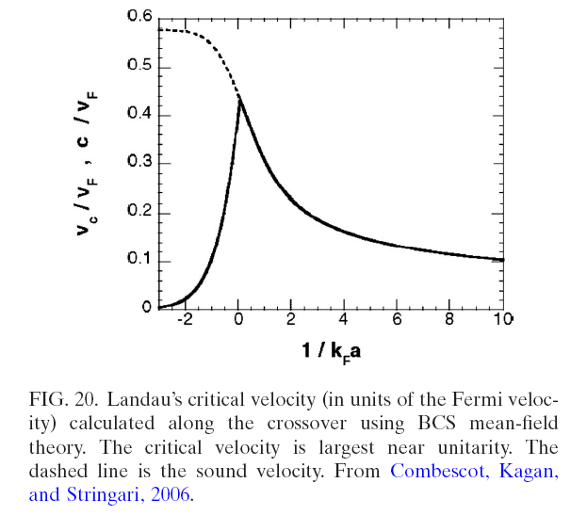
Critical velocity in a unitary gas
Values obtained using QMC data
From Giorgini, Pitaevskii and Stringari,
Rev. Mod. Phys., 80, 1215 (2008)
Study based on BCS/Leggett approximation
Miller et al. (MIT, 2007)

Slide 50
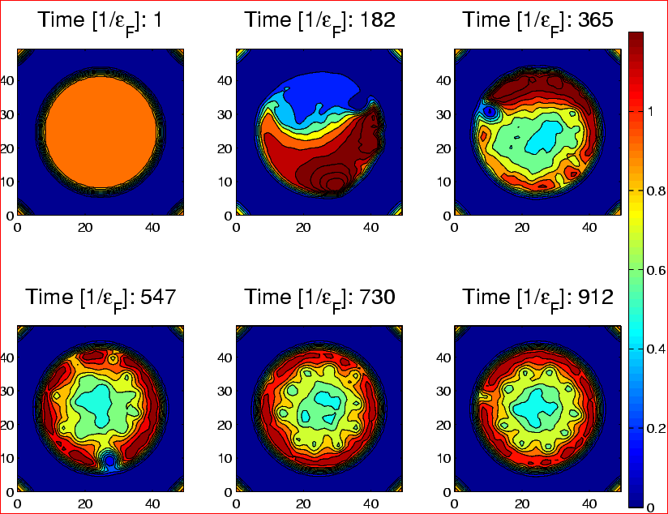
Density cut through a stirred unitary Fermi gas at various times.

Slide 51
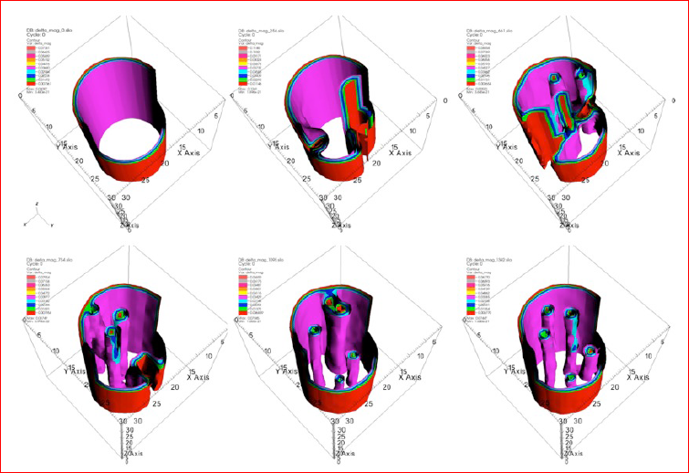
Profile of the pairing gap of a stirred unitary Fermi gas at various times.

Slide 52
We created a set of accurate and efficient tools for the petaflop regime
which have been successfully implemented on leadership class computers
(Franklin, JaguarPF)
Currently capable of treating large volumes for up to 10,000-20,000 fermions ,
and for long times, fully self-consistently and with no symmetry restrictions
under the action of complex spatio-temporal external probes
The suites of codes can handle systems and phenomena ranging from:
ground states properties
excited states in the linear response regime,
large amplitude collective motion,
response to various weak and strong external probes
There is a clear path towards exascale applications and implementation of the
Stochastic TD(A)SLDA

Slide 53
Properties of the Unitary Fermi Gas (UFG)
The properties of the UFG are defined by the number density and the
temperature only universal properties
UFG is stable and superfluid at zero temperature
Full thermodynamic properties are known from ab initio calculations and
most of them were confirmed by experiment
The quasiparticle spectrum was determined in ab initio calculations at zero
and finite temperatures
UFG has the highest (relative) critical temperature of all known superfluids
UFG has the highest critical velocity of all known superfluids
The elusive Larkin-Ovchinnikov (FFLO) pairing can be realized under
extremely favorable conditions. The system displays the equivalent of
charge density waves   supersolid
Extremely favorable conditions to realize induced P- or F-wave superfluidity
UFG demonstrates the pseudogap behavior
In the time-dependent regime one finds an incredible rich range of
new qualitative phenomena (in particular flow with supercritical velocities)

