Slide 1
Static Properties and Dynamics
of Strongly Interacting Many Fermion Systems
Aurel Bulgac
University of Washington, Seattle, USA
Collaborators:
M.M. Forbes, P. Magierski, Y.-L. (Alan) Luo, K.J. Roche, I. Stetcu, S. Yoon, Y. Yu
Funding: DOE grants No. DE-FG02-97ER41014 (UW NT Group)
DE-FC02-07ER41457 (SciDAC-UNEDF)
Slides to be posted at: http://www.phys.washington.edu/users/bulgac/

Slide 2
I will discuss properties of two different systems,
which surprisingly share a lot in common:
Cold atomic gases
Nuclear systems

Slide 3
I am in big trouble:
I have too many slides!
I do not have enough slides!!!
Both statements are correct!!!!!

Slide 4
First lecture – Static properties
How to implement Density Functional Theory (DFT)
in the Case of Superfluid Fermion Systems
Second Lecture - Implementation of Time-Dependent DFT
for Superfluid Fermion Systems in 3D
Applications to unitary gas and nuclei and how all this was
implemented on JaguarPf (the largest supercomputer in the world)

Slide 5
Outline:
What is a unitary Fermi gas
Very brief/skewed summary of DFT
Bogoliubov-de Gennes equations, renormalization
Superfluid Local Density Approximation (SLDA)
for a unitary Fermi gas
Fermions at unitarity in a harmonic trap within SLDA and comparison with ab intio results
Challenges one has to face in order to implement DFT in nuclei

Slide 7
http://www.unedf.org

Slide 9
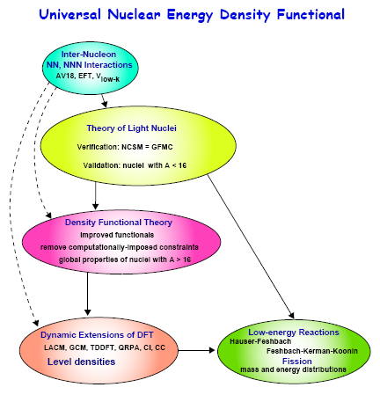

Slide 10
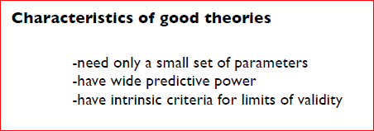
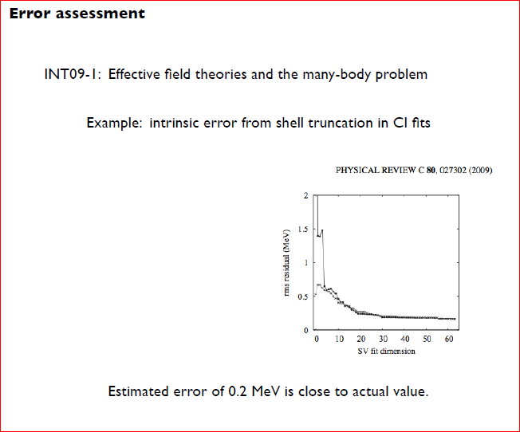
From a talk given by G.F. Bertsch,
INT at 20, July 1-2, 2010

Slide 11
Part I

Slide 12
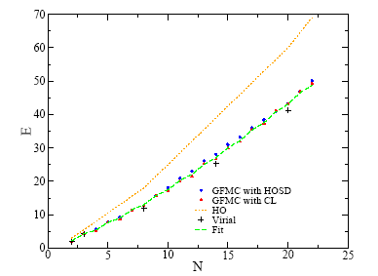
Unitary Fermi gas in a harmonic trap
Chang and Bertsch, Phys. Rev. A 76, 021603(R) (2007)

Slide 13
Why would one want to study this system?
One reason:
(for the nerds, I mean the hard-core theorists,
not for the phenomenologists)
Bertsch’s Many-Body X challenge, Seattle, 1999
What are the ground state properties of the many-body system composed of spin ½ fermions interacting via a zero-range, infinite scattering-length contact interaction.

Slide 14
What are the scattering length and the effective range?
If the energy is small only the s-wave is relevant.

Slide 15
Let us consider a very old example: the hydrogen atom.
The ground state energy could only be a function of:
Electron charge
Electron mass
Planck’s constant
and then trivial dimensional arguments lead to
Only the factor ½ requires some hard work.

Slide 16
Let us turn now to dilute fermion matter
The ground state energy is given by a function:
Taking the scattering length to infinity and the range
of the interaction to zero, we are left with:
Pure number
(dimensionless)

Slide 17
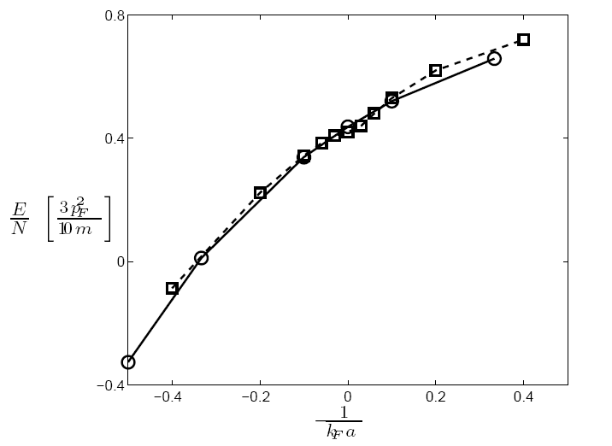
BEC side
BCS side
Solid line with open circles – Chang et al. PRA, 70, 043602 (2004)
Dashed line with squares - Astrakharchik et al. PRL 93, 200404 (2004)

Slide 18
What is a unitary Fermi gas

Slide 19
Bertsch Many-Body X challenge, Seattle, 1999
What are the ground state properties of the many-body system composed of
spin ½ fermions interacting via a zero-range, infinite scattering-length contact
interaction.
In 1999 it was not yet clear, either theoretically or experimentally,
whether such fermion matter is stable or not.
- systems of bosons are unstable (Efimov effect)
- systems of three or more fermion species are unstable (Efimov effect)
Baker (winner of the MBX challenge) concluded that the system is stable.
See also Heiselberg (entry to the same competition)
Chang et al (2003) Fixed-Node Green Function Monte Carlo
and Astrakharchik et al. (2004) FN-DMC provided best the theoretical
estimates for the ground state energy of such systems.
Thomas’ Duke group (2002) demonstrated experimentally that such systems
are (meta)stable.

Slide 20
Consider Bertsch’s MBX challenge (1999): “Find the ground state of infinite homogeneous neutron matter interacting with an infinite scattering length.”
Carlson, Morales, Pandharipande and Ravenhall,
PRC 68, 025802 (2003), with Green Function Monte Carlo (GFMC)
normal state
Carlson, Chang, Pandharipande and Schmidt,
PRL 91, 050401 (2003), with GFMC
superfluid state
This state is half the way from BCS→BEC crossover, the pairing correlations are in the strong coupling limit and HFB invalid again.

Slide 21
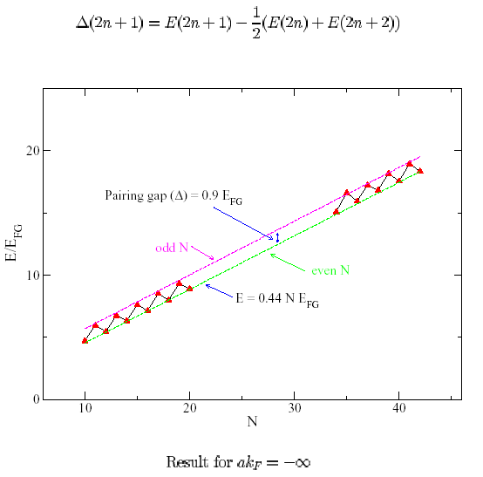
Green Function Monte Carlo with Fixed Nodes
Chang, Carlson, Pandharipande and Schmidt, PRL 91, 050401 (2003)

Slide 22
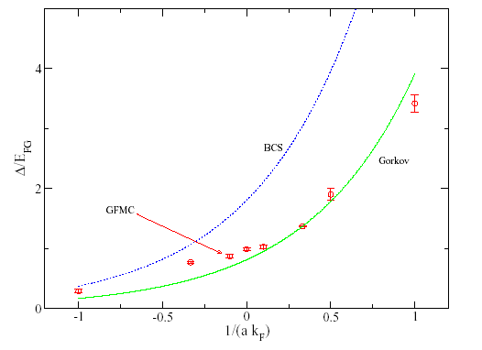
Fixed node GFMC results, S.-Y. Chang et al. PRA 70, 043602 (2004)

Slide 23
BCS →BEC crossover
Eagles (1960), Leggett (1980), Nozieres and Schmitt-Rink (1985),
Randeria et al. (1993),…
If a<0 at T=0 a Fermi system is a BCS superfluid
If |a|=∞ and nr₀³1 a Fermi system is strongly coupled and its properties
are universal. Carlson et al. PRL 91, 050401 (2003)
If a>0 (ar₀) and na³1
the system is a dilute BEC of tightly bound dimers

Slide 24
Carlson’s talk at UNEDF meeting, Pack Forest, WA, August, 2007

Slide 25
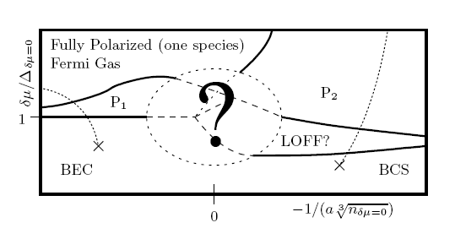
Fermi gas near unitarity has a very complex phase diagram (T=0)
Bulgac, Forbes, Schwenk, PRL 97, 020402 (2007)

Slide 26
Very brief/skewed summary of DFT

Slide 27
Density Functional Theory (DFT)
Hohenberg and Kohn, 1964
Local Density Approximation (LDA) Kohn and Sham, 1965
particle density only!
The energy density is typically
determined in ab initio calculations
of infinite homogeneous matter.
Kohn-Sham equations

Slide 28
Kohn-Sham theorem
Injective map
(one-to-one)
Universal functional of density
independent of external potential

Slide 29
How to construct and validate an ab initio EDF?
Given a many body Hamiltonian determine the properties of
the infinite homogeneous system as a function of density
Extract the energy density functional (EDF)
Add gradient corrections, if needed or known how (?)
Determine in an ab initio calculation the properties of a
select number of wisely selected finite systems
Apply the energy density functional to inhomogeneous systems
and compare with the ab initio calculation, and if lucky declare
Victory!

Slide 30
One can construct however an EDF which depends both on
particle density and kinetic energy density and use it in a
extended Kohn-Sham approach (perturbative result)
Notice that dependence on kinetic energy density and on the
gradient of the particle density emerges because of finite
range effects.
Bhattacharyya and Furnstahl, Nucl. Phys. A 747, 268 (2005)

Slide 31
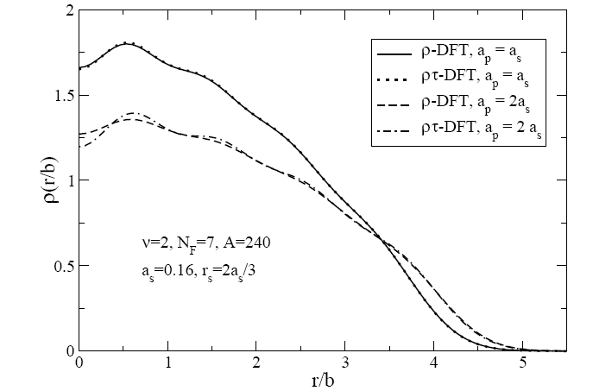
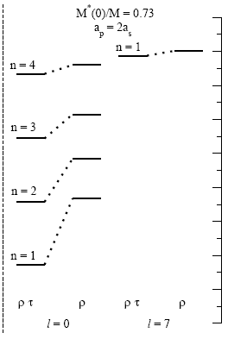
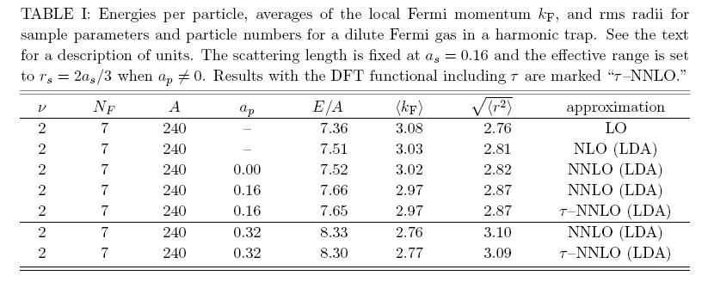
The single-particle spectrum of usual Kohn-Sham approach is unphysical,
with the exception of the Fermi level.
The single-particle spectrum of extended Kohn-Sham approach has physical meaning.

Slide 32
Extended Kohn-Sham equations
Position dependent mass
Normal Fermi systems only!

Slide 33
However, not everyone is normal!

Slide 34
Superconductivity and superfluidity in Fermi systems
Dilute atomic Fermi gases T_{c}  10⁻¹² – 10⁻⁹ eV
Liquid ³He T_{c}  10⁻⁷ eV
Metals, composite materials T_{c}  10⁻³ – 10⁻² eV
Nuclei, neutron stars T_{c}  10⁵ – 10⁶ eV
QCD color superconductivity T_{c}  10⁷ – 10⁸ eV
units (1 eV  10⁴ K)

Slide 35
Bogoliubov-de Gennes equations and renormalization

Slide 36
SLDA - Extension of Kohn-Sham approach to
superfluid Fermi systems
Mean-field and pairing field are both local fields!
(for sake of simplicity spin degrees of freedom are not shown)
There is a little problem! The pairing field  diverges.

Slide 37
Why would one consider a local pairing field?
Because it makes sense physically!
The treatment is so much simpler!
Our intuition is so much better also.
radius of interaction
inter-particle separation
coherence length
size of the Cooper pair

Slide 38
Nature of the problem
at small separations
It is easier to show how this singularity appears
in infinite homogeneous matter.

Slide 39
Pseudo-potential approach
(appropriate for very slow particles, very transparent,
but somewhat difficult to improve)
Lenz (1927), Fermi (1931), Blatt and Weiskopf (1952)
Lee, Huang and Yang (1957)

Slide 40
The SLDA (renormalized) equations
Position and momentum dependent running coupling constant
Observables are (obviously) independent of cut-off energy (when chosen properly).

Slide 41
Superfluid Local Density Approximation (SLDA)
for a unitary Fermi gas

Slide 42
The naïve SLDA energy density functional
suggested by dimensional arguments

Slide 43
The SLDA energy density functional at unitarity
for equal numbers of spin-up and spin-down fermions
Only this combination is cutoff independent
can take any positive value,
but the best results are obtained when  is fixed by the qp-spectrum

Slide 44
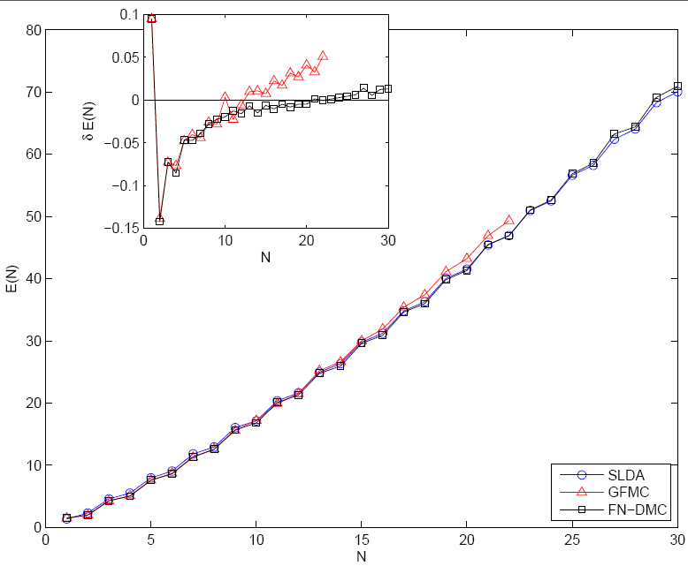
Fermions at unitarity in a harmonic trap
Total energies E(N)
GFMC - Chang and Bertsch, Phys. Rev. A 76, 021603(R) (2007)
FN-DMC - von Stecher, Greene and Blume, PRL 99, 233201 (2007)
PRA 76, 053613 (2007)
Bulgac, PRA 76, 040502(R) (2007)

Slide 45
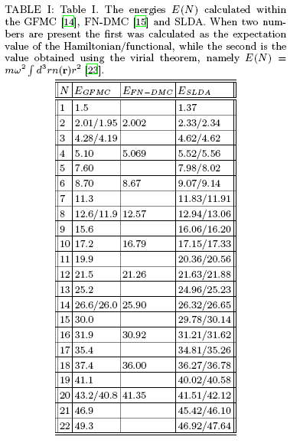
NB Particle projection
neither required nor
needed in SLDA!!!

Slide 46
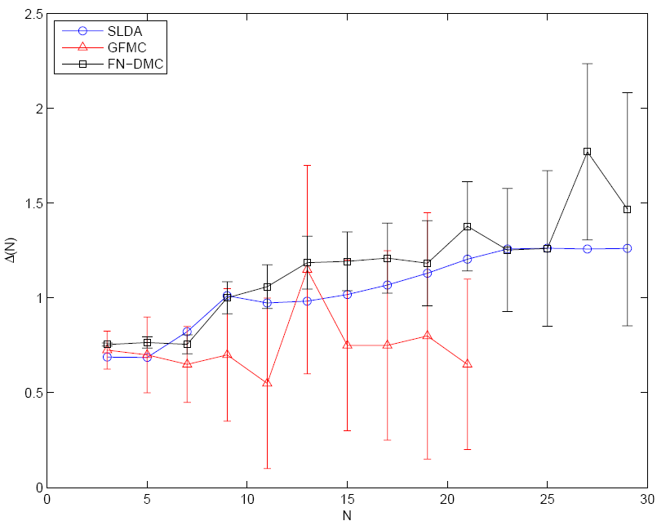
Fermions at unitarity in a harmonic trap
Pairing gaps
GFMC - Chang and Bertsch, Phys. Rev. A 76, 021603(R) (2007)
FN-DMC - von Stecher, Greene and Blume, PRL 99, 233201 (2007)
PRA 76, 053613 (2007)
Bulgac, PRA 76, 040502(R) (2007)

Slide 47
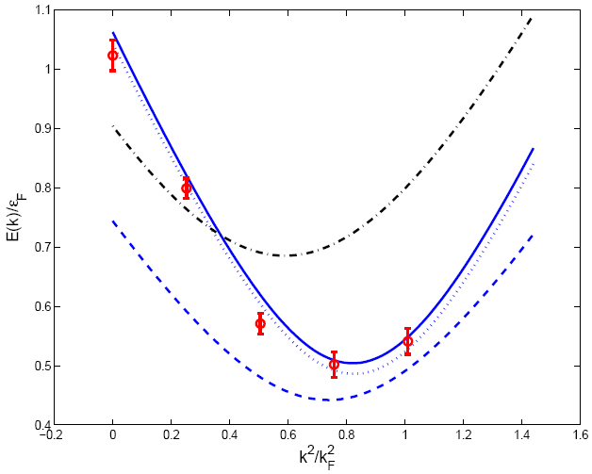
Quasiparticle spectrum in homogeneous matter
solid/dotted blue line - SLDA, homogeneous GFMC due to Carlson et al
red circles - GFMC due to Carlson and Reddy
dashed blue line - SLDA, homogeneous MC due to Juillet
black dashed-dotted line – meanfield at unitarity
Two more universal parameter characterizing the unitary
Fermi gas and its excitation spectrum:
effective mass, meanfield potential
Bulgac, PRA 76, 040502(R) (2007)

Slide 48
Agreement between GFMC/FN-DMC and SLDA extremely good,
a few percent (at most) accuracy
Why not better?
A better agreement would have really signaled big troubles!
Energy density functional is not unique,
in spite of the strong restrictions imposed by unitarity
Self-interaction correction neglected
smallest systems affected the most
Absence of polarization effects
spherical symmetry imposed, odd systems mostly affected
Spin number densities not included
extension from SLDA to SLSD(A) needed
ab initio results for asymmetric system needed
Gradient corrections not included

Slide 49
Until now we kept the numbers of spin-up
and spin-down equal.
What happens when there are not enough partners
for everyone to pair with?
(In particular this is what one expects to happen in
color superconductivity, due to a heavier strange
quark)
What theory tells us?

Slide 50
Green – Fermi sphere of spin-up fermions
Yellow – Fermi sphere of spin-down fermions
LOFF/FFLO solution (1964)
Pairing gap becomes a spatially varying function
Translational invariance broken
Muether and Sedrakian (2002)
Translational invariant solution
Rotational invariance broken

Slide 51
What we think is happening in spin imbalanced systems?
Induced P-wave superfluidity
Two new superfluid phases where before they were not expected
One Bose superfluid coexisting with one P-wave Fermi superfluid
Two coexisting P-wave Fermi superfluids
Bulgac, Forbes, Schwenk, Phys. Rev. Lett. 97, 020402 (2006)

Slide 52
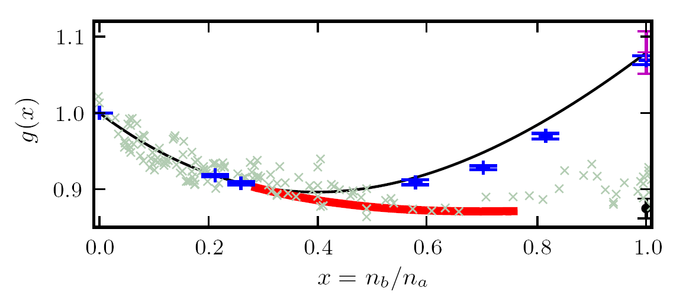
A refined EOS for spin unbalanced systems
Red line: Larkin-Ovchinnikov phase
Bulgac and Forbes,
Phys. Rev. Lett. 101, 215301 (2008)
Black line: normal part of the energy density
Blue points: DMC calculations for normal state, Lobo et al, PRL 97, 200403 (2006)
Gray crosses: experimental EOS due to Shin, Phys. Rev. A 77, 041603(R) (2008)

Slide 53
Asymmetric SLDA (ASLDA)
Bulgac and Forbes, arXiv:0804:3364

Slide 54
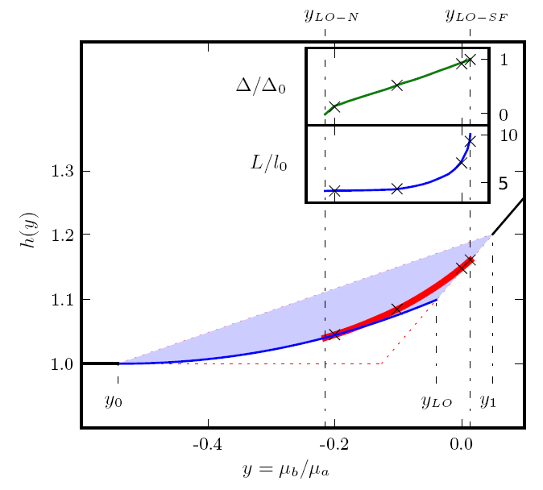
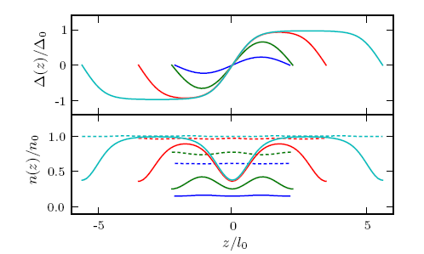
A Unitary Fermi Supersolid:
the Larkin-Ovchinnikov phase
Bulgac and Forbes
PRL 101, 215301 (2008)

Slide 55
Challenges towards implementation of SLDA in nuclei

Slide 56
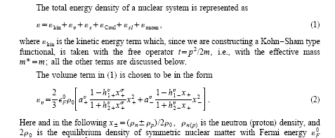
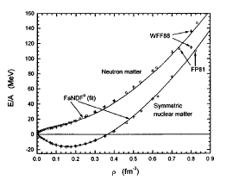
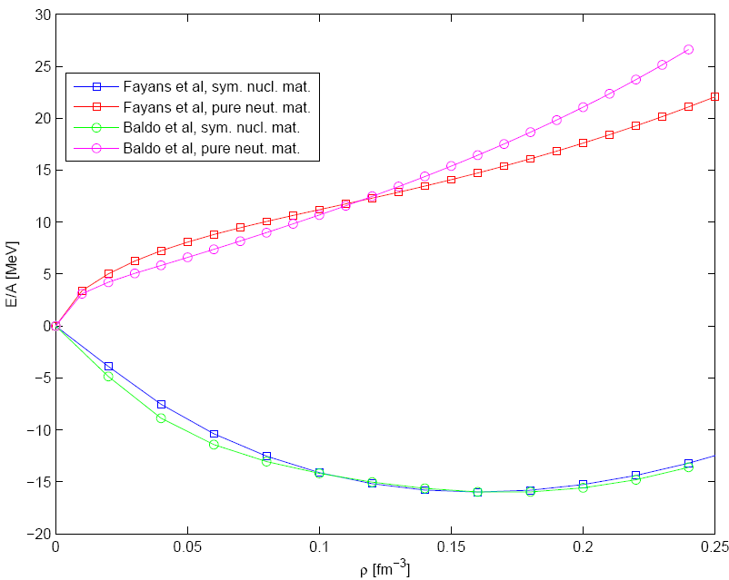
Baldo, Schuck, and Vinas, arXiv:0706.0658

Slide 57
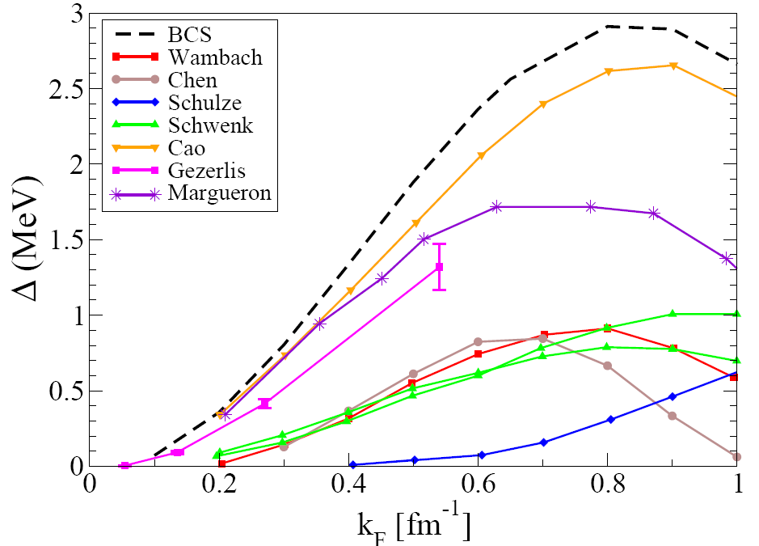
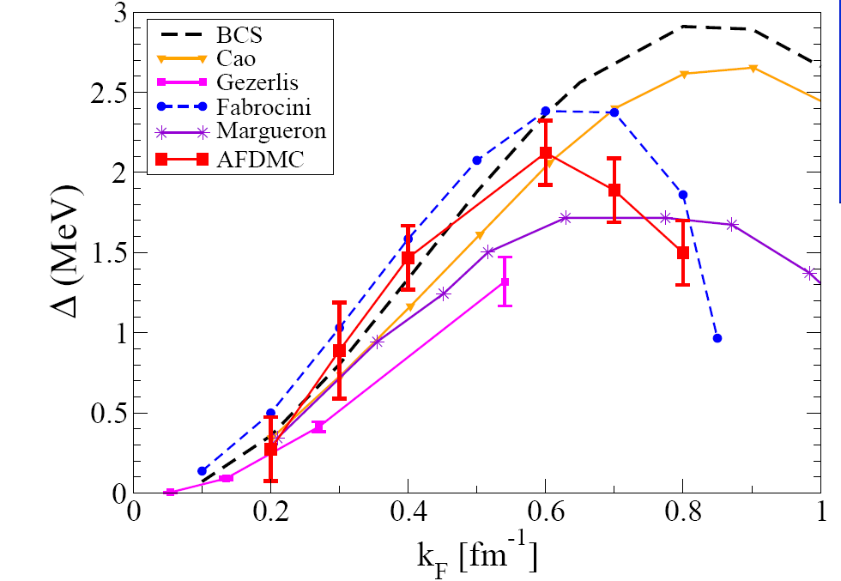
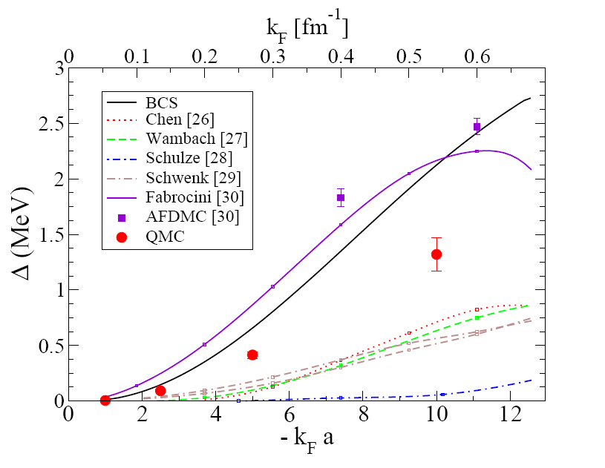
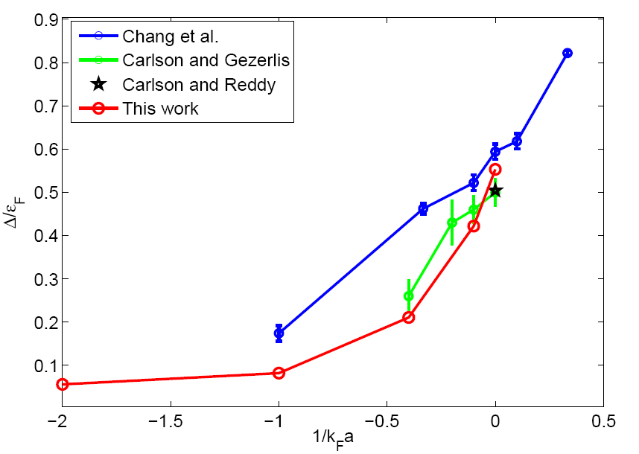
Gandolfi et al. arXiv:0805.2513
Gezerlis and Carlson, PRC 77, 032801 (2008)
Bulgac et al. arXiv:0801.1504, arXiv:0803.3238

Slide 58
Let us summarize some of the ingredients of the SLDA in nuclei
Energy Density (ED) describing the normal system
ED contribution due to superfluid correlations
Isospin symmetry
(Coulomb energy and other relatively small terms not shown here.)
Let us consider the simplest possible ED compatible with nuclear symmetries
and with the fact that nuclear pairing corrrelations are relatively weak.

Slide 59
Let us stare at the anomalous part of the ED for a moment, … or two.
?
SU(2) invariant
NB I am dealing here with s-wave pairing only (S=0 and T=1)!
The last term could not arise from a two-body bare interaction.

Slide 60
In the end one finds that a suitable superfluid
nuclear EDF has the following structure:
Isospin symmetric
The same coupling constant for both even and odd
neutron/proton numbers!!!

Slide 61
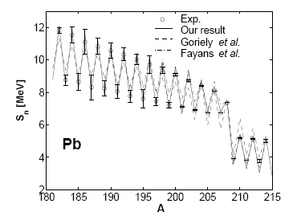
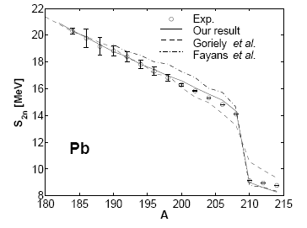
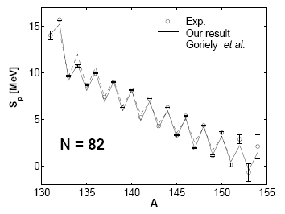
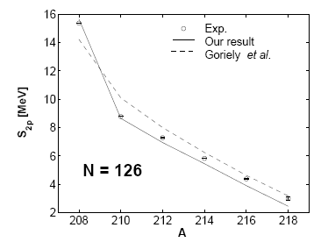
A single universal parameter for pairing!

Slide 62
Intermission

Slide 63
Part II

Slide 64
Time Dependent Phenomena
The time-dependent density functional theory is viewed in general as a reformulation of the exact quantum mechanical time evolution of a many-body system when only single-particle properties are considered.
TDDFT for normal systems:
A.K. Rajagopal and J. Callaway, Phys. Rev. B 7, 1912 (1973)
V. Peuckert, J. Phys. C 11, 4945 (1978)
E. Runge and E.K.U. Gross, Phys. Rev. Lett. 52, 997 (1984)
http://www.tddft.org
TDSLDA
For time-dependent phenomena one has to add currents!

Slide 65
From a talk given by I. Stetcu, UNEDF 2010

Slide 66
From a talk given by I. Stetcu, UNEDF 2010

Slide 67
From a talk given by I. Stetcu, UNEDF 2010

Slide 68
From a talk given by K.J. Roche, UNEDF 2010

Slide 69
A very rare excitation mode: the Higgs pairing mode.

Slide 70
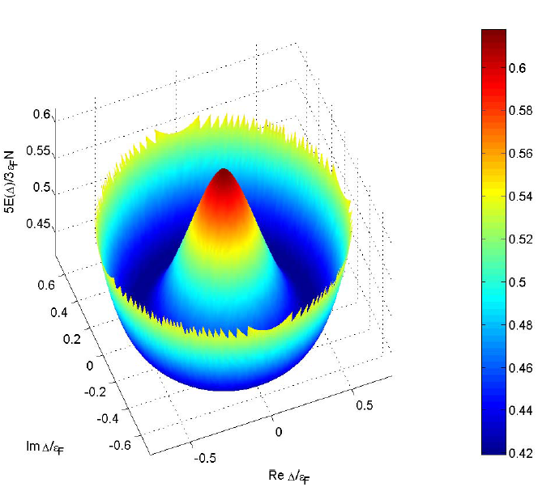
Energy of a Fermi system as a function of the pairing gap
Quantum hydrodynamics
“Landau-Ginzburg” equation

Slide 71
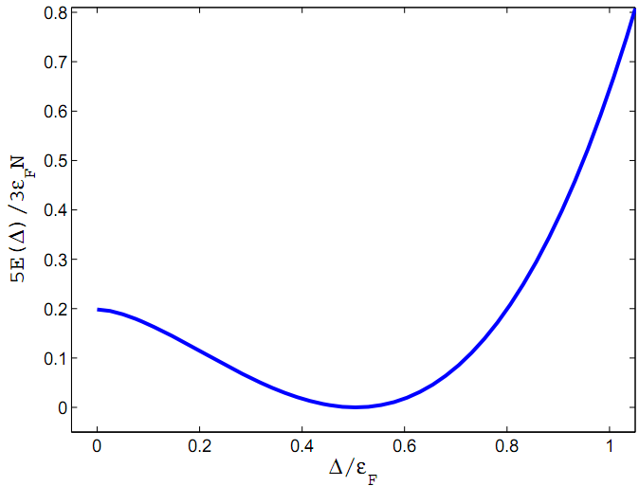
Higgs mode
Small amplitude oscillations of the modulus of
the order parameter (pairing gap)
This mode has a bit more complex character
cf. Volkov and Kogan (1972)

Slide 72
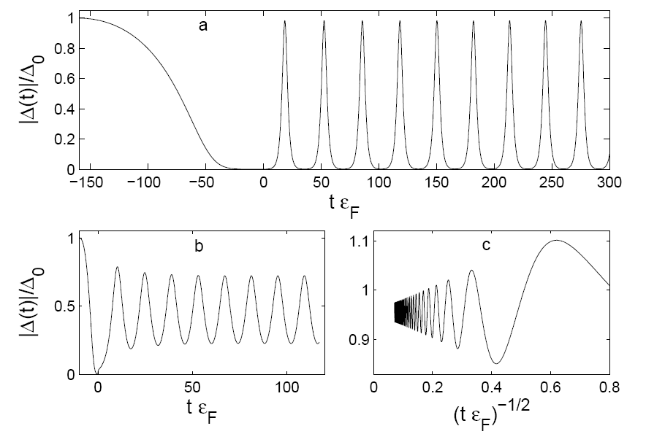
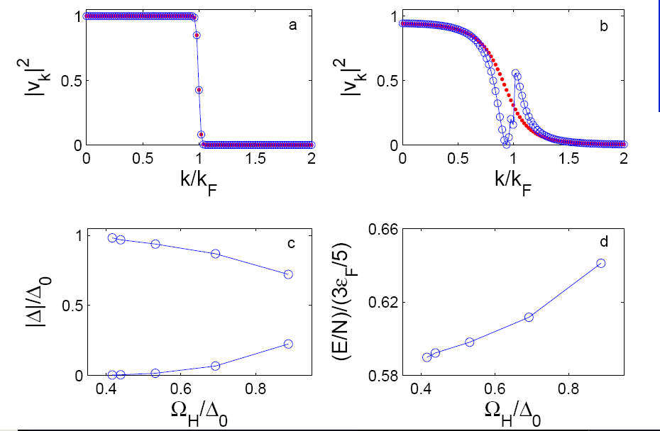
Response of a unitary Fermi system to changing
the scattering length with time
Tool: TD DFT extension to superfluid systems (TD-SLDA)
All these modes have a very low frequency below the pairing gap
and a very large amplitude and excitation energy as well
None of these modes can be described either within Quantum Hydrodynamics
or Landau-Ginzburg like approaches
Bulgac and Yoon, Phys. Rev. Lett. 102, 085302 (2009)

Slide 73
TDSLDA
(equations TDHFB/TDBdG like)
The system is placed on a 3D spatial lattice
Derivatives are computed with FFTW
Fully self-consistent treatment with Galilean invariance
No symmetry restrictions
Number of quasiparticle wave functions is of the order
of the number of spatial lattice points
Initial state is the ground state of the SLDA (formally like HFB/BdG)
The code was implementation on JaguarPf

Slide 74
I will present a few short movies, illustrating the complex
time-dependent dynamics in 3D of a unitary Fermi superfluid
and nuclei excited with various external probes.
In each case we solved on JaguarPf the TDSLDA equations for a 32³ spatial lattice (approximately 30k to 40k quasiparticle wavefunctions) for about 10k to 100k time steps using from about 30K to approximately 40K PEs
Fully unrestricted calculations!
The size of the problem we solve here is several orders of magnitude
larger than any other similar problem studied by other groups (and we plan to further increase the size significantly).
The movies will be eventually posted at
http://www.phys.washington.edu/groups/qmbnt/index.html

Slide 75
Summary
Created a set of accurate and efficient tools for the petaflop regime
Successfully implementated on leadership class computers (Franklin, JaguarPF)
Currently capable of treating nuclear volumes as large as 50³ fm³ , for up to
10,000-20,000 fermions , and for times up to a fraction of an attosecond
fully self-consistently and with no symmetry restrictions and under the action
of complex spatio-temporal external probes
Capable of treating similarly large systems of cold atoms
The suites of codes can handle systems and phenomena ranging from:
ground states properties
excited states in the linear response regime,
large amplitude collective motion,
response to various electromagnetic and nuclear probes,
There is a clear path towards exascale applications and implementation of the
Stochastic TD(A)SLDA

