Slide 1
Quantum Dynamics with TDSLDA
A. Bulgac
M.M. Forbes, P. Magierski, Y.-L. (Alan) Luo, K.J. Roche, I. Stetcu, Y. Yu

Slide 2
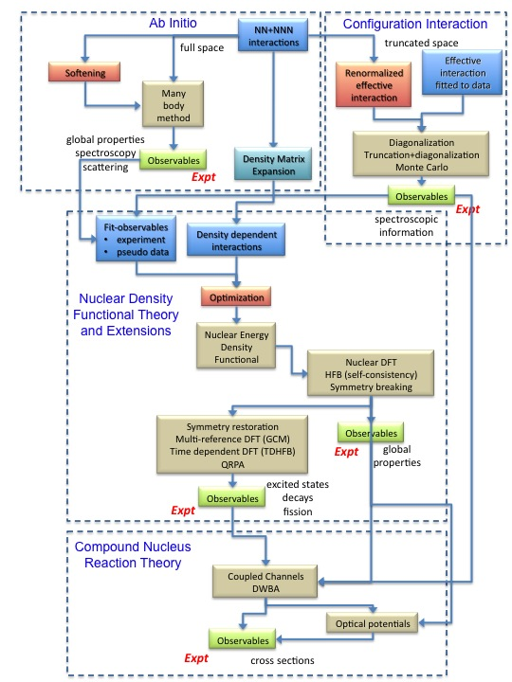

Slide 4
TDSLDA
(equations TDHFB/TDBdG like)
The system is placed on a 3D spatial lattice
Derivatives are computed with FFTW
Fully self-consistent treatment with Galilean invariance
No symmetry restrictions
Number of quasiparticle wave functions is of the order
of the number of spatial lattice points
Initial state is the ground state of the SLDA (formally like HFB/BdG)
The code and implementation on JaguarPf was described in talks
by I. Stetcu and K.J. Roche

Slide 5
I will present five short movies, illustrating the complex
time-dependent dynamics in 3D of a unitary Fermi superfluid
and of ²⁸⁰Cf excited with various external probes.
In each case we solved on JaguarPf the TDSLDA equations for a 32³ spatial lattice (approximately 30k to 40k quasiparticle wavefunctions) for about 10k to 100k time steps using from about 30K to approximately 40K PEs
Fully unrestricted calculations!
The size of the problem we solve here is several orders of magnitude
larger than any other similar problem studied by other groups (and we plan to further increase the size significantly).
The movies will be eventually posted at
http://www.phys.washington.edu/groups/qmbnt/index.html

Slide 6
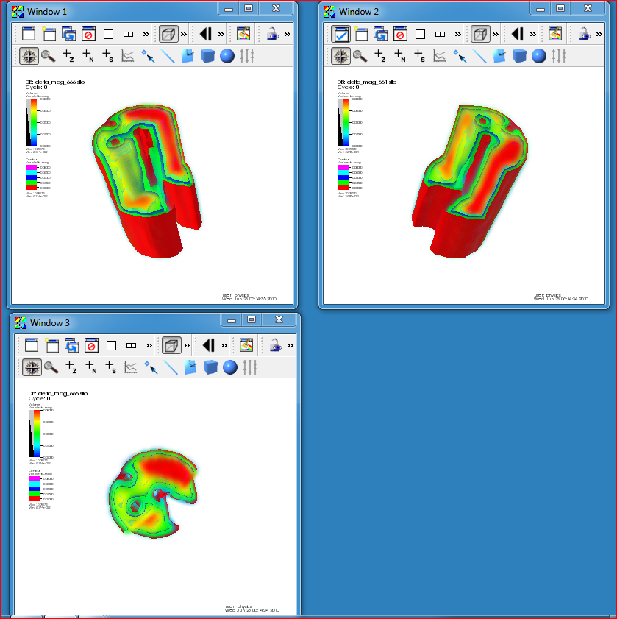
Stirring of a unitary superfluid and generation of complex
vortical motion by a rod and ball rotating in a cylindrical container

Slide 7
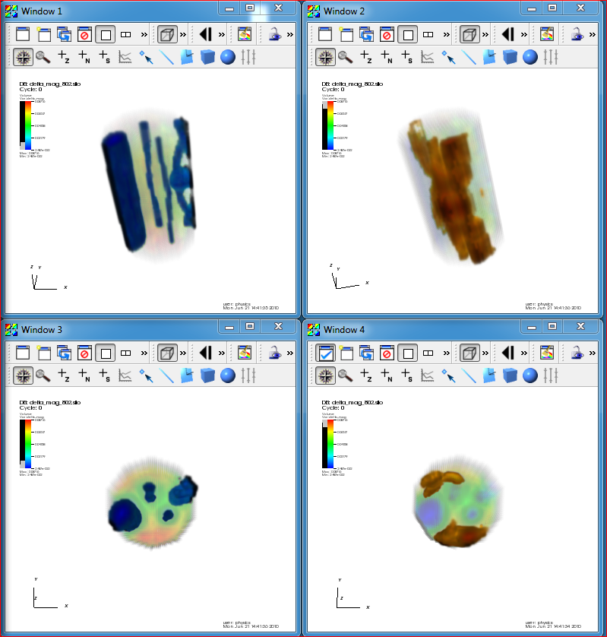
Stirring of a unitary superfluid and generation of complex
vortical motion by a rod and ball rotating in a cylindrical container

Slide 8
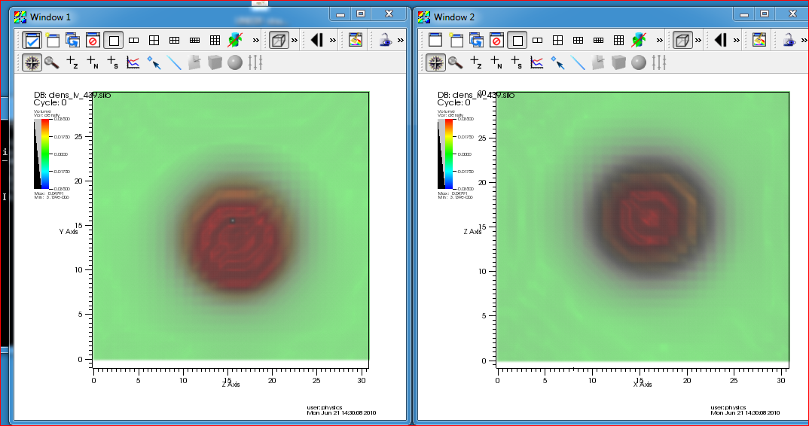
Excitation of an isovector dipole mode in ²⁸⁰Cf
by a passing relativistic heavy ion

Slide 9
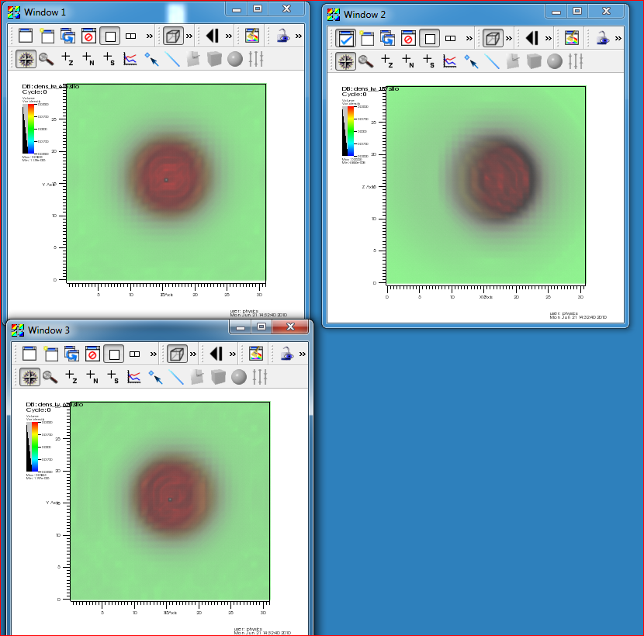
Excitation of an isovector dipole mode in ²⁸⁰Cf
by “two” passing relativistic heavy ions

Slide 10
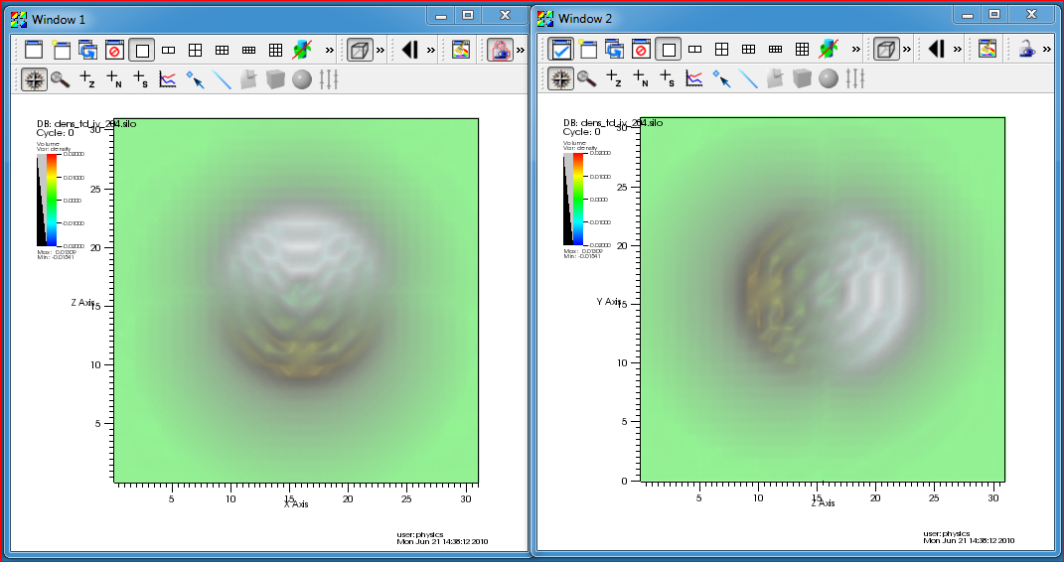
Excitation of an isovector dipole mode in ²⁸⁰Cf by a
quasi-adiabatic time-dependent external isovector dipole field, which is switched off suddenly

Slide 11
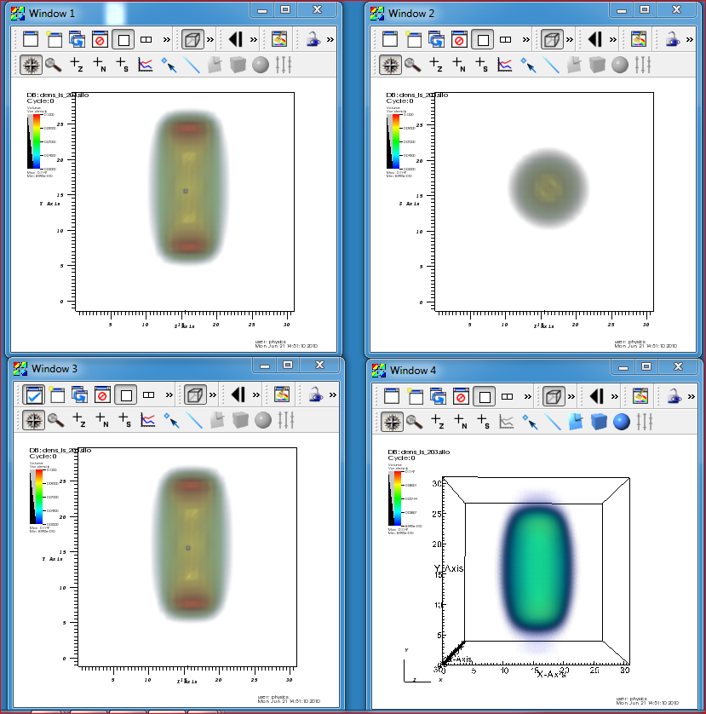
Excitation of an isoscalar quadrupole mode in ²⁸⁰Cf
by a quais-adiabatic time-dependent external isoscalar quadrupole field + a smaller isovector dipole field, which are switched off very rapidly and followed by its subsequent induced fission

Slide 12
Summary
Created a set of accurate and efficient tools for the petaflop regime
Successfully implementated on leadership class computers (Franklin, JaguarPF)
Currently capable of treating nuclear volumes as large as 50³ fm³ , for up to
10,000-20,000 fermions , and for times up to a fraction of an attosecond
fully self-consistently and with no symmetry restrictions and under the action
of complex spatio-temporal external probes
Capable of treating similarly large systems of cold atoms
The suites of codes can handle systems and phenomena ranging from:
ground states properties
excited states in the linear response regime,
large amplitude collective motion,
response to various electromagnetic and nuclear probes,
up to various types of nuclear reactions (including induced fission)
In the remaining time we plan to optimize and increase the
performance of all codes. Great challenges: analysis and presentation
There is a clear path towards exascale applications and implementation of the
Stochastic TD(A)SLDA
Hyak (UW MRI-NSF funded and UW - part of UW eScience) is online
a 140 nodes x 8 = 1320 PEs and 48 Gb per node.
This is a dedicated development machine for the NPLQCD multi-baryon effort
led by M.J. Savage and for the Stoch-TDSLDA

