Slide 1
Some Open Problems in Nuclear
Large Amplitude Collective Motion
(including fission)
Aurel Bulgac
University of Washington
Funding: DOE grants No. DE-FG02-97ER41014 (UW NT Group)
DE-FC02-07ER41457 (SciDAC-UNEDF)

Slide 2
This will consist mostly a discussion of some issues with LACM
and future possible approaches
I will show some results due to my collaboration with:
Sukjin YOON (UW)
Kenneth J. ROCHE (PNNL-Seattle)
Yongle YU (now at Wuhan Institute of Physics and Mathematics)
Yuan Lung LUO (UW)
Piotr MAGIERSKI (Warsaw and UW)
Ionel STETCU (UW)

Slide 3
Z
Y
X
Coulomb excitation of ⁴⁸Cr by an ultra-relativistic heavy ion

Slide 6
A few details of the calculation:
We solved the time-dependent 3D SLDA (HFB) equations for ⁴⁸Cr
Only Coulomb interaction between the projectile and target
(10 fm impact parameter)
We described ⁴⁸Cr with approximately 3,600 quasiparticle wave functions
(this is already about an order of magnitude above all current TDHF
calculations, and we still have about two or more orders of magnitude in store
to expand easily)
We used 3,600 processors on Franklin at NERSC for about 10 hours
(both weak and strong scaling properties of the code are essentially perfect
up to about 50,000 processors so far)
More movies of TD-SLDA simulations are available for viewing at
http://www.phys.washington.edu/groups/qmbnt/vortices_movies.html

Slide 7
Outline:
Where do we stand right now with the theory?
Open problems in (nuclear) LACM.
Current approaches and their limitations.
The computational tools we have developed so far for today’s leadership class computers and beyond.
Our long-range vision for the study of:
Nuclear dynamics - large and small amplitude collective motion (LACM), reactions and fission
Vortex creation and dynamics in neutron stars (pinning and de-pinning mechanism)
Cold atoms in static and dynamic traps and optical lattices and other condensed matter systems.

Slide 8
From the point of view of numerical simulations we could say that
the work of the founding fathers of statistical mechanics has been
to transform a simple problem (B) into a terrible mess (A). Of
course we have learned a lot in this process.
Statistical Field Theory, by Giorgio Parisi
Addison-Wesley, 1988

Slide 9
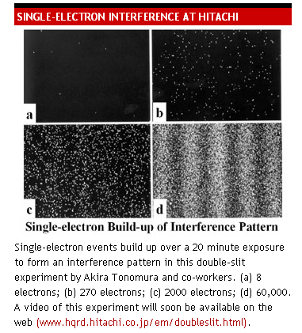

Slide 10
Present theoretical approaches and phenomenology for
LACM and fission studies:
Pure phenomenogical stochastic dynamics :
Langevin/Kramers equations
Stochastic/Langevin TDHF
Adiabatic Time-Dependent Hartree-Fock-Bogoliubov (ATDHFB) theory
The basic assumption is that LACM/nuclear fission can be described with a
many-body wave function with the GCM- structure:
Microscopic-macroscopic model
not based on ab intio input
no self-consistency
physical intuition drives the definition of relevant degrees of freedom

Slide 11
Talk of E. Vardaci at FISSION 2009

Slide 12
Extended, … Stochastic TDHF approaches
Wong and Tang, Phys. Rev. Lett. 40, 1070 (1978)
Ayik, Z. Phys. A 298, 83 (1980)
...
Ayik Phys. Lett. B658, 174 (2008)
Gaussian random numbers
defined a prescribed temperature
in a Fermi-Dirac distribution
Subsequently these equations are projected on a collective subspace and
a Langevin equation is introduced for the collective DoF

Slide 13
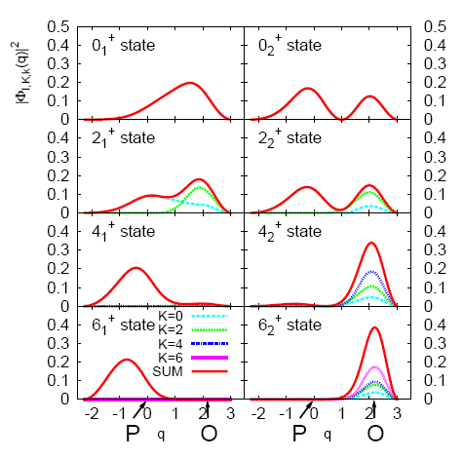
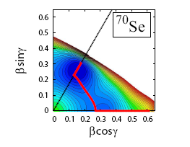
While ATDHFB approximation has a great number of positive
aspects, it comes with a long series of great deficiencies:
The determination of the number of relevant degrees of freedom is as a rule determined by the practioner using intuition/prejudice or prevailing attitudes.
There are knows methods on how to mechanize this process and eliminate arbitrariness,
but they are extremely difficult to implement in practice.
Hinohara, Nakatsukasa, Matsuo, and
Matsuyanagi, Phys. Rev. C 80, 014305 (2009)

Slide 14
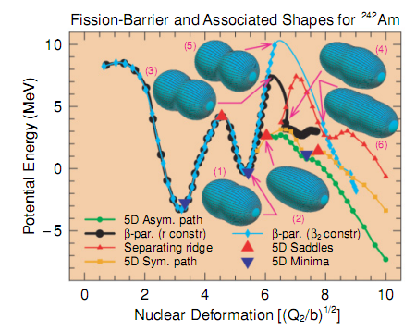
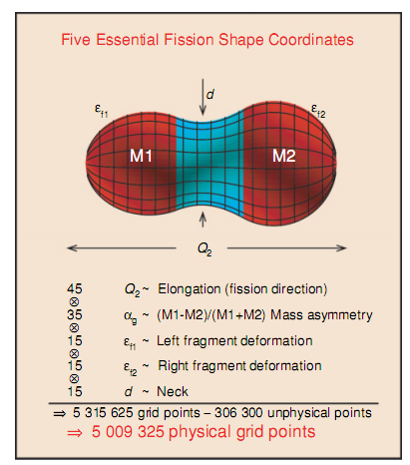
Computing the potential energy surface alone for only 3 collective degrees of freedom is equivalent to computing the entire nuclear mass table.
P. Moller and collaborators need more than 5,000,000 shapes in a five dimensional space.
Is this the right and the entire complete set of collective coordinates?
P.Moller et al. Phys. Rev. C 79, 064304 (2009)

Slide 15
In order to determine the collective part of the wave function one needs to solve
the Hill-Wheeler integral equation in the corresponding n-dimensional space.
This is routinely (but not always) performed by invoking a further approximation
(Gaussian Overlap Approximation) the accuracy of which is difficult to assess and
one generates a Schrödinger equation in collective coordinates.
ATDHFB theory is based on the assumption that an expansion in velocities is accurate up to second order terms. However there are clear examples where this is wrong.
The inertial tensor is usually hard to evaluate and often approximate methods are used.

Slide 16
It is obvious that a significantly larger number of degrees of freedom are
necessary to describe LACM and fission in particular.
One would like to have as well: charge asymmetry, shapes of the fragments, excitation energy of the fragments, …
In this case the ATHFB approach becomes clearly unmanageable, even for computers envision in the next decade, and the veracity of the approximation is questionable .

Slide 17
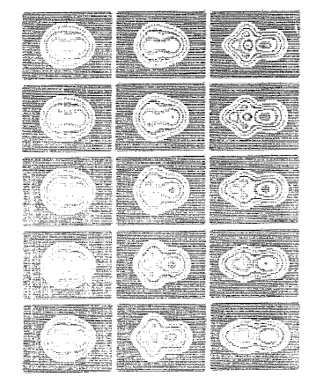
``Spontaneous fission“ of ³²S
Even though the initial and final states
have axial symmetry, along the fission path
this symmetry is broken in order to
rearrange occupation probabilities and
avoid a diabolical point/level crossing,
where a Dirac monopole resides.
J.W. Negele, Nucl. Phys. A 502, 371c (1989)
An unpublished calculation due to R. Wolff, G. Puddu and J.W. Negele
8 occupied orbitals evolved in 3D and imaginary time on a mesh 20³x1000
no isospin dof, no pairing, simplified nuclear EDF

Slide 18
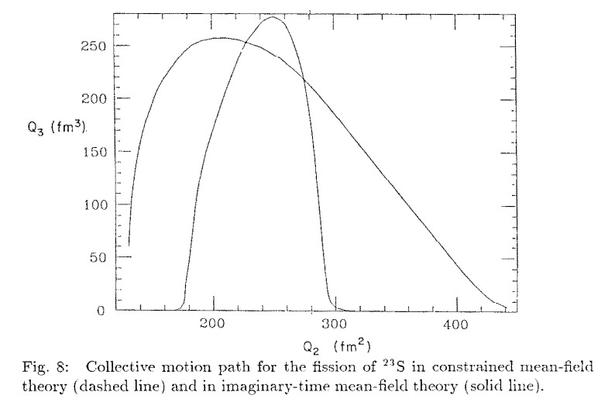
J.W. Negele, Nucl. Phys. A 502, 371c (1989)

Slide 19
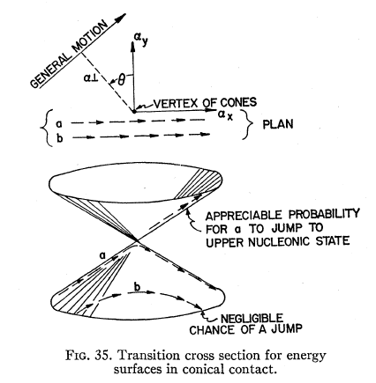
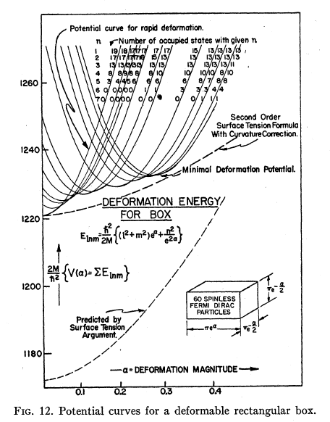
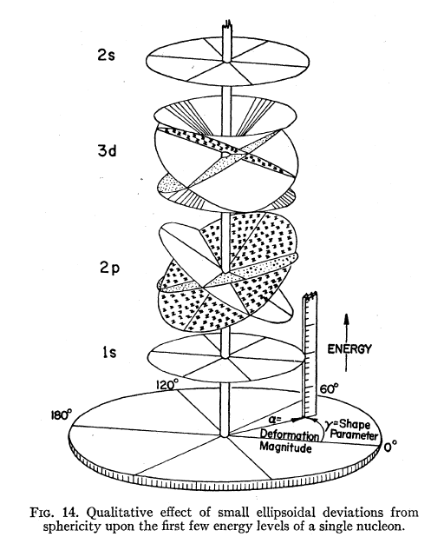
How do nuclei deform?
D.L. Hill and J.A. Wheeler, Phys. Rev. 89, 1102 (1953)
Nuclear Constitution and the Interpretation of Fission Phenomena

Slide 20
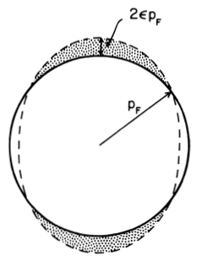
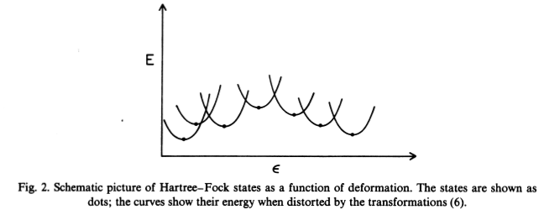
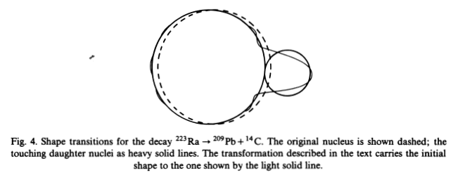
G.F. Bertsch, F. Barranco, and R.A. Broglia, How Nuclei Change Shape
in Windsurfing the Fermi Sea, eds. T.T.S. Kuo and J. Speth

Slide 21
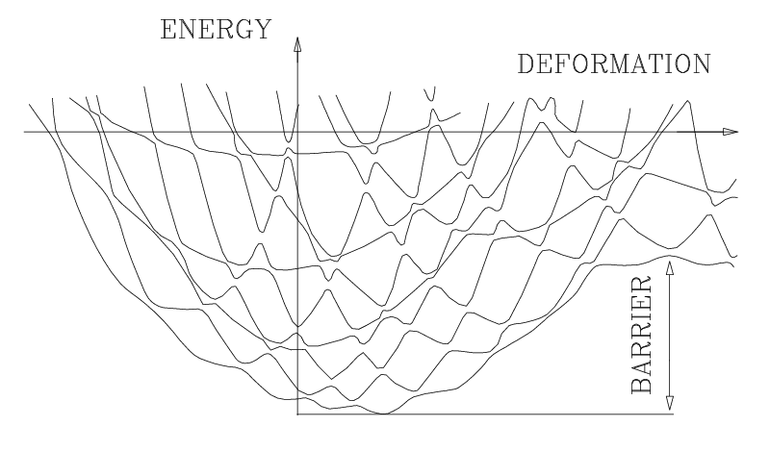
It is not obvious that the Slater determinant wave function should minimize the energy. Entropy production, level crossings, symmetry breaking.
Generic adiabatic large amplitude potential energy SURFACES
In LACM adiabaticity/isentropic or isothermal behavior is not a guaranteed
The most efficient mechanism for transitions at level crossing is due to pairing
Level crossings are a great source of : entropy production (dissipation), dynamical symmetry breaking , non-abelian gauge fields (Dirac monopoles reside at level crossings)

Slide 22
Evolution operator of an interacting many-body system
(after a Trotter expansion and a Hubbard-Stratonovich transformation)
This representation is not unique!
The one-body evolution operator is arbitrary!!!
Kerman, Levit, and Troudet, Ann. Phys. 148, 443 (1983)

Slide 23
What is the best one-body propagator?
Stationary phase approximation leads to some form of
Time-Dependent Meanfield

Slide 24
However, there is a bright spot if one is interested in one-body observables alone
Time-Dependent Density Functional Theory (TDDFT) asserts
that there exists an exact description, which formally looks like
Time-Dependent Selfconsistent Meanfield.
A.K. Rajagopal and J. Callaway, Phys. Rev. B 7, 1912 (1973)
V. Peuckert, J. Phys. C 11, 4945 (1978)
E. Runge and E.K.U. Gross, Phys. Rev. Lett. 52, 997 (1984)
http://www.tddft.org
There is a problem however!
Nobody knows how the true Time-Dependent (or not) Density Functional
really looks like and there are no known exact algorithms for its generation.
But we know that it exits for sure.

Slide 25
So what is this DFT stuff?

Slide 26
Kohn-Sham theorem
Injective map
(one-to-one)
Universal functional of particle density alone
Independent of external potential
Normal Fermi systems only!

Slide 27
However, not everyone is normal!

Slide 28
SLDA - Extension of Kohn-Sham approach to
superfluid Fermi systems
Mean-field and pairing field are both local fields!
(for sake of simplicity spin/isopsin degrees of freedom are not shown)
There is a little problem! The densities  and  diverges!
But all this can be fixed rather easily.

Slide 29
For time-dependent phenomena one has to add currents.

Slide 30
DFT has however a serious restriction. One can not extract any information
about two-body observables.
For example, if we were to study the fission of a nucleus, we will in principle
determine the average masses of the daughters, but we will have no information
about the width of the mass distribution.

Slide 31
There is a relatively simple solution in time-dependent
meanfield theory due to Balian and Veneroni (late 1980’s and early 1990’s)
This method allows in principle the evaluation of both averages and widths.

Slide 33
The main problem however is that we have to consider the generic situation
with multiple potential energy surfaces, and not only one self-consistent field.

Slide 34
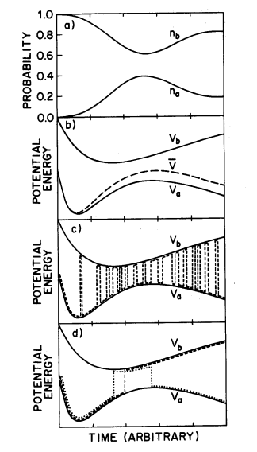
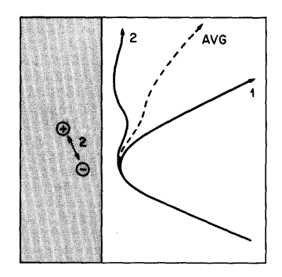
John C. Tully suggested the following recipe for condensed matter
and chemistry applications
J. Chem. Phys. 93, 1061 (1990)

Slide 35
The best solution however is to implement and treat the auxiliary fields
as stochastic Stochastic TD-SLDA
In 3D this is a problem for the petaflop to exaflop supercomputers

Slide 36
What do we gain following this route?
We are going to solve the interacting quantum many-body problem in a
manner similar to how this experimental result was obtained.

Slide 37
We are going to get away from the terrible mess
and solve instead a simpler problem.
From the point of view of numerical simulations we could say that
the work of the founding fathers of statistical mechanics has been
to transform a simple problem (B) into a terrible mess (A). Of
course we have learned a lot in this process.
Statistical Field Theory, by Giorgio Parisi
Addison-Wesley, 1988

Slide 38
For the sake of discussion let us see what we could in principle be able to
calculate?
We do not need to determine any collective coordinates, potential energy
surfaces, inertia tensor, non-abelian gauge fields, etc. as the system will find
naturally the right collective manifold
We will not need to assume either isentropic, isothermal, … meanfield solutions.
Instead the temperature and entropy of the collective subsystem will evolve according
to the rules of QM. This will be the most natural framework to describe dissipation
in collective nuclear motion.
We should be able to compute directly the mass, charge distributions and the
excitation energy distributions of each fragment
We should be able to follow in real time a real experimental situation,
such as induced fission or fusion
All this is naturally not limited to nuclear physics alone, this is a
general approach to solve a large class of many-body problems
numerically exactly, with quantifying errors, within the next decade
… or sooner.

