Slide 1
Publishing scholarly articles
Ben Marwick
ARC Future Fellow, UOW
Associate Professor, UW
bmarwick@uw.edu

Slide 2
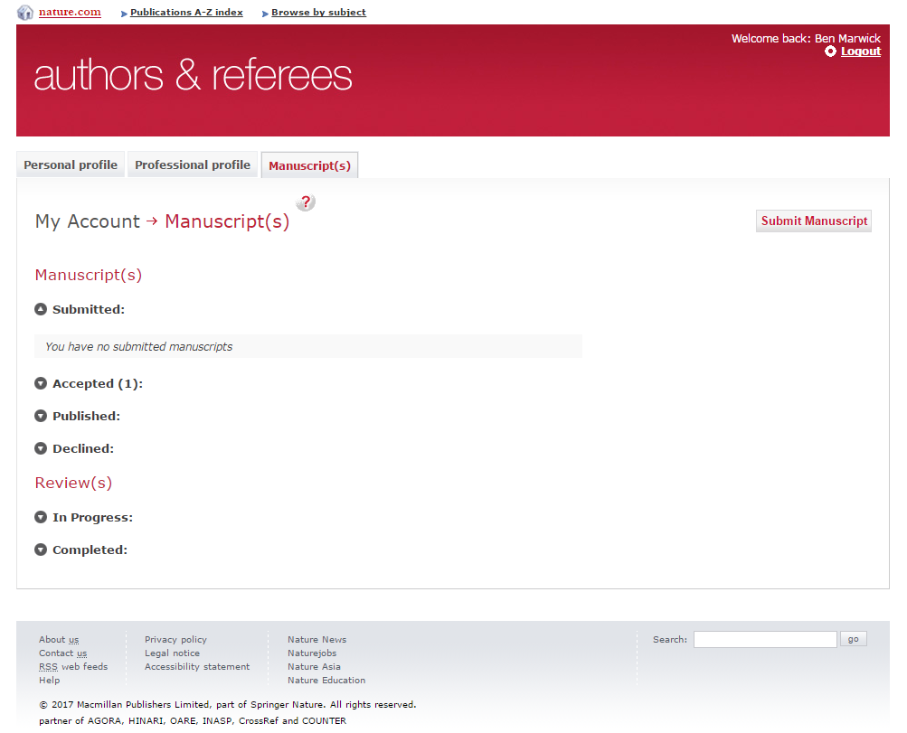

Slide 3
Choosing a journal
Structuring your article
Citations & references
Figures & tables
Managing peer reviews
Some rules

Slide 4
How to choose a journal for your article?
Only submit to one journal at a time, and wait for the response of the editor and the reviewers.
Look at the articles you have consulted to prepare your manuscript.
Read very recent publications in each journal, and find out the hot topics and the types of articles accepted.
Avoid predatory journals

Slide 5
How to choose a journal for your article?
Check on Google Scholar
Check the names of the editorial board
Check for Society affiliation
Check for frequency of publication
Check with your senior colleagues

Slide 6
Read & follow the instructions to authors

Slide 7
A good
generic article structure

Slide 8
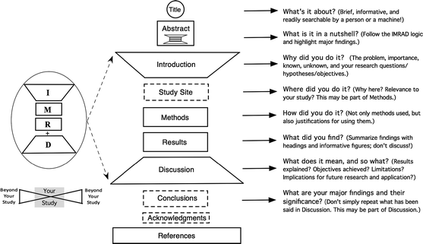

Slide 10
The Abstract

Slide 11
Five stages of an Introduction

Slide 13
Results
You have three basic choices: organization 1) by chronology or type, 2) from most to least important, or 3) in the same order as that of the Methods.
Stick to the facts. Present the factual trends and reserve all discussion of their meaning and significance for the Discussion
Discussion
Begin the Discussion with the answer to the question you posed in the Introduction.
Explain the meaning and significance of your results do not merely repeat them
Explain how they fit with those of other studies, extending, refuting, or confirming their findings

Slide 14
Conclusion
State the most important outcome of your work.
Do not simply summarize the points already made in the body
Show whether, or to what extent, you have succeeded in addressing the need stated in the Introduction.
Make the Conclusion interesting and memorable for the reader
Give an idea of what could or should still be done in relation to the issue addressed in the paper, the future directions

Slide 15
Citations and references
Use up-to-date citations
Use sci-hub.cc & libgen.io to get literature
Follow the journal style
Use reference manager software to save time and frustration (e.g. Zotero, Mendeley, both free!)

Slide 16
Reference manager

Slide 17
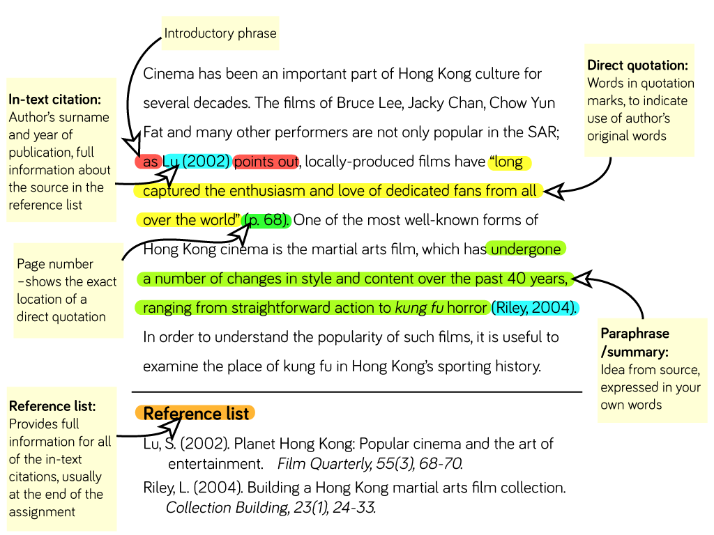

Slide 18
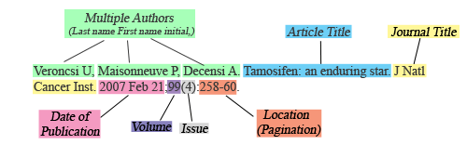

Slide 19
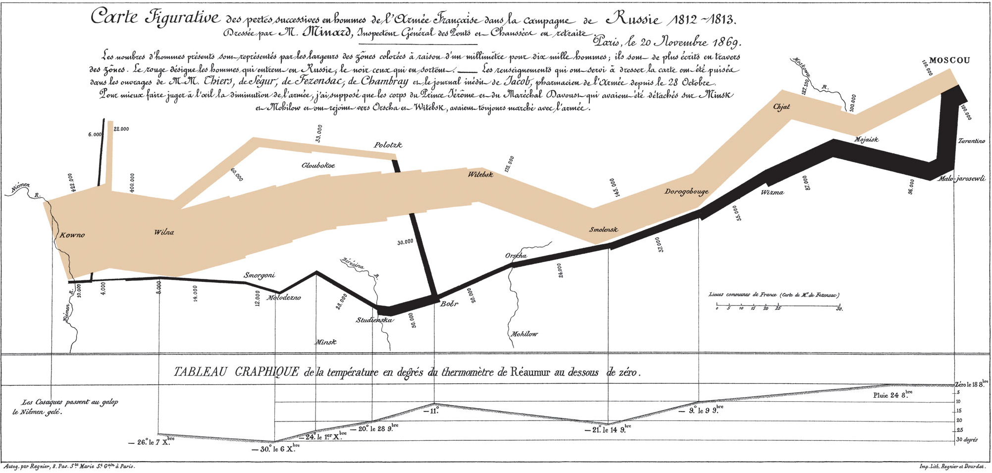
Figures and Tables
Notes:
Discussion appears on pages 226 and 227.

Slide 20
A few guiding principles for tables and figures…
Above all else, show the data don’t fake it, tell the truth
Maximize the data-to-ink ratio no chartjunk - decorative elements that provide no data and cause confusion
Erase redundant and non-data-ink use thin lines, discrete data containers, subtle graphics
Revise and edit

Slide 21
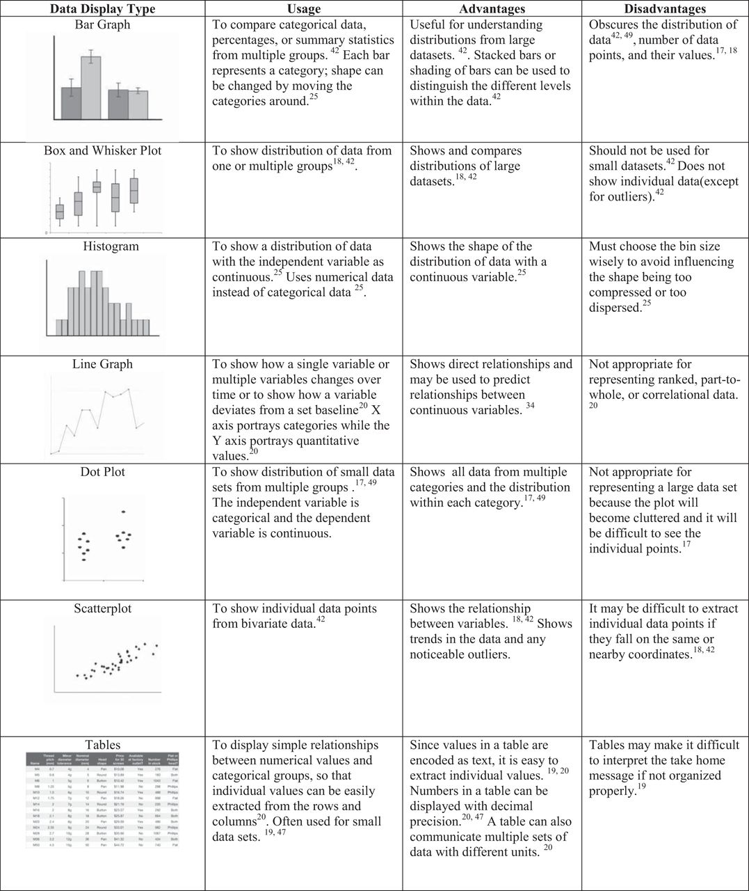
Choose a graph that suits your data
Notes:
http://advan.physiology.org/content/40/1/123

Slide 22
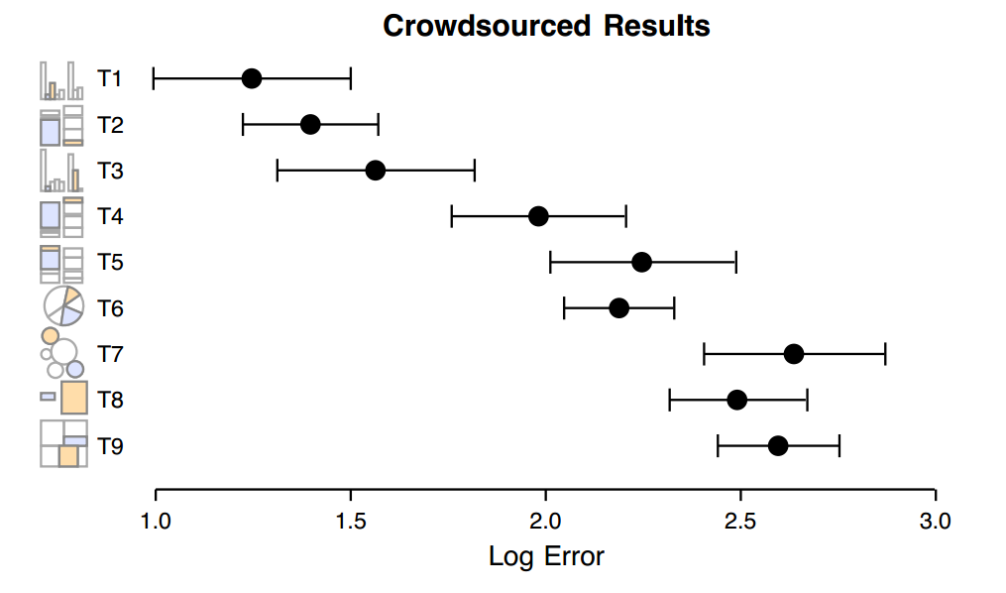
Crowdsourcing Graphical Perception: Using Mechanical
Turk to Assess Visualization Design Jeffrey Heer and Michael Bostock
http://hci.stanford.edu/jheer/files/2010-MTurk-CHI.pdf

Slide 23
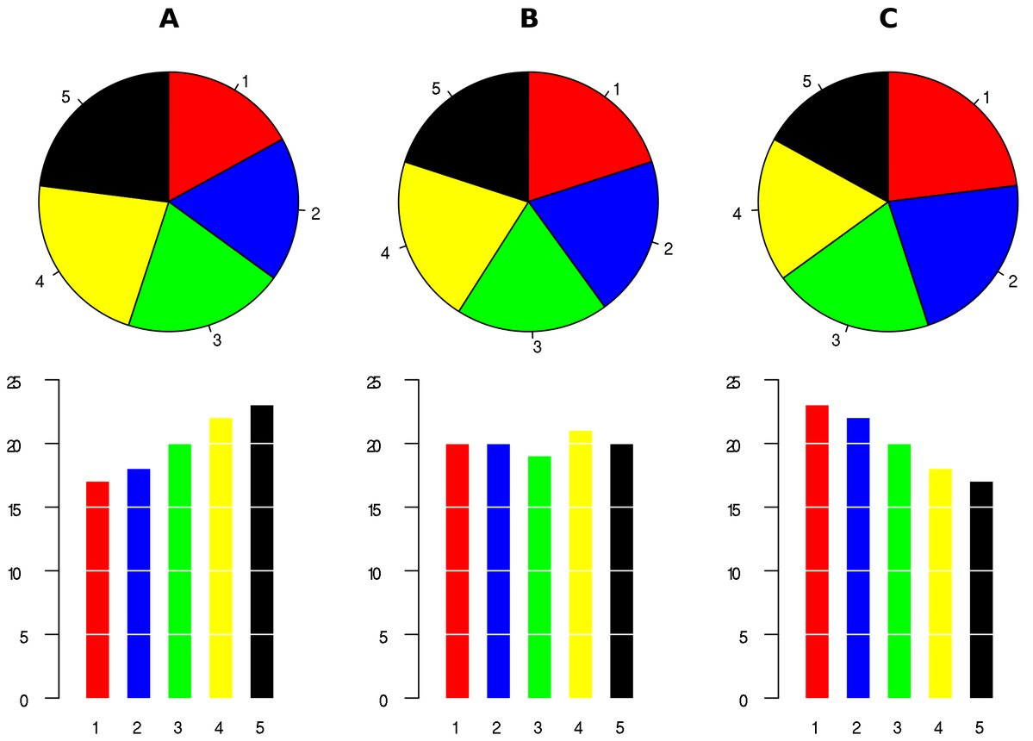
Do not use pie charts

Slide 25
Tufte’s Data-Ink ratio
Data-Ink: Ink that changes as the data changes

Slide 26
Erase redundant data-ink
Histogram of Midterm Results
18
# of Students
11
7
5
2
1
0
C
B-
B
B+
A-
A
Scoring Buckets

Slide 29
Show the data

Slide 31
Use R for data analysis
And making graphs
Free!
Very powerful
Lots of help and tutorials on the internet

Slide 32
Graph or Table?

Slide 33
When to tabulate? There are no hard rules
Is it important is it to be able to see exact individual values? Table
Is it important is it to understand the overall trend? Graph
Have a lot of data? Graph
Making comparisons? Graph

Slide 34
“Unless the object is to transmit precise numerical values … to the reader, tables appear to be inferior to charts as display devices”
Spence, I., and Lewandowsky, S. (1991), “Displaying Proportions and Percentages,” Applied Cognitive Psychology, 5, 61–77.

Slide 35
What all tables should have…
Detailed caption that is a commentary on the data, highlighting the main features
A sensible number of significant figures
A logical order – ranked by values, alphabetical, etc.

Slide 36
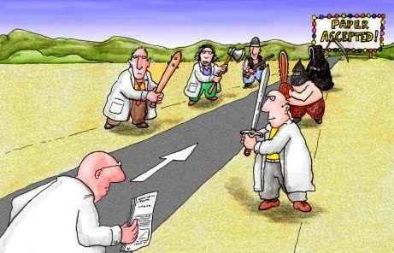

Slide 38
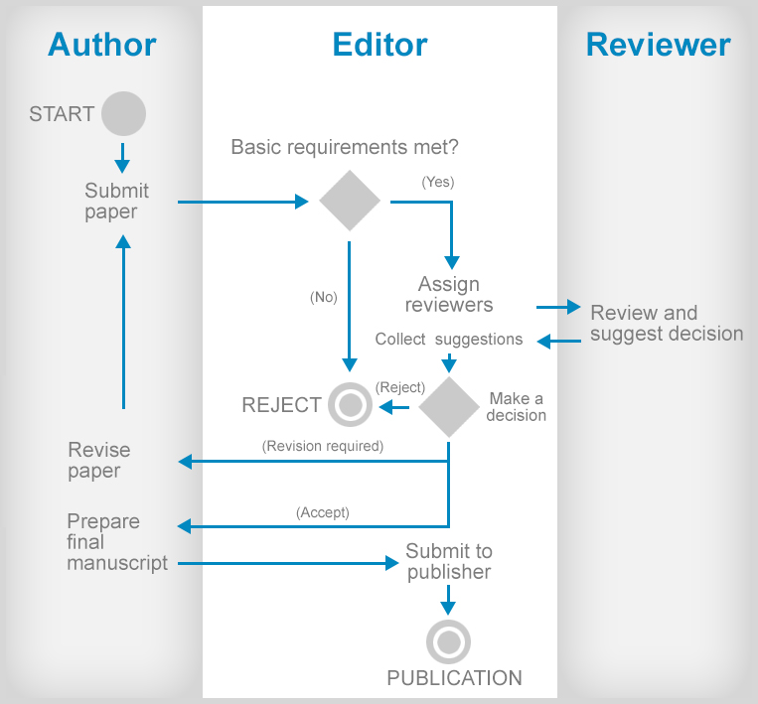

Slide 39
What & where Peer Reviewers look for

Slide 40
What & where Peer Reviewers look for

Slide 42
THE 3 GOLDEN RULES OF RESPONDING TO PEER REVIEWS
Rule 1: Answer completely
Rule 2: Answer politely
Rule 3: Answer with evidence

Slide 43
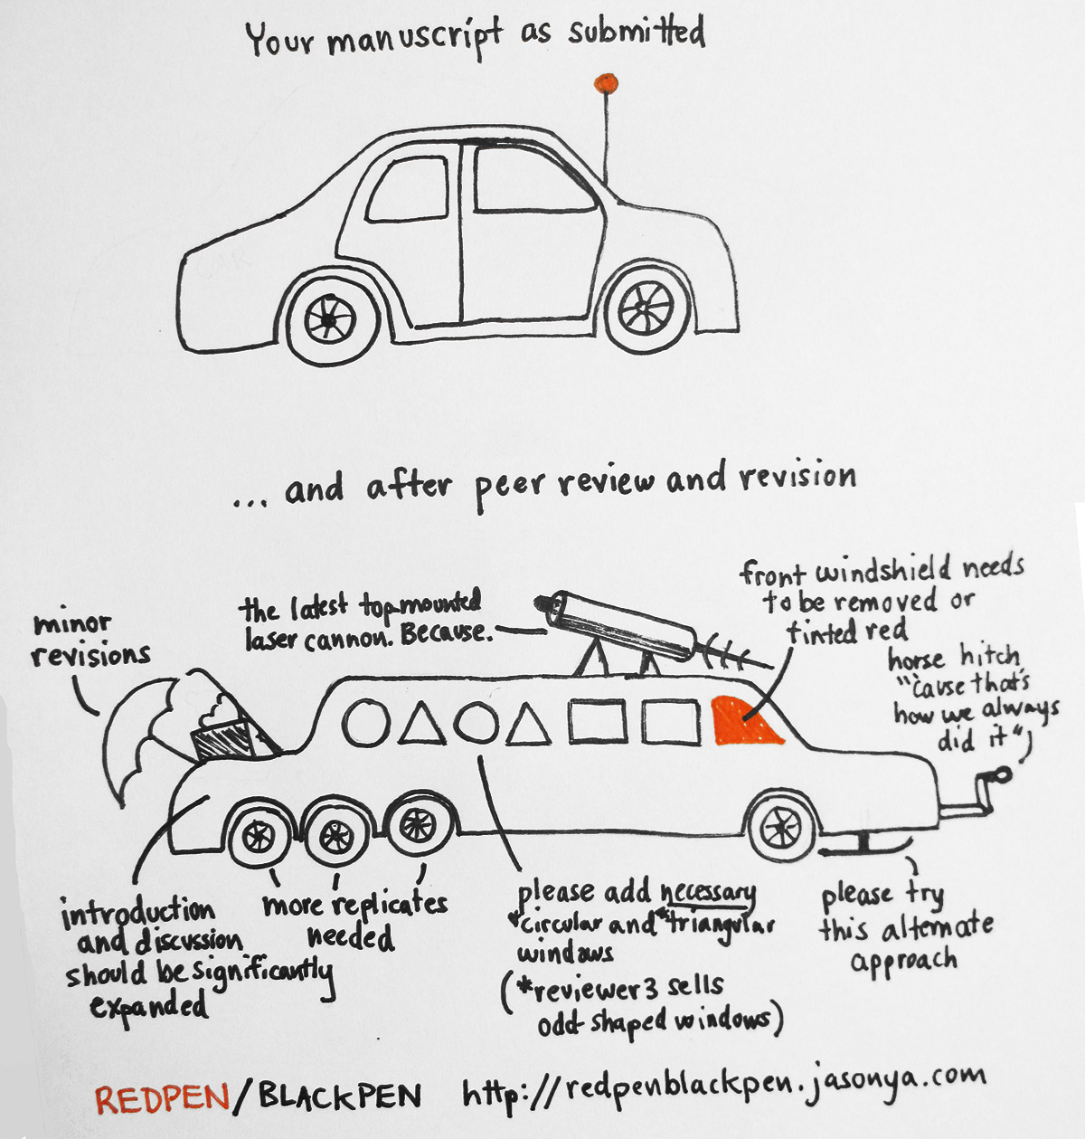

Slide 44
There are no rules, but…

Slide 46
Rule 1: Read many papers, and learn from both the good and the bad work of others.
Rule 2: The more objective you can be about your work, the better that work will ultimately become.
Rule 3: Good editors and reviewers will be objective about your work.
Rule 4: If you do not write well in the English language, take lessons early; it will be invaluable later.
Rule 5: Learn to live with rejection.
Rule 6: The ingredients of good science reporting are obvious—good
organization, the appropriate use of
tables and figures, the right length,
writing to the intended audience—
do not ignore the obvious.
Rule 7: Start writing the paper the
day you have the idea of what
questions to pursue.
Rule 8: Become a reviewer early in
your career.
Rule 9: Decide early on where to try
to publish your paper.
Rule 10: Quality is everything.

Slide 47
Principle 1: Properly Organize the Manuscript
Principle 2: Clearly State the Study Question and Study Rationale
Principle 3: Explain the Materials and Methods in a Systematic Manner
Principle 4: Structure the Materials and Methods and Results Sections in a Similar Manner
Principle 5: Make the Discussion Section Concise
Principle 6: Explain If—and Why—
Your Study Results Are Important
Principle 7: Avoid Overinterpretation
of the Results
Principle 8: Explain the Limitations of the Study
Principle 9: Account for Unexpected Results
Principle 10: Fully Incorporate Reviewers’ Suggestions into a Revised Manuscript

Slide 48
Why do papers get rejected?
They are overcrowded with ideas.
They don’t reassure the reader that the research is trustworthy
They don’t fit the journal.
There’s no sense that the paper is adding anything new.
The writing sounds inexperienced
The paper is poorly structured.
It’s just too local, too small, too insignificant.

Slide 49
What gets you accepted?
Attention to details
Check and double check your work
Consider the reviews
English must be as good as possible
Presentation is important
Take your time with revision
Acknowledge those who have helped you
New, original and previously unpublished
Critically evaluate your own manuscript
Ethical rules must be obeyed
ACCEPTANCE

Slide 50
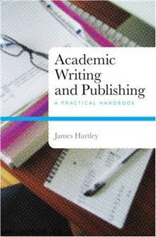
How to improve?
Journal club
Writing group
Ask for others to give feedback on your writing
Read published articles often
http://getalifephd.blogspot.com
http://www.phd2published.com
https://thesiswhisperer.com/
https://twitter.com/WriteThatPhD
http://www.phrasebank.manchester.ac.uk/

